Slide 1
CEEW-CEF Market Handbook Q2 2020-21
Image: iStock
18 November 2020
© Council on Energy, Environment and Water 2020

Slide 2
CEEW-CEF Market Handbook
India is undergoing an energy transition from fossil-based to clean energy. Evidence-based decision-making can accelerate the process.
CEEW Centre For Energy Finance’s Market Handbook aims to help key investors, executives and policymakers with evidence-based decision-making by:
Identifying and analysing trends critical to India’s energy transition
Presenting data-backed evidence based on the most relevant indicators
Connecting the dots and presenting a short-term market outlook
The handbook attempts to comment and answer on some critical questions such as:
What is India’s generation capacity and energy mix?
What are the key trends in renewable energy (RE) tariffs?
What is the current situation of the discom payment delay situation?
How have the power market reforms progressed?
What are key trends in the electric vehicles (EV) and energy storage markets?
cef.ceew.in

Slide 3
Contents
Generation Capacity And Energy Mix
4
Coal Phase-Out
6
RE Auctions
7
Discom Payables
8
Power Markets
9
Policy and Regulatory Developments
10
Renewable Energy Finance
11
Energy Storage
14
Electric Mobility
15
Image: iStock
Annexures
17
19
About Us
cef.ceew.in

Slide 4
Generation capacity: rooftop solar picks up further pace, but grid-scale RE capacity additions decline
4
Takeaways & Outlook
Quarterly RE capacity additions have slowed down, particularly in the last two quarters, partly due to supply chain disruptions from Covid-19 pandemic.
Despite the decline in grid-scale solar and wind capacity addition, rooftop solar saw increased adoption with 399 MW capacity being added in Q2 FY21 (vs 188 MW in Q2FY20). Gujarat, Rajasthan, and Tamil Nadu led the growth in rooftop solar installations.
Among RE categories, solar (grid-scale and rooftop) continues to dominate, accounting for nearly 60% of the capacity added in Q2 FY21.
The MNRE has allowed an extension of five months for grid-scale project commissioning on account of Covid-19. Noticeable RE capacity may be added in the future as the lockdown eases.
3.2 GW RE capacity was sanctioned/auctioned in Q2 FY21. This is slightly lower than the 4.4 GW capacity sanctioned/auctioned in Q1 FY21. This 4.4 GW excludes another 8 GW sanctioned in Q1 under a manufacturing linked upsizing of a solar auction from an earlier quarter.
Source: Central Electricity Authority. *Includes solar rooftop capacity (3.2 GW as of September 2020)
Source: Ministry of New and Renewable Energy.
cef.ceew.in

Slide 5
Energy mix: share of RE down marginally from 11.4% in Q2 FY20 to 10.7% in Q2 FY21; unseasonable and sharp reduction in wind speeds was the primary cause
5
Takeaways & Outlook
Total generation in Q2 FY21 was marginally up (0.8%) compared to Q1 FY20 due to the lifting of the Covid-19 lockdown.
July: Down by 1.4%
August: Down by 1.0%
September: Up by 5.0%
Total Q1 FY21: Up by 0.8%
RE generation fell 4.7%, while coal/lignite generation was up by 1.3% (vs Q2 FY20).
The decline in RE generation can be attributed to exceptionally low wind speeds in high-wind states (Rajasthan, Gujarat and Tamil Nadu) leading to a decline in wind energy generation by 41.1% in July 2020 (vs July 2019).
As a result, RE’s share in average daily generation saw a marginal decline in Q2 FY21 (vs Q2 FY20), while hydro and coal remained buoyant.
RE: Share down from 11.4% to 10.7%
Hydro: Share up from 17.5% to 17.6%
Coal/lignite: Share up from 64.7% to 65.1%
RE share snapshot
 | Q2 FY19 |  | Q2 FY20 |  | Q2 FY21
 | RE share % | Day | RE share % | Day | RE share % | Day
Highest | 15.8% | 26 July 2018 | 15.9% | 09 July 2019 | 16.8% | 12 August 2020
Lowest | 5.1% | 29 September 2018 | 5.2% | 24 September 2019 | 6.1% | 02 September 2020
Average | 11.3% | NA | 11.4% | NA | 10.7% | NA
Source: POSOCO. Note: RE technologies include solar, wind, biomass, waste to energy and small hydro and does not include rooftop solar and large hydro (>25 MW) generation.
cef.ceew.in

Slide 6
Coal phase-out: coal capacity addition remained subdued with net Q2 FY21 additions of 550 MW, which were approximately a third of RE additions (1,560 MW) during the same period
6
Takeaways & Outlook
Although coal capacity growth was net positive (additions less retirement), the pace of additions remained subdued.
With INR 1,06,908 crore of power sector loans turning non-performing assets (NPAs) as of September 2019 (as per RBI), incremental bank lending to the sector faces challenges. Many banks may also be approaching statutory limits on power sector exposure.
PFC/REC continues to back coal projects in India, although their share in its loan book has started to decline (from 63% in Q2 FY19 to 58% in Q1 FY21). To compensate, PFC/REC has increased its exposure to RE and hydro projects, which now account for 6% and 5% of its loan book, respectively.
In Q1 FY21, the share of coal in PFC/REC’s loan book remained steady at 58% despite a noticeable increase in lending to coal projects (the change in gross loan assets was INR 5,919 crore). This increase may signal additional capacity coming online and/or may comprise of working capital loans to coal power producers owing to moratorium extended to discoms (for paying non-RE energy bills) in Q1 FY21.
Source: Central Electricity Authority
Source: PFC investor presentations; figures are derived from the same. Note: Sector-wise break up of PFC loan asset data unavailable for Q2 FY21.
cef.ceew.in

Slide 7
RE auctions: 3.2 GW of RE was auctioned in Q2, with auctions for plain vanilla RE giving way to auctions for blended generation mixes
7
Key auction results
(last 6 months)
Bid spotlight: SECI thermal* round-the-clock (RTC-II), 5,000 MW
Takeaways & Outlook
New and innovative tenders include different combinations and varying shares (or bundling) of solar, wind, energy storage, thermal and hydro capacities.
Under the recently concluded SECI blended wind–solar bid, up to 20% of the total contracted capacity is allowed to be solar PV.
Bundling solar and wind projects is aimed at improving the transmission infrastructure utilisation, and such projects are expected to have higher CUFs as well (40–50% versus 25–35% for vanilla solar/wind projects). The bid conditions allow for solar and wind projects to be located at different locations but with a single energy injection point.
Improved transmission utilisation and low tariffs for such projects make them attractive to discoms struggling with RE integration and financial challenges (owing to the economic slowdown).
Capacity allotted (MW)
Least tariff discovered (INR/kWh)
Tariff and winner
Bid expected to conclude in Q3 FY21
Key provisions
Round-the-clock energy supply with a combination of solar, wind, storage and other technologies (thermal, hydro, etc.). Provision to bundle power from new intermittent RE (solar/wind) projects with spare capacity of existing firm power projects (thermal, hydro, etc.) at different locations
Comments
Bid allows oversizing of solar/wind capacities and requires firm power, especially during peak hours
Minimum capacity utilization factor (CUF) requirement of 85% during peak hours and on an annual basis
Excess energy generation may be sold in open markets with transmission connectivity
The bid particularly does not allow tying up of existing thermal projects in a different RLDC zone from that of RE projects. This may limit participation with most stressed/surplus thermal capacity located in Eastern Zone and RE resource rich areas in Southern Zone
Minimum 51% of annual energy supply from solar, wind and storage
Gujrat (GUVNL) solar, Tranche-X, 100 MW (September 2020)
100
2.73
Rajasthan (SECI) solar, 10 MW (September 2020)
10
2.58
Pan-India (SECI) blended wind-solar, Tranche-IX, 2,500 MW (August 2020)
970
2.99
Q2 FY21
Gujarat (GUVNL) solar, Tranche-IX, 700 MW (August 2020)
700
2.78
Pan-India (NTPC) solar, 1,200 MW (August 2020)
1,170
2.43
Maharashtra (Tata Power) solar-wind, 225 MW (July 2020)
225
2.59
Pan-India (SECI) solar, Tranche-IX, 2,000 MW (June 2020)
2,000
2.36
Q1 FY21
Pan-India (SECI) solar-wind-storage, RTC-I, 400 MW (May 2020)
400
2.90
Pan-India (NHPC) solar, 2,000 MW (April 2020)
2,000
2.56
Source: SECI and state renewable agencies. * Recent changes in bidding guidelines allow any firm power source (thermal, hydro, etc. to be combined with RE SECI = Solar Energy Corporation of India; RTC = Round the clock
cef.ceew.in

Slide 8
Discom payables: overdues continue to mount but at a slower pace
8
Takeaways & Outlook
As of September 2020, the amount overdue by discoms was INR 1,41,830 crore, representing an increase of 50% compared to September 2019.
However, there has only been a 5% increase in overdues in Q2 FY21 as compared to a 30% spike in Q1 FY21. The three-month moratorium allowed for conventional power producers explains the drastic increase in the overdues in Q1 FY21.
The states with the most payment delays are Rajasthan, Uttar Pradesh, Uttarakhand, Andhra Pradesh, Telangana, Karnataka, Bihar, and Tamil Nadu.
PFC/REC sanctioned INR 37,607 crore of the INR 90,000 crore (as of August 2020) liquidity package issued for discoms. The package includes loans for discoms to clear delayed power purchase payments; the loans are for a tenure of 10 years with a moratorium of up to 3 years.
The states that utilised the loans so far are Uttar Pradesh, Telangana, Andhra Pradesh, Rajasthan, Punjab, West Bengal, and Manipur.
Q2 FY21
Q1 FY21
Source: PRAAPTI portal (Based on voluntary disclosure from power producers).
Source: UDAY portal (Based on data disclosed by discoms as of 31st Mar 2020. *Data not available for these states; values derived from 2018-19 financial reports). Note: Due to the unavailability of the UDAY portal, data from the CEEW-CEF Market Handbook Q1 FY21 has been used.
INR 90,000 crore liquidity package to discoms for clearing their dues to power producers has been increased to increased to INR 1,18,273 crore by Ministry of Power.
cef.ceew.in

Slide 9
Power markets: September peak power demand recovers to surpass 2019 levels, GTAM market introduced, but REC trading suspended due to arbitration issues
9
Takeaways & Outlook
Peak power and energy demand recovered in September 2020 to surpass 2019 levels as the Covid-19 lockdown started to lift.
Green term ahead market (GTAM) was launched by the IEX on 21 August 2020. GTAM is expected to expand avenues for discoms and corporates to procure green energy, in addition to existing ones such as long term power purchase agreements (PPAs) and renewable energy certificates (RECs).
REC trading was suspended in July 2020 by APTEL due to arbitration concerning CERC’s order removing the floor price and reducing the forbearance (maximum) price. It is expected to resume in November 2020.
Short-term electricity prices (in both day-ahead and real-time spot markets) saw an increase to 2.53 INR/kWh and 2.42 INR/kWh in Q2 FY21 (from 2.35 INR/kWh and 2.22 INR/kWh in Q1 FY21), respectively. This is owing to a recovery in demand from discoms and increased volumes when compared to Q2 FY20 levels.
2020
Source: CEA.
Source: Indian Energy Exchange (IEX).
Peak demand saw a post-lockdown recovery in September 2020 and surpassed September 2019 levels. A similar recovery was seen in energy demand with combined energy demand during July, August, and September FY21 reaching FY20 levels.
REC trading remained suspended in Q2 FY21 by the Appellate Tribunal for Electricity (APTEL) due to arbitration on the removal of the floor price by the Central Electricity Regulatory Commission (CERC) in Q1 FY21.
Real time spot market snapshot (IEX)
 | Volume (million kWh) | Price (INR/kWh)
July | 785.0 | 2.49
August | 860.6 | 2.27
September | 704.0 | 2.52
Total/average | 2,349.6 | 2.42
Source: IEX.
Source: IEX.
Average day-ahead spot market prices declined by 20% in Q2 FY21 (compared to Q2 FY20), with an overall volume increase of 6%. September 2020 saw a decline in prices with a 37% increase in volumes when compared to September 2019.
The real-time market with trading in 15-minute time blocks commenced from 1 June 2020. The average price discovered increased from 2.22 INR/kWh in June 2020 to 2.42 INR/kWh in Q2 FY21.
cef.ceew.in

Slide 10
Policy and regulatory developments: Electricity (Rights of Consumers) Rules 2020 proposed, ISTS waiver extended till June 2023
10
Takeaways & Outlook
The proposed Electricity (Rights of Consumers) Rules, 2020, broadly aim to improve discom performance monitoring, electricity supply reliability and consumer services such as metering, billing, payments, and grievance redressal.
The government plans to privatise state electricity distribution companies, starting with the union territories, to improve their financial and operational performance, thereby reducing financial stress in India’s power sector.
Over the last couple of years, most RE projects getting sanctioned/commissioned have been required to evacuate energy through ISTS network and multiple waivers on its charges have helped RE developers bid for low RE tariffs.
The recent extension of ISTS waiver till June 2023 is expected to provide relief to RE developers from the disrupted supply chains, project delays and cost overruns owing to Covid-19 nationwide lockdown.
Draft Electricity (Rights of Consumers) Rules 2020
Extension of ISTS waiver for RE projects
ISA appointed ‘One Sun One World One Grid’ implementation agency
Discoms to follow key provisions of the proposed rules for supplying electricity to consumers.
No new electricity connections to be added without meters (prepayment or smart prepayment).
Discoms to mandatorily bill all consumers and ensure the bills reach them at least 10 days prior to the date of payment, Rebate for a customer if the bill delivery is delayed.
Mandatory online payment of bills exceeding INR 1,000.
Discoms to monitor and report reliability indices for the duration and frequency of outages.
Limit on net metering set as 5 kW for solar rooftop systems. Gross metering to be provided above 5 kW.
Consumers to be compensated for outages as well as delays in processing applications for grid interactive rooftop solar.
Discom to set up a mechanism for monitoring consumer grievance redressal and a dedicated call centre.
Ministry of Power further extended the waiver of interstate transmission system (ISTS) charges and losses on all solar and wind projects commissioned before 30 June 2023.
Earlier in 2019, the waiver was extended from 31 March 2022 to 31 December 2022.
International Solar Alliance (ISA) was appointed as the implementing agency for bid process management of ‘One Sun One World One Grid’ initiative by MNRE.
An RfP was issues in Q1 FY21 for developing long term vision, implementation plan, road map and institutional framework for the same.
Privatisation of discoms proposed
Dispute resolution committee for RE developers
The government plans to privatise electricity discoms in India starting with the union territories in order to improve their financial and operational performance.
Ministry of Power also issued standard bidding guidelines for privatization.
A dispute resolution committee has been set up by MNRE to settle the disputes between solar/wind power developers and SECI/NTPC.
Source: Publicly available information.
cef.ceew.in

Slide 11
Renewable energy finance: market concentration increased versus the previous quarter, and bidders in Q2 FY21 auctions included new entrants as well as those with limited RE footprints
11
Key deals (Q2 FY21)
84%
Takeaways & Outlook
Nearly 3.2 GW of RE capacity was sanctioned/auctioned in Q2 FY21 (vs 12.4 GW in Q1 FY21). Bids in auctions continued to be concentrated in the hands of a few developers.
Auctions witnessed participation from new market entrants such as O2 Power (started operations in January 2020) and SJVN, a Government of India utility engaged in hydro projects.
Deal activity primarily consisted of acquisition of solar assets by investors looking to invest in quality PPAs (SECI/NTPC). In addition, Fourth Partner Energy raised debt/mezzanine finance from European impact investment funds to expand its rooftop and corporate PPA (open access) solar portfolio in India.
Market concentration which rose from 81% in the previous quarter to 84%, is expected to remain high going forward with dominant players having an edge in raising and pricing capital at the scale.
Acquisition
Target: Rattan India (306 MW solar assets)
Acquirer: Global Infrastructure Partners
Amount: INR 1,670.0 cr (USD 222.6 million)
Q2 FY21
September 2020
Market concentration in sanctioned RE capacity
Mezzanine finance
Company: Fourth Partner Energy Investors: Symbiotics, Triodos, and ASN Amount: INR 126.0 cr (USD 16.0 million)
Note: Market concentration has been calculated as the ratio of top five RE capacities sanctioned, to the total RE capacity sanctioned
.
September 2020
Equity investment
Company: Avaada Energy
Investor: Asian Development Bank
Amount: INR 110.0 cr (USD 15.0 million)
Developer-wise RE capacity sanctioned during Q2 FY21 (3,175 MW)
September 2020
Acquisition
Target: ACME Solar (400 MW solar assets) Acquirer: Actis Amount: Not available
August 2020
Acquisition
Target: First Solar (40 MW solar assets)
Acquirer: Ayana Renewables
Amount: Not available
August 2020
Debt investment
Company: Fourth Partner Energy Investor: ResponsAbility Amount: INR 110.0 cr (USD 15.0 million)
July 2020
Source: Publicly available information.
Source: CEEW Centre for Energy Finance.
cef.ceew.in

Slide 12
Renewable energy finance: pure-play RE developers continue their impressive run, but subdued performance by manufacturers and EPC players
12
Takeaways & Outlook
The share prices of pure-play RE developers such as Adani Green and Azure Power significantly outperformed the market, as the stocks continued to attract investor interest as the Covid-19 lockdown gradually lifted.
The stock price of Inox Wind, a developer-manufacturer remained flat versus the previous quarter, whereas that of Suzlon, another developer–manufacturer, fell significantly as a widening net loss in Q1 FY21 (reported in Q2 FY21) dashed investor hopes of a debt restructuring led recovery.
Other listed RE companies such as Sterling Wilson Solar (EPC) and Borosil Renewables (glass manufacturing) continue to underperform the market due to specific issues.
Q1 FY21
Q2 FY21
Source: Money Control.
cef.ceew.in

Slide 13
Renewable energy finance: bond yields continue on their downward trajectory, reaching pre-Covid-19 levels
13
Takeaways & Outlook
The purpose of green bond capital raises has traditionally been to refinance existing project debt, with Adani Green and ReNew Power being among the most active issuers.
The twin challenges of low liquidity in the Indian bond market coupled with credit rating constraints (most RE project loans are typically rated below AA, the minimum requirement for local market acceptance), is what has driven Indian RE developers to tap international debt capital markets.
However, the economic shock caused by Covid-19 had hit RE developer bonds particularly hard, with yields rising sharply in Q1 FY21. This proved to be a temporary aberration.
Higher than pre-Covid-19 level yields in Q2 FY21 continued to act as a deterrent to new issuances. Indian RE developers began returning to the overseas green bond markets as yields subsequently reverted close to their pre-Covid-19 levels, but only after the quarter (Q2 FY21) had ended.
Q1 FY21
Q2 FY21
Source: Reserve Bank of India, State Bank of India, Trading Economics, Money Control and BondEvalue.
cef.ceew.in

Slide 14
Energy storage: international markets lead the way in RE and storage tender design innovations
14
Portugal’s innovative solar and storage tender design (700 MW)
Takeaways & Outlook
Innovative tender design is a key trend in India and other countries.
Portugal recently concluded a solar PV and storage auction with multiple options (with and without storage).
The plain solar PV (without storage) option led to the discovery of a new lowest-ever solar tariff of 0.97 INR/kWh (11.14 EUR/MWh or 13.16 USD/MWh).
On the other hand, solar PV combined with storage capacity was awarded based on a EUR/MW/year payment from developer to access the grid, against two revenue streams – (a) sale of energy in the wholesale market, and (b) flexibility payments for load shifting and ancillary services enabled by storage.
India also expects to see RE combined with storage auctions of higher capacities in the future as the tendering agencies and discoms aim to tackle grid level RE integration challenges.
India’s energy storage projects
Bidding options
Project location & tender issue date | Application & technology | Details
Chhattisgarh (SECI), September 2020 | 200 MW solar with 150 MWh BESS | Expected bid conclusion in Q3 FY21
Pan India (SECI), March 2020 | 5,000 MW solar, wind, storage, others (thermal, hydro, etc.) hybrid in RTC manner | Expected bid conclusion in Q3 FY21
Leh & Kargil (SECI), January 2020 | 14 MW solar with 42 MWh BESS | Expected bid conclusion in Q3 FY21
Andaman & Nicobar Islands (SECI), January 2020 | 4 MW floating solar with 2 MWh BESS | Expected bid conclusion in Q3 FY21
Delhi and Dadra & Nagar Haveli (SECI), October 2019 | 400 MW with solar, wind and storage hybrid | Bid concluded in May 2020 with tariff of 3.60 INR/kWh
Lakshadweep (SECI), September 2019 | 1.95 MW solar with 2.15 MWh BESS | Bid concluded with an undisclosed price
Haryana (UHBVN/DHBVN), September 2019 | 100 MW solar, solar-wind or small hydro with storage | Expected bid conclusion in Q3 FY21
Fixed tariff, solar PV only
RE developer to bid for solar PV project only
Fixed yearly tariff (EUR/MWh) for a period of 15 years
Merchant, solar PV only
RE developer to bid for solar PV project only
Sale of energy in the wholesale daily market with a yearly payment (EUR/MW/year) for access to the grid
Merchant, solar PV + storage
RE developer to bid for solar PV with storage
Sale of energy in the wholesale daily market with a yearly payment (EUR/MW/year) for access to the grid
Additional revenue streams with storage for load shifting and ancillary services
Bidding parameter
Portuguese authorities calculated the net present value (NPV) of each bid (EUR/MW) and awarded bids with the highest income to the Portuguese system
For the fixed tariff option, the NPV was calculated based on the difference between the forecasted electricity market prices (15 years) and fixed tariff, multiplied by theoretical generation
For the merchant options, it was calculated based on the direct EUR/MW payment for grid access. In case of storage, bidders included discount on flexibility payment for storage
Source: Government of Portugal.
Source: SECI and state renewable agencies.
cef.ceew.in

Slide 15
Electric mobility: EV and hybrid vehicle sales pick up as the lockdown is lifted
15
Takeaways & Outlook
With the easing up of the lockdown, overall electric vehicle (EV) and hybrid sales went up dramatically by 194.4% in Q2 FY21 (vs Q1 FY21), owing to a pent-up demand during the Covid-19 lockdown.
However, EV and hybrid vehicle sales for Q2 FY21 at 49,453 still remained well below the Q2 FY20 level of 62,053.
Indian states such as Delhi and Telangana notified state EV policies to subsidise EVs and set up charging stations to tackle the challenges of high cost and range anxiety.
OEMs with highest EV sales in Q2 FY21 were:
2W: Hero Electric (1,917), Okinawa (1,374) and Ampere (725)
3W: Y.C. Electric (1,831), Saera Electric (1039) and Mahindra Electric* (1,406)
4W: Tata Motors* (1,486), Mahindra Reva (706) and MG Motors* (489)
With fleet operators such as Amazon, Flipkart, Uber, etc. committing to electric fleets, the four-wheeler commercial segment is expected to gain traction.
Q1 FY21
Q2 FY21
Source: Vahan Sewa dashboard (Includes only registered vehicles. Unregistered vehicles include low-speed (< 25 km/hr), e-rickshaws (three-wheelers) and electric two-wheelers), Electric Mobility Dashboard, CEEW Centre for Energy Finance. * Based on sales data for FY21 up to October 2020.
cef.ceew.in

Slide 16
Thank you
You can find us at cef.ceew.in | @CEEW_CEF
Authors
Nikhil Sharma (nikhil.sharma@ceew.in)
Karan Kochhar (karan.kochhar@sciencespo.fr)
Arjun Dutt (arjun.dutt@ceew.in)
Saloni Jain (saloni.jain@ceew.in)
Gagan Sidhu (gagan.sidhu@ceew.in)
cef.ceew.in

Slide 17
Annexure I: Green bond issuances (last 2 years)
17
Date | Company | Size (USD million) | Sector | Coupon rate (%) | Rating | Tenor (Years) | Purpose
January 2020 | ReNew Power | 450 | Solar and wind | 5.875% | BB-/Stable (Fitch) | 5 | Refinancing of maturing debt
October 2019 | Adani Green Energy | 362.5 | Solar and wind | 4.625% | BBB- (Fitch) | 20 | Repaying foreign currency loans and rupee borrowings
September 2019 | Azure power | 350 | Solar | 5.65% | Not available | 5 | Refinancing of existing debt
September 2019 | ReNew Power | 300 | Solar and wind | 6.45% | Ba2 (Moody's) | 5 | Capacity expansion and repaying high cost debt
October 2019 | Greenko | 950 | Solar and wind | 5.50% | Ba1 (Moody’s) | 5 | Refinancing of solar and wind projects
June 2019 | Adani Green Energy | 500 | Solar | 6.25% | BB+ (Fitch) | 5 | Refinancing of solar projects
March 2019 | ReNew Power | 375 | Solar and wind | 6.67% | BB (Fitch) | 5 | Capex and refinancing of outstanding ECB
January 2019 | Tata Cleantech | 25.6 | Solar and wind | Not available | Not available | Not available | Capacity expansion
September 2018 | State Bank of India | 650 | Solar and wind | US Treasury + 1.65% (US investors) 3 Libor + 1.51% (British investors) | BBB- (Fitch) | 5 | Investment in RE projects
Source: Climate Bonds Initiative and company press releases.
cef.ceew.in

Slide 18
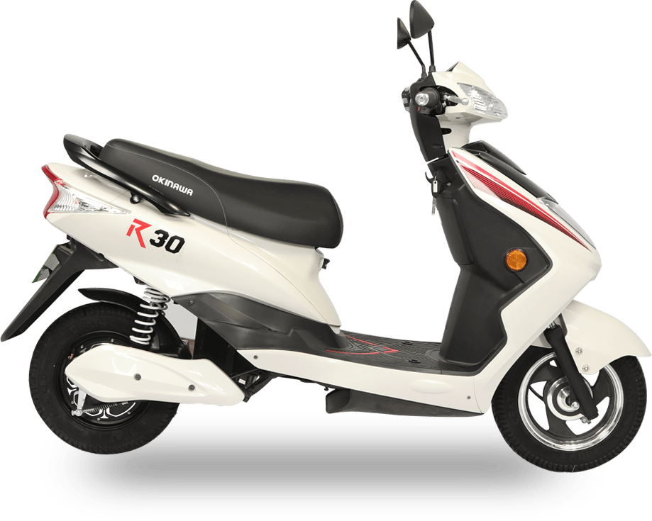
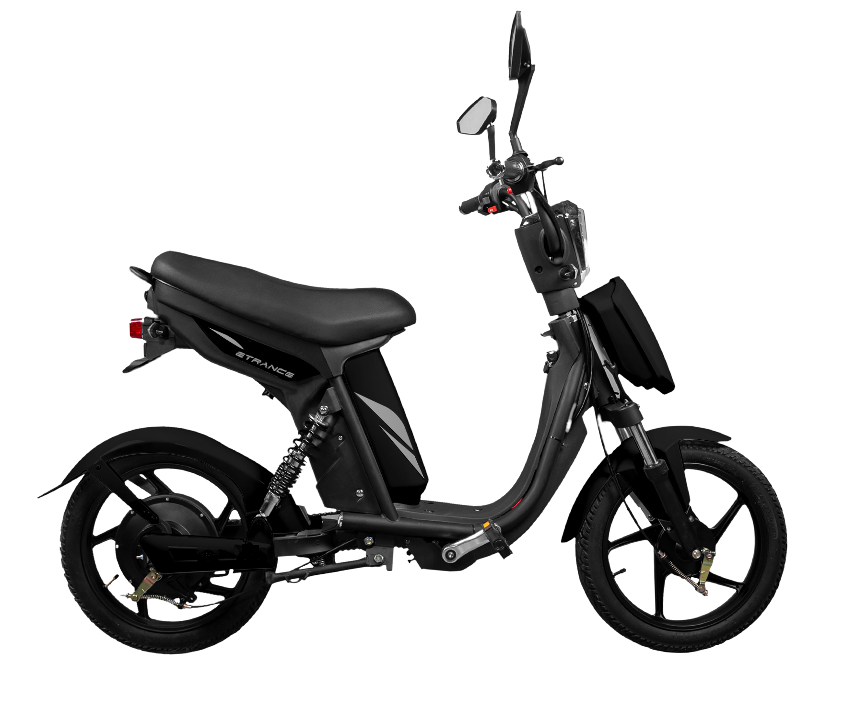
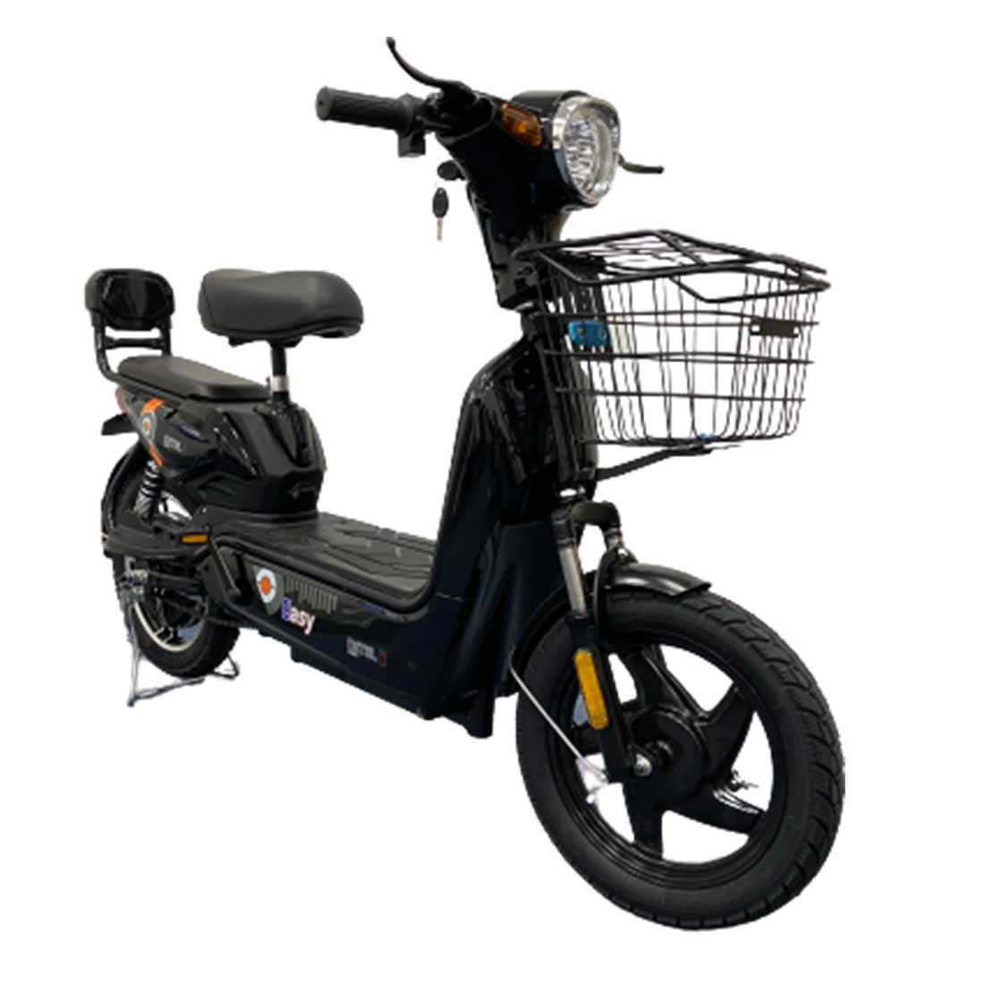
Annexure II: Key electric mobility facts and figures
18
2.11%
933
FAME-II target met
2,877
Public charging stations
as of 7th November 2020
As of June 2020
Note: Target of selling 1,562,000 EVs (2W, 3W, 4W and buses) under FAME-II scheme by FY22
Number of public charging stations to be setup across key 34 highways/expressways as per DHI
EV sales per 1000 non-EV sales
Recent electric vehicle launches
Q2 FY21
54
12.0INR/km
Okinawa R30
Price: INR 58,932
Range: 60 km
Battery capacity: 1.34 kWh
Tripura
24
Chandigarh
Average EV cab tariffs
Pure EV eTrance+
20
Note: Average internal combustion engine (conventional) cab tariffs are around 16.4 INR/km
Price: INR 56,999
Range: 65 km
Battery capacity: 1.25 kWh
Assam
19
DetelEV Easy
Delhi
Price: INR 19,000
Range: 60 km
Battery capacity: 48 V, 12 Ah
14
6.0–7.2Lakh INR
Bihar
Atum 1.0
13
Price: INR 50,000
Range: 100 km
Battery capacity: 48 V, 18.6 Ah
Uttar Pradesh
Price range for an electric car (hatchback)
Source: Vahan Sewa dashboard, CEEW Centre for Energy Finance, Department of Heavy Industries, CEA.
cef.ceew.in

Slide 19
About us: CEEW is among Asia’s leading policy research institutions
19
cef.ceew.in

Slide 20
CEEW Centre for Energy Finance
20
Build evidence
Consistent, reliable, and up to date monitoring & analysis of clean energy markets – investment, payment schedules, market trends, etc.
Create coherence
Periodic convening of multi-stakeholder groups to deliberate on market activities in clean energy
Design solutions
Design and feasibility pilots of fit-for-purpose business models & financial solutions for clean energy solutions
cef.ceew.in

Slide 21
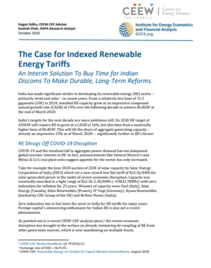
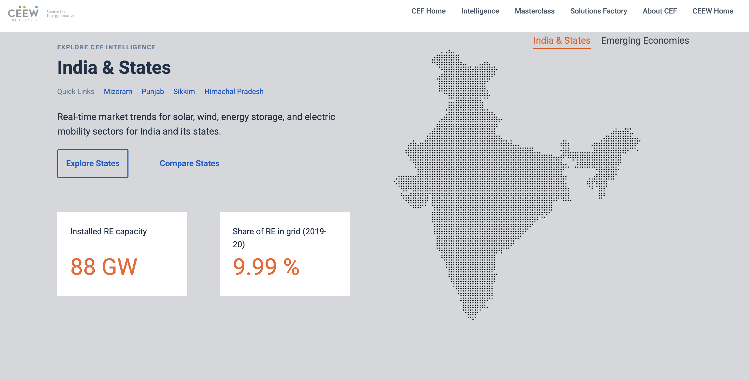
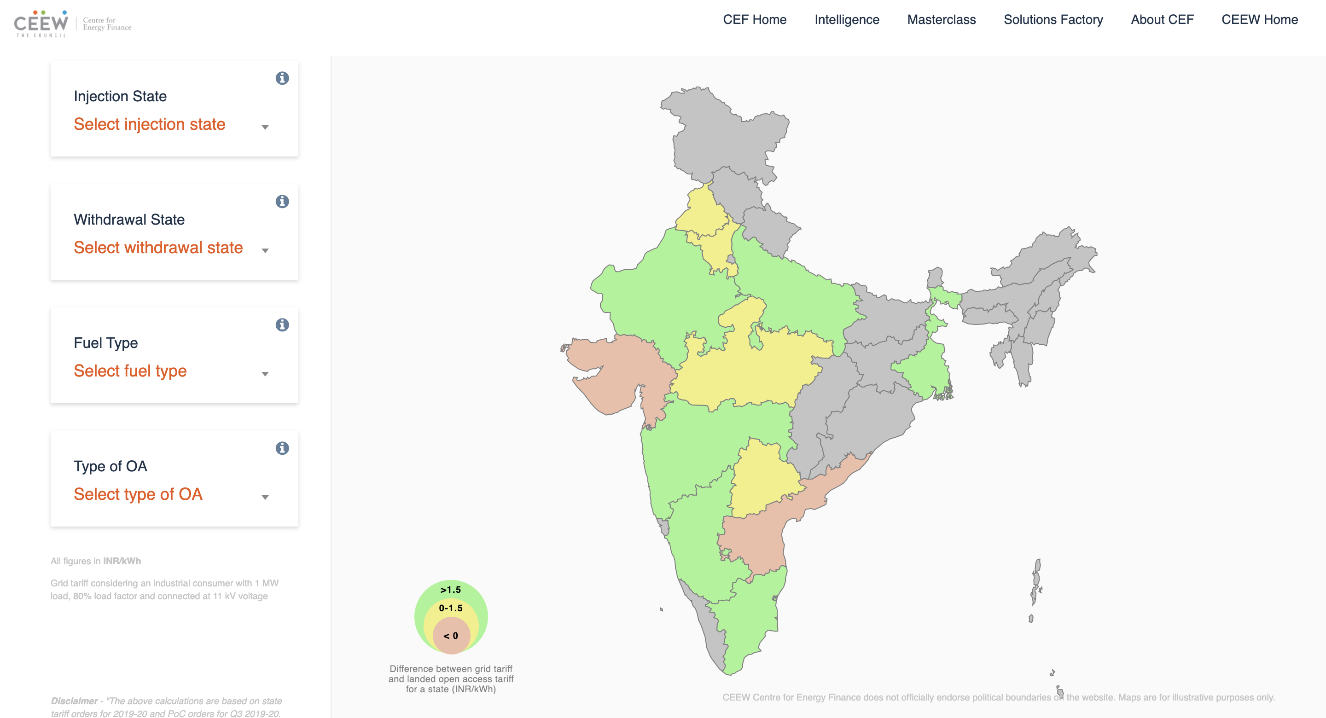
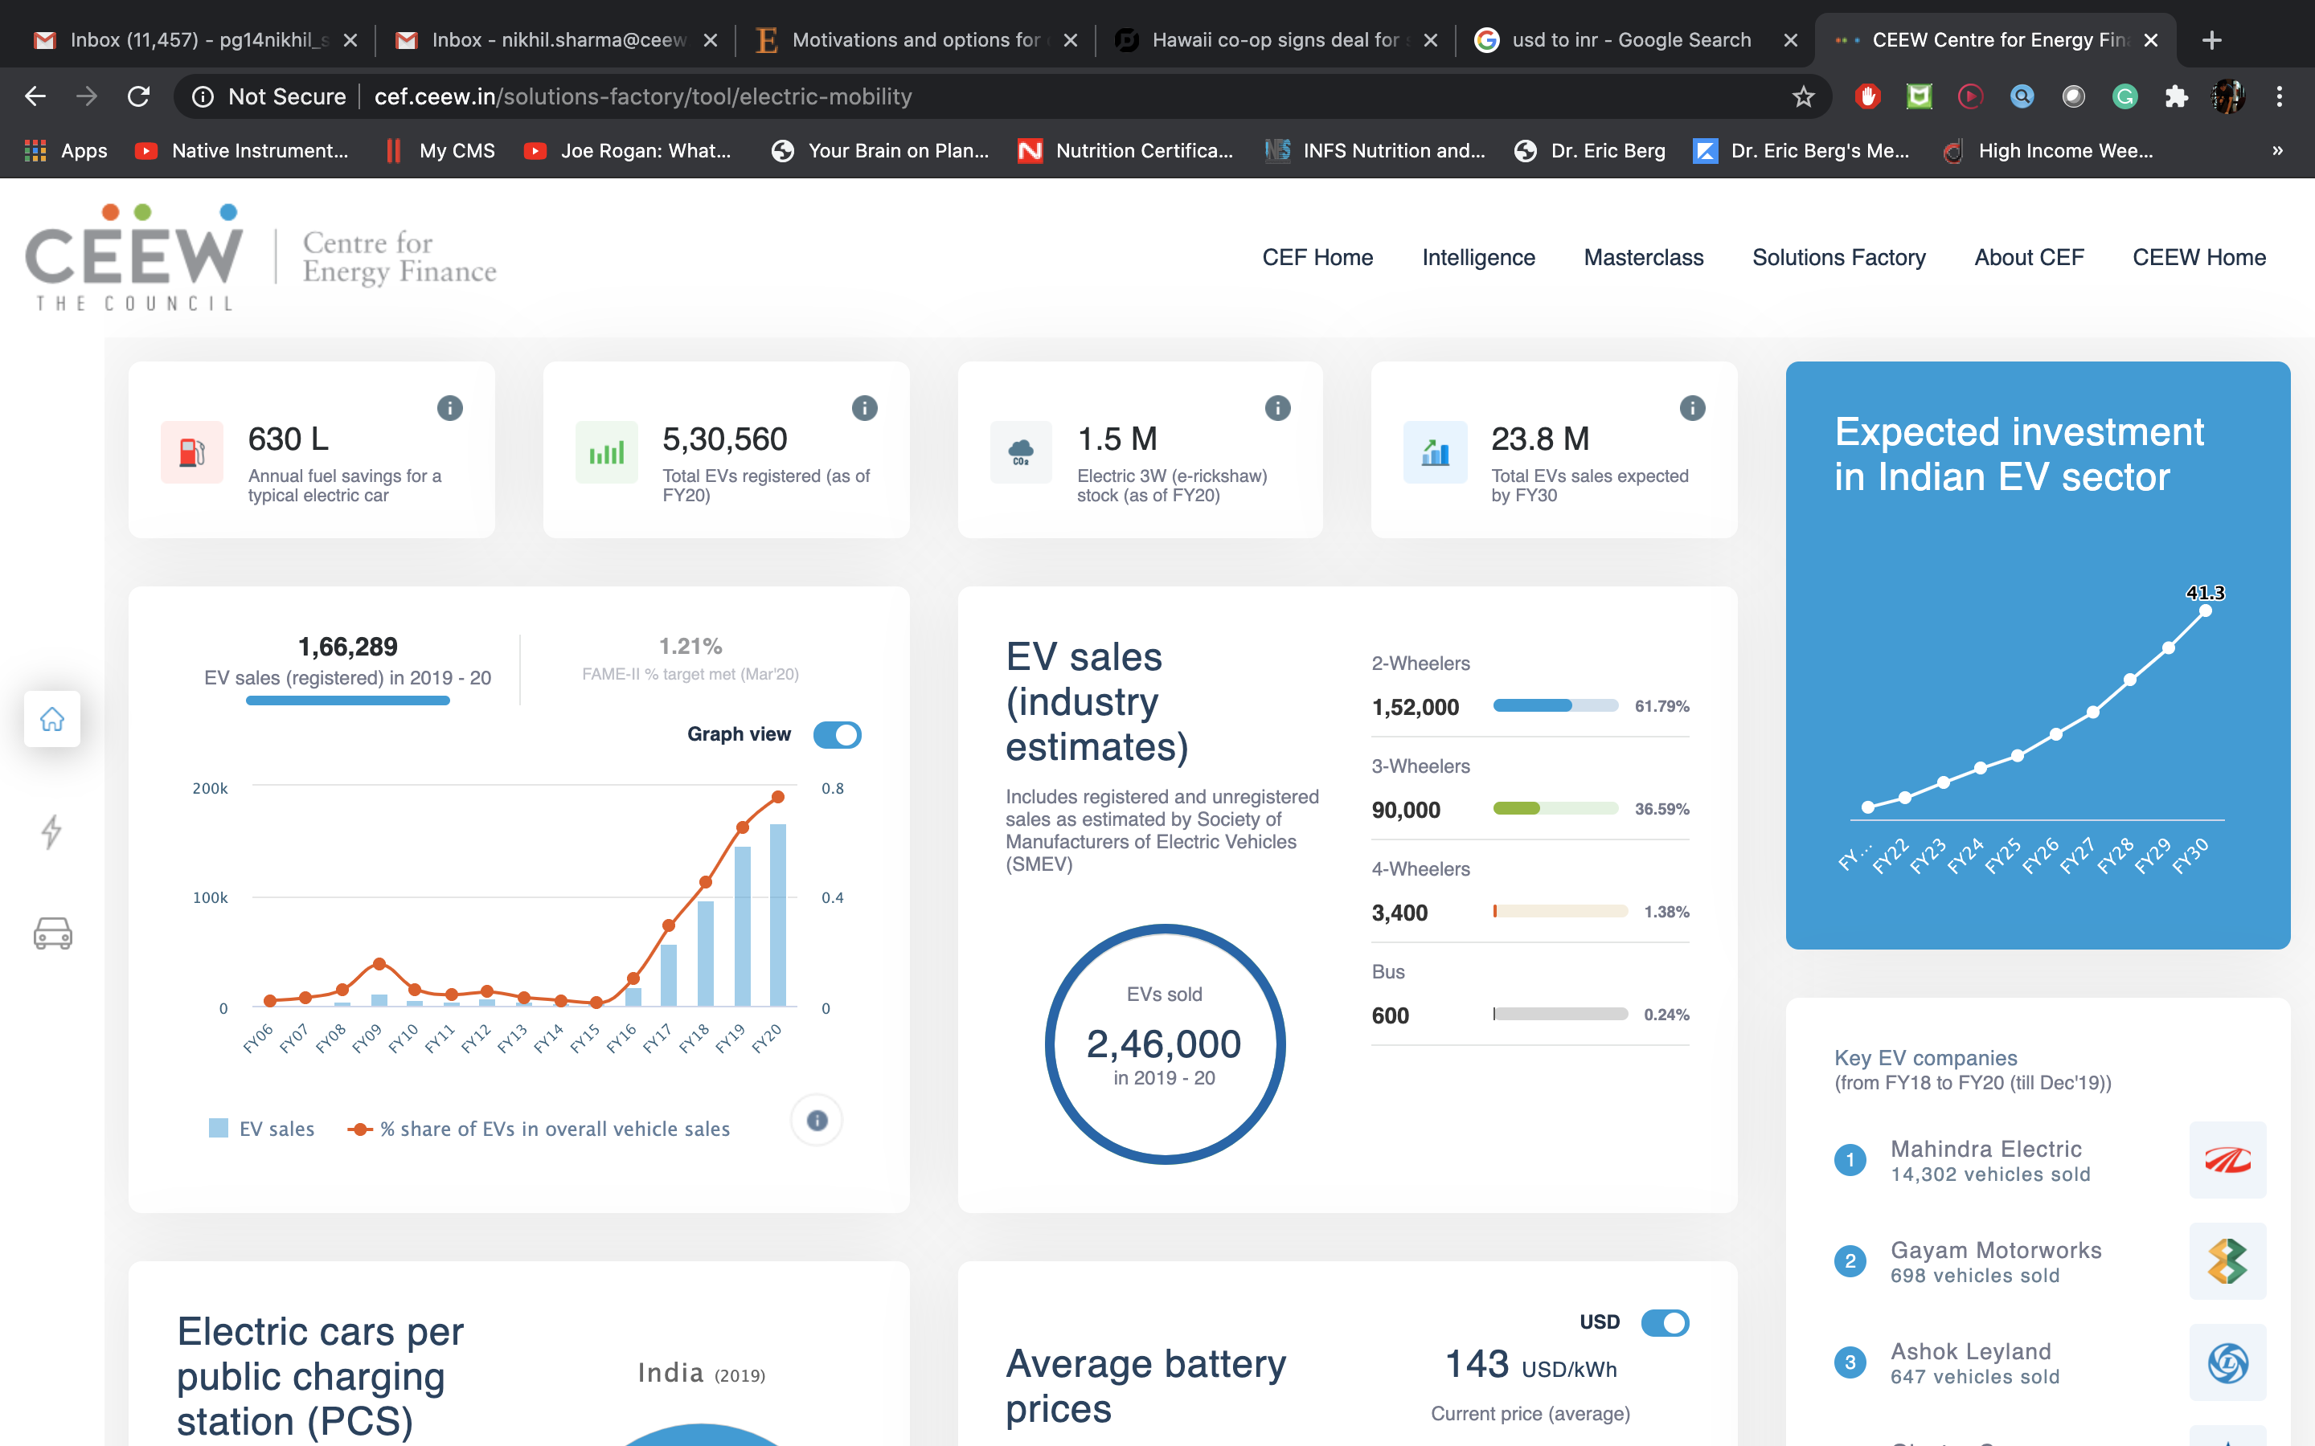
Our recent publications, dashboards and tools
21
Clean Energy Investment Trends 2020
The Case for Indexed Renewable Energy Tariffs
Scaling Up Solar Manufacturing in India to Enhance India’s Energy Security
RE-Financing India’s Energy Transition
CEEW-CEF Dashboard
Open Access Tool
Electric Mobility Dashboard
cef.ceew.in

