Slide 1
CEEW-CEF Market Handbook Q3 2020-21
Image: iStock
15 February 2021
© Council on Energy, Environment and Water 2020

Slide 2
CEEW-CEF Market Handbook
India is undergoing an energy transition from fossil-based to clean energy. Evidence-based decision-making can accelerate the process.
CEEW Centre For Energy Finance’s Market Handbook aims to help key investors, executives and policymakers with evidence-based decision-making by:
Identifying and analysing trends critical to India’s energy transition
Presenting data-backed evidence based on the most relevant indicators
Connecting the dots and presenting a short-term market outlook
The handbook attempts to comment and answer on some critical questions such as:
What is India’s generation capacity and energy mix?
What are the key trends in renewable energy (RE) tariffs?
What is the current situation of the discom payment delay situation?
How have the power market reforms progressed?
What are key trends in the electric vehicles (EV) and energy storage markets?
cef.ceew.in

Slide 3
Contents
Generation Capacity And Energy Mix
4
Coal Phase-Out
6
RE Auctions
7
Discom Payables
8
Power Markets
9
Policy and Regulatory Developments
10
Renewable Energy Finance
11
Energy Storage
14
Electric Mobility
15
Image: iStock
Annexures
17
19
About Us
cef.ceew.in

Slide 4
Generation capacity: RE capacity additions rebound to pre Covid-19 levels, as the economy starts to see a recovery
4
Takeaways & Outlook
No noticeable coal/lignite, hydro, nuclear, gas/diesel capacity has been added since last four quarters whereas there has been a noticeable increase in RE capacity.
The pace of RE capacity addition has begun to match pre Covid-19 levels, in line with an economic and RE supply chain recovery once the lockdown ended.
Specifically, the 1.9 GW of RE capacity added in Q3 FY21, was 59% higher than the lowest quarterly capacity addition (1.2 GW) in Q1 FY21. The low capacity addition in Q1 FY21 was an aftermath of the Covid-19 lockdown, announced in March 2020.
Among RE categories, solar (grid-scale and rooftop) continues to dominate, accounting for 73% of the capacity added in Q3 FY21.
2.97 GW RE capacity was sanctioned/auctioned in Q3 FY21. A decline in quarterly capacity sanctioned/auctioned was observed (4.4 GW and 3.2 GW sanctioned/auctioned in Q1 FY21 and Q2 FY21, respectively). This might be due to challenges faced by SECI in finding adequate buyers for the previously tendered (higher tariff) capacities in the face of rapidly declining tariffs and discoms’ grid integration challenges.
Source: Central Electricity Authority. *Includes solar rooftop capacity (3.5 GW as of December 2020)
Source: Ministry of New and Renewable Energy.
cef.ceew.in

Slide 5
Energy mix: share of RE up from 8.0% in Q3 FY20 to 9.0% in Q3 FY21; overall large hydro generation down by 9.8% in Q3 FY21 versus Q3 FY20
5
Takeaways & Outlook
Total generation in Q3 FY21 was up by 7.3% compared to Q3 FY20 with the lifting of the Covid-19 lockdown and signs of economic recovery.
October: Up by 12.8%
November: Up by 3.7%
December: Up by 5.3%
Total Q3 FY21: Up by 7.3%
Overall RE generation increased by 20.0%, while large hydro generation decreased by 9.8% and coal/lignite generation grew by 8.3% (vs Q3 FY20).
As a result, RE’s share in average daily generation saw an increase in Q3 FY21 (vs Q3 FY20), hydro saw a decline while coal/lignite remained buoyant.
RE: Share up from 8.0% to 9.0%
Hydro: Share down from 11.8% to 9.9%
Coal/lignite: Share up from 73.3% to 74.1%
RE share snapshot
 | Q3 FY19 |  | Q3 FY20 |  | Q3 FY21
 | RE share % | Day | RE share % | Day | RE share % | Day
Highest | 10.9% | 15 December 2018 | 11.7% | 17 December 2019 | 12.4% | 27 November 2020
Lowest | 5.1% | 17 October 2018 | 5.3% | 11 October 2019 | 6.5% | 29 October 2020
Average (Daily) | 6.9% | NA | 8.0% | NA | 9.0% | NA
Source: POSOCO. Note: RE technologies include solar, wind, biomass, waste-to-energy and small hydro and does not include rooftop solar and large hydro (>25 MW) generation.
cef.ceew.in

Slide 6
Coal phase-out: coal capacity addition remained subdued with net Q3 FY21 additions of 369 MW, which were less than 20% of the RE additions (1,924 MW) during the same period
6
Takeaways & Outlook
Although coal capacity growth was net positive (additions less retirements), the pace of additions remained subdued. The net capacity addition declined by 18% in Q3 FY21 (from Q2 FY21).
PFC/REC continues to back coal projects in India, although their share in its loan book declined further to 56% in Q2 FY21 (from 58% in Q1 FY21). To compensate, PFC/REC has increased its exposure to RE and hydro projects, which account for 6% and 5%, respectively, of its loan book as of Q2 FY21.
Source: Central Electricity Authority
Source: PFC investor presentations; figures are derived from the same. Note: Sector-wise break up of PFC loan asset data unavailable for Q3 FY21.
cef.ceew.in

Slide 7
RE auctions: 2.97 GW of RE was auctioned in Q3 FY21; India discovered a new low in RE tariffs at 1.99 INR/kWh at the Gujarat (GUVNL) solar auction
7
Key auction results
(last six months)
Bid spotlight: Gujarat (GUVNL) solar, 500 MW, Phase IX
Takeaways & Outlook
Historically low tariffs were discovered in Q3 FY21, first at 2.00 INR/kWh and subsequently at 1.99 INR/kWh for the SECI and Gujarat (GUVNL) bids, respectively.
The bids were oversubscribed and attracted high international participation, which indicates a lower risk perception among developers/investors regarding the Indian market.
Access to low-cost financing is a major factor behind the discovery of such low tariffs. International developers with access to OECD rates (below 1%) with a hedging cost of 5–6% (as per industry estimates) may access debt at ~7%. Meanwhile, an AAA-rated developer like the NTPC may access domestic debt at ~7–7.5%, which is well below typical commercial lending rates in India.
Given low demand for new capacity owing to legacy PPAs (coal overcapacity), discoms have been reluctant to sign PPAs for solar/wind auctions. As per CEEW-CEF estimates, nearly 18.57 GW of capacity auctioned has unsigned PPAs. SECI’s decision to sell power to discoms at a weighted average tariff based on multiple bids is a key contributing factor.
Capacity allotted (MW)
Least tariff discovered (INR/kWh)
Tariff and winner
Tariff discovered: 1.99 INR/kWh
Key provisions
Comments
Key factors behind the discovery of lowest tariff:
Minimum capacity utilization factor (CUF) requirement of 17% on an annual basis
Excess energy generation may be sold in open markets with transmission connectivity
Power purchase assurance due to the PPA signed with GUVNL unlike recent SECI bids that are facing difficulty in signing PPAs.
Winners: NTPC, Aditya Birla Renewables, Al Jomaih Energy and Water Co and Torrent Power
Power purchase assurance and signing of PPA within 30 days of issuance of LoA
Access to low-cost financing by foreign bidder Al Jomaih Energy and Water Co and by NTPC due to its AAA/Stable credit rating
Facilitation of land acquisition by state agency
Expectation of fall in module prices and use of bifacial modules
Exemption of duties (safeguard, BCD) owing to expected commissioning after July 2021
SECI, Pan India solar-wind, 1,200 MW, Tranche III (December 2020)
1,200
2.41
Gujarat (GUVNL) solar, 500 MW, Phase IX (December 2020)
500
1.99
Q3 FY21
Rajasthan (SECI) solar, 1,070 MW, Tranche III (November 2020)
1,070
2.00
Kerala (KSEB) solar, 200 MW (November 2020)
200
2.97
GUVNL, 100 MW, Solar, Raghanesda Solar Park, Phase X, Gujarat (September 2020)
100
2.73
Gujarat (GUVNL) solar, Tranche IX, 700 MW (August 2020)
700
2.78
Q2 FY21
Pan-India (NTPC) solar, 1,200 MW (August 2020)
1,170
2.43
Pan-India (SECI) blended wind-solar, Tranche IX, 2,500 MW (August 2020)
970
2.99
Maharashtra (Tata Power) solar-wind, 225 MW (July 2020)
225
2.59
Source: SECI and state renewable agencies. SECI = Solar Energy Corporation of India; RTC = Round the clock
cef.ceew.in

Slide 8
Discom payables: liquidity infusion into discoms under the PFC/REC scheme further slows down the pace of mounting overdues to power producers
8
Takeaways & Outlook
As of December 2020, the amount overdue by discoms was INR 1,43,116 crore, representing an increase of 33% compared to December 2019.
There has only been a 1% increase in overdues in Q3 FY21 as compared to the 30% spike in Q1 FY21. The three-month moratorium in Q1 FY21 and the liquidity package for discoms to pay the power producers explains lowering of rate of increase of amount overdue.
The states with the most payment delays include Rajasthan, Uttar Pradesh, Uttarakhand, Andhra Pradesh, Telangana, Karnataka, Uttar Pradesh, and Tamil Nadu.
PFC/REC sanctioned INR 1,18,273 crore (as of October 2020) of the liquidity package issued for discoms. The package includes loans for discoms to clear delayed power purchase payments; the loans are for a tenure of 10 years with a moratorium of up to 3 years.
The states that utilised the loans so far are Uttar Pradesh, Telangana, Andhra Pradesh, Rajasthan, Punjab, West Bengal, and Manipur.
Q3 FY21
Q2 FY21
Q1 FY21
Source: PRAAPTI portal (Based on voluntary disclosure from power producers).
Source: UDAY portal (Based on data disclosed by discoms as of 30th Sep 2020. *Data not available for these states; values derived from 2018-19 financial reports).
PFC/REC’s liquidity scheme has been utilized by discoms in the states of Uttar Pradesh, Telangana, Andhra Pradesh, Rajasthan, Punjab, West Bengal, and Manipur.
cef.ceew.in

Slide 9
Power markets: Power demand consistently surpassed 2019 levels; GTAM volumes declined due to low sell-side liquidity owing to a lean wind–solar season during November–December
9
Takeaways & Outlook
Peak power and energy demand consistently surpassed Q3 FY20 levels in all months, indicating an economic recovery.
REC trading remains suspended due to arbitration concerning CERC ’s order removing the floor price and reducing the forbearance (maximum) price.
The green term–ahead market saw an increase in volumes initially as surplus discoms (exceeding their RE procurement above the RPOs) started to sell in the market. A decrease in wind–solar generation in November–December resulted in a decline in sell-side liquidity.
Short-term electricity prices (in both day-ahead and real-time spot markets) increased to 2.58 INR/kWh and 2.79 INR/kWh in Q3 FY21 (from 2.53 INR/kWh and 2.43 INR/kWh in Q2 FY21, respectively). This is due to increased power demand from discoms. An increase in the share of short-term procurement in the overall procurement mix (12.45% in November 2020 from 10.09% in November 2019) also contributed to this.
Source: CEA.
Source: Indian Energy Exchange (IEX). *Day ahead contingency
Peak demand saw a post-lockdown resurgence in the months of October, November, and December 2020 and surpassed 2019 levels.
Volumes in the green term–ahead market underwent an initial increase and a subsequent decline due to a low solar and wind season in December 2020. However, the price has gone on a generally upward trajectory since its inception.
Real time market snapshot (IEX)
 | Volume (million kWh) | Price (INR/kWh)
October | 893.5 | 2.69
November | 893.6 | 2.75
December | 1129.1 | 2.94
Total/average | 2,837.2 | 2.79
Source: IEX.
Source: IEX.
Average day-ahead spot market prices declined by 2% in Q3 FY21 (compared to Q3 FY20) with a significant volume increase of 44%, owing to a recovery in power demand and an increase in the share of short-term procurement in the overall mix of discoms.
The real-time market with 15-minute time block trading commenced on 1 June 2020. The average price discovered increased from 2.22 INR/kWh in June 2020 to 2.94 INR/kWh in Q3 FY21; this was driven by a boost in buyer-side liquidity.
cef.ceew.in

Slide 10
Policy and regulatory developments: Electricity (Rights of Consumers) Rules, 2020, notified; Ministry of Power proposed rules on PPA tariffs, curtailment and change in law
10
Takeaways & Outlook
The Electricity (Rights of Consumers) Rules, 2020, were notified by the Ministry of Power. They aim to improve discom performance and electricity supply reliability.
As per the rules, a limit of 10 kW on net-metering has been imposed. The industry has challenged this limit as a major deterrent to the growth of the solar rooftop sector. As such, Ministry of Power is currently considering this limit for revision. Net-metering allows a grid-connected rooftop consumer to directly offset the energy injected into the grid, thereby ensuring higher incentives.
In response to the financial crunch due to the Covid-19 pandemic, the Ministry of Finance took measures to relax PBG and EMD requirements to reduce bidding costs for RE developers.
Aiming to provide a fillip to Indian manufacturing, exports, and self-reliance (‘Atmanirbhar Bharat’), the government announced production-linked incentives worth INR 22,600 crore for high-efficiency solar PV modules and advance chemistry cell battery development.
Notification of Electricity (Rights of Consumers) Rules 2020 by Ministry of Power
Ministry of Finance relaxed PBG, EMD requirements in central government tenders
Amendment of guidelines by MNRE on blended (round the clock) RTC RE procurement
Consumers to get an electricity connection with 7 days (30 days for rural areas) of applying.
No new electricity connections to be added without meters (prepayment or smart prepayment).
Discoms to mandatorily bill all consumers and ensure the bills reach them at least 10 days prior to the date of payment, Rebate for a customer if the bill delivery is delayed.
Discoms to monitor and report reliability indices for the duration and frequency of outages.
Automatic compensation for consumers if standards of performance (such as outages and application processing timelines) aren’t adhered to by discoms.
Limit on net metering set as 10 kW for solar rooftop systems. Gross metering to be provided above 10 kW.
Discom to set up a mechanism for monitoring consumer grievance redressal and a dedicated call centre.
Performance bank guarantee (PBG) reduced to 3%.
No Earnest money deposit (EMD) required, bidders to submit bid security declaration.
Applicable to all new tenders, contracts to be issued or concluded by December 2021.
As per the revised guidelines, any non-renewable power source (including storage) can be blended with RE.
RE and non-RE plants can be in the same or different RLDC regions.
Penalty on failure to meet requirements increased from 25% to 400% of applicable tariff.
Ministry of Power proposed rules on PPA tariffs, curtailment and change in law
Government of Gujarat announced Solar Policy 2021, valid till December 2025
Discoms to sign PPAs at weighted average of tariff bids.
RE developers to sell curtailed power over power exchanges.
Tariff revision for ‘change in law’ events within 30 days, verification by regulators within 90 days.
Incentives for consumers consumers to set up rooftop solar with eligibility to sell power to discom and no limit on capacity installed (earlier 50% of contracted capacity).
Focus on reducing operating (electricity) costs for MSMEs with exemption of cross subsidy and additional surcharge for open access.
Source: Publicly available information.
cef.ceew.in

Slide 11
Renewable energy finance: market concentration decreased slightly from the previous quarter, and bidders in Q3 FY21 auctions included international developers and the NTPC
11
Key deals (Q3 FY21)
81%
Takeaways & Outlook
Nearly 2.97 GW of RE capacity was sanctioned/auctioned in Q3 FY21 (vs. 3.2 GW in Q2 FY21). Auction bids continued to be concentrated in the hands of a few developers.
Auctions included participation from international developers such as Al Jomaih Energy and Water Co. and NTPC, the largest Government of India utility engaged in thermal power generation.
Deal activity primarily consisted of equity investment in RE assets by investors looking to invest in quality PPAs (SECI/NTPC). In addition, the acquisition of ReNew Power’s wind farms by Ayana Renewable and that of Essel Green Energy by Adani Green indicate rampant M&A in the clean energy sector.
Market concentration, which declined slightly from 84% in the previous quarter to 81%, is expected to remain high going forward, with dominant players having an edge in raising and pricing capital at the required scale.
Equity investment
Company: Ayana Renewable Investor: NIIF, CDC Group Amount: INR 2,845.0 crore (USD 390.0 million)
Q3 FY21
December 2020
Market concentration in sanctioned RE capacity
Acquisition
Target: Fotowatio Renewable Ventures
Acquirer: IndiGrid Investment Managers Limited
Amount: INR 649.3 crore (USD 89.6 million)
Note: Market concentration is calculated as the ratio of the top five RE capacities sanctioned to the total RE capacity sanctioned
.
December 2020
Equity investment
Target: Borosil Renewables Acquirer: Convergent Finance LLP Amount: INR 198.4 crore (USD 27.2 million)
Developer-wise RE capacity sanctioned during Q3 FY21 (2,970 MW)
December 2020
Acquisition
Target: ReNew Power (Wind Farms in Karnataka)
Acquirer: Ayana Renewable
Amount: INR 1,600.0 crore (USD 220.0 million)
November 2020
Acquisition
Target: Essel Green Energy Private Limited
Acquirer: Adani Green Energy Limited
Amount: INR 1,300.0 crore (USD 178.2 million)
October 2020
Equity investment
Target: Avaada Energy Private Limited Acquirer: Deutsche Investitions und Entwicklungsgesellschaft (DEG) and KfW Group Amount: INR 72.9 crore (USD 10.0 million)
October 2020
610
Source: Publicly available information.
Source: CEEW Centre for Energy Finance.
cef.ceew.in

Slide 12
Renewable energy finance: most RE stocks outperform the market, as even the laggards from previous quarters recover from Covid-19 shocks
12
Takeaways & Outlook
All the listed RE stocks (except EPC player Sterling & Wiling Solar) outperformed the market (Sensex) as of Q3 FY21, which was in turn up by 25% (from the end of Q2 FY21).
The share prices of pure play RE developers such as Adani Green and Azure Power continued to significantly outperform the market, as the stocks attracted investor interest.
The stock price of Inox Wind, a developer–manufacturer, rose steadily in Q3 FY21, unlike in the previous quarter during which it remained flat. For Suzlon Energy, a developer–manufacturer, the stock price rose notably owing to net profit in Q2 FY21 (reported in Q3 FY21), partly due to lower employee and financing costs (debt structuring was announced in Q1 FY21).
Share prices of Borosil Renewables (glass manufacturing) spiked in December 2020 despite consistently underperforming the market during Q1 and Q2 FY21. This was after the company raised funds from institutional investors to double its solar glass production capacity.
Q1 FY21
Q2 FY21
Q3 FY21
Source: Money Control.
cef.ceew.in

Slide 13
Renewable energy finance: bond yields fell even below pre-Covid-19 levels and Q3 FY21 saw Indian developers returning to the international bond markets
13
Takeaways & Outlook
The twin challenges of low liquidity in the Indian bond market coupled with credit rating constraints (most RE project loans are typically rated below AA, the minimum requirement for local market acceptance) has driven Indian RE developers to tap international debt capital markets.
Bond yields recovered from the economic shock that Covid-19 caused, which led to a temporary rise in yields in Q1 FY21.
With bond yields falling to pre-Covid-19 levels in Q2 FY21 and below even that in Q3 FY21, Indian RE developers began returning to overseas green bond markets. ReNew Power and CLP Wind Farms in Q3 FY21 raised fresh rounds of green bonds to refinance their existing debt (Annexure I).
Q1 FY21
Q2 FY21
Q3 FY21
Source: Reserve Bank of India, State Bank of India, Trading Economics, Money Control and BondEvalue. * Current yield.
cef.ceew.in

Slide 14
Energy storage: key RE and storage auctions in India get multiple extensions
14
Innovative RE and storage procurement models for better grid integration
Takeaways & Outlook
Countries advanced in the energy transition such as Chile and the US have shifted towards system-friendly procurement models.
In Chile’s 2017 auction, intraday and seasonal supply blocks were defined, and the demand was aggregated and auctioned separately, with developers free to use any combination of technologies to deliver the power.
The tariff discovered was 32.5 USD/MWh (2.5 INR/kWh), considering a sale of deviation through spot markets and the expected benefits of declining module costs with a commissioning date five years from the auction.
India may learn from Nevada, USA, how to conduct an auction with different tariffs for off-peak and on-peak hours; this may start with Indian utilities conducting a detailed demand assessment.
India’s RE blended with firm power technologies (thermal, hydro, storage, etc.) has multiple extensions. Key amendments to the auction include allowing project components (solar, wind, storage, thermal, etc.) to be located anywhere in India and extending the commissioning period from 18 to 24 months.
India’s energy storage projects
Intraday and seasonal supply blocks, Chile (2017)
Distribution companies provide demand and regulator aggregates projected supply requirements, conducts auction
Developers bid for one or several time blocks representing projected demand
Blocks have a base and a variable component to absorb unexpected demand
Production deviation settled at spot market prices
Tariff discovered: 32.5 USD/MWh (2.5 INR/kWh)
Project location & tender issue date | Application & technology | Details
Leh. UT of Ladakh (SECI), December 2020 | 20 MW solar with 50 MWh BESS | Expected bid conclusion in Q4 FY21
Chhattisgarh (SECI), September 2020 | 100 MW solar with 150 MWh BESS | Expected bid conclusion in Q4 FY21 (extended)
Pan India (SECI), March 2020 | 5,000 MW solar, wind, storage, others (thermal, hydro, etc.) hybrid in RTC manner | Expected bid conclusion in Q4 FY21 (extended)
Leh & Kargil (SECI), January 2020 | 14 MW solar with 42 MWh BESS | Expected results in Q4 FY21
Andaman & Nicobar Islands (SECI), January 2020 | 4 MW floating solar with 2 MWh BESS | Expected results in Q4 FY21
Delhi and Dadra & Nagar Haveli (SECI), October 2019 | 400 MW with solar, wind and storage hybrid | Bid concluded in May 2020 with tariff of 3.60 INR/kWh
Lakshadweep (SECI), September 2019 | 1.95 MW solar with 2.15 MWh BESS | Bid concluded with an undisclosed price
Peak tariff for peak demand periods, Nevada, USA (2019)
Procurement of solar and storage to help Nevada meet 2030 the target of 50% renewable generation
NV Energy (utility) defined on-peak tariff for evening hours (4 p.m. to 9 p.m.) for the summer months (July to August)
On-peak tariff paid at 6 times of the off-peak tariff to RE developers
Tariff discovered: Off-peak tariff of 21.0 USD/MWh (1.6 INR/kWh) to 25.0 USD/MWh (1.9 INR/kWh) and on-peak tariff of 138.0 USD/MWh (10.4 INR/kWh) to 161.0 USD/MWh (12.1 INR/kWh)
Source: System-friendly procurement through round-the-clock power: International experiences, USAID, 2020.
Source: SECI and state renewable agencies.
cef.ceew.in

Slide 15
Electric mobility: EV and hybrid vehicle sales are only slightly below the Q3 FY20 levels
15
Takeaways & Outlook
Following the lockdown, overall electric vehicle (EV) and hybrid vehicle sales went up dramatically, by 47.1% in Q3 FY21 (from Q2 FY21), owing to pent-up demand during the lockdown.
EV and hybrid vehicle sales for Q3 FY21, at 72,767, were only slightly below (3%) of Q3 FY20 level of 75,044; this indicates of an economic recovery, with consumers starting to spend once again.
The decision of the Ministry of Road Transport and Highways (MoRTH) to allow states to register and sell EVs without pre-fitted batteries is expected to further drive EV adoption among Indian consumers.
OEMs with highest EV sales in Q3 FY21 were:
2W: Hero Electric (3,028), Ampere (2,290) and Okinawa (1,803)
3W: Y.C. Electric (2,776), Mahindra Electric* (2,734) and Saera Electric (1,187)
4W: Tata Motors* (2,422), Mahindra Electric* (825) and MG Motors* (716)
Q1 FY21
Q2 FY21
Q3 FY21
Source: Vahan Sewa dashboard (Includes only registered vehicles. Unregistered vehicles include low-speed (< 25 km/hr), e-rickshaws (three-wheelers) and electric two-wheelers), Electric Mobility Dashboard, CEEW Centre for Energy Finance. *Based on sales data for FY21 up to January 2021.
cef.ceew.in

Slide 16
Thank you
You can find us at cef.ceew.in | @CEEW_CEF
Authors
Nikhil Sharma (nikhil.sharma@ceew.in)
Dhruv Warrior (dhruvrajwarrior@gmail.com)
Shrey Sood (shrey.sood@ceew.in)
Meghna Nair (meghna.nair@ceew.in)
Gagan Sidhu (gagan.sidhu@ceew.in)
cef.ceew.in

Slide 17
Annexure I: Green bond issuances (last 2 years)
17
Date | Company | Size (USD million) | Sector | Coupon rate (%) | Rating | Tenor (Years) | Purpose
October 2020 | CLP Wind Farms | 40 | Wind | Not available | AA (India Ratings) | 2 to 3 | Refinancing of existing debt
October 2020 | ReNew Power | 325 | Solar and wind | 5.375% | Not available | 3.5 | Refinancing high-cost local debt
January 2020 | ReNew Power | 450 | Solar and wind | 5.875% | BB-/Stable (Fitch) | 5 | Refinancing of maturing debt
October 2019 | Adani Green Energy | 362.5 | Solar and wind | 4.625% | BBB- (Fitch) | 20 | Repaying foreign currency loans and rupee borrowings
September 2019 | Azure power | 350 | Solar | 5.65% | Not available | 5 | Refinancing of existing debt
September 2019 | ReNew Power | 300 | Solar and wind | 6.45% | Ba2 (Moody's) | 5 | Capacity expansion and repaying high cost debt
October 2019 | Greenko | 950 | Solar and wind | 5.50% | Ba1 (Moody’s) | 5 | Refinancing of solar and wind projects
June 2019 | Adani Green Energy | 500 | Solar | 6.25% | BB+ (Fitch) | 5 | Refinancing of solar projects
March 2019 | ReNew Power | 375 | Solar and wind | 6.67% | BB (Fitch) | 5 | Capex and refinancing of outstanding ECB
January 2019 | Tata Cleantech | 25.6 | Solar and wind | Not available | Not available | Not available | Capacity expansion
September 2018 | State Bank of India | 650 | Solar and wind | US Treasury + 1.65% (US investors) 3 Libor + 1.51% (British investors) | BBB- (Fitch) | 5 | Investment in RE projects
Source: Climate Bonds Initiative and company press releases.
cef.ceew.in

Slide 18
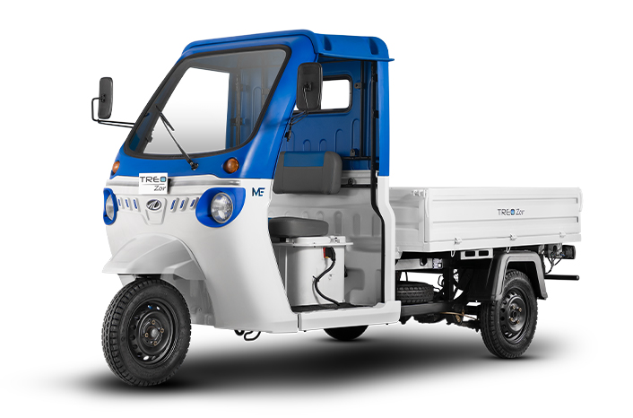
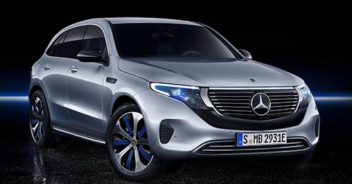
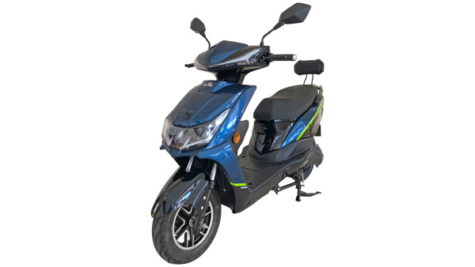
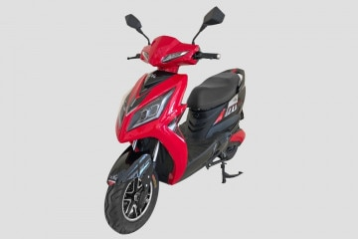
Annexure II: Key electric mobility facts and figures
18
2.94%
407
998
FAME-II target met
Number of EV OEMs in India
Number of EV dealerships in India
as of 25th January 2020
As of December 2020
As of December 2020
Note: Target of selling 1,562,000 EVs (2W, 3W, 4W and buses) under FAME-II scheme by FY22
EV sales per 1000 non-EV sales
Recent electric vehicle launches
Q3 FY21
12.0INR/km
49
Mahindra Treo Zor
Price: INR 2,73,000
Range: 125 km
Battery capacity: 7.37 kWh
Tripura
29
Average EV cab tariffs
Delhi
Note: Average internal combustion engine (conventional) cab tariffs are around 16.4 INR/km
Mercedes-Benz EQC
22
Price: INR 99,30,000
Range: 445-471 km
Battery capacity: 80 kWh
Assam
13
EeVe Atreo
Bihar
Price: INR 64,900
Range: 90-100 km
Battery capacity: 27 Ah
12
15.0–28.0Lakh INR
Karnataka
EeVe Ahava
11
Price: INR 55,900
Range: 60-70 km
Battery capacity: 27 Ah
Uttar Pradesh
Price range for an electric car (SUV)
Source: Vahan Sewa dashboard, CEEW Centre for Energy Finance, Department of Heavy Industries, CEA.
cef.ceew.in

Slide 19
About us: CEEW is among Asia’s leading policy research institutions
19
cef.ceew.in

Slide 20
CEEW Centre for Energy Finance
20
Build evidence
Consistent, reliable, and up to date monitoring & analysis of clean energy markets – investment, payment schedules, market trends, etc.
Create coherence
Periodic convening of multi-stakeholder groups to deliberate on market activities in clean energy
Design solutions
Design and feasibility pilots of fit-for-purpose business models & financial solutions for clean energy solutions
cef.ceew.in

Slide 21
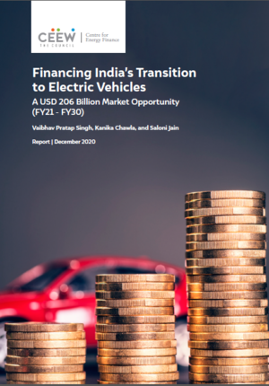
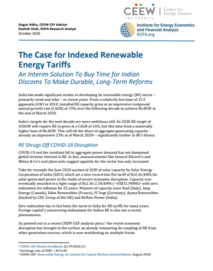
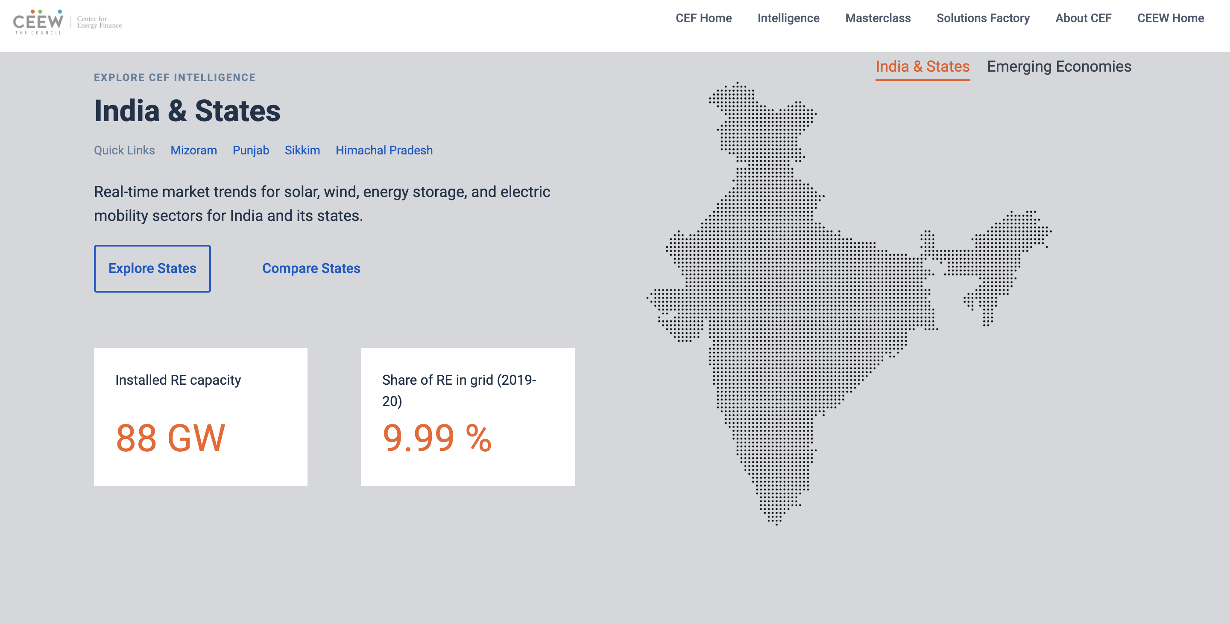
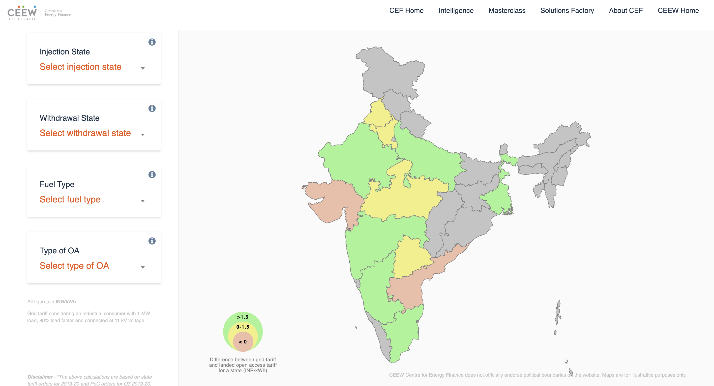
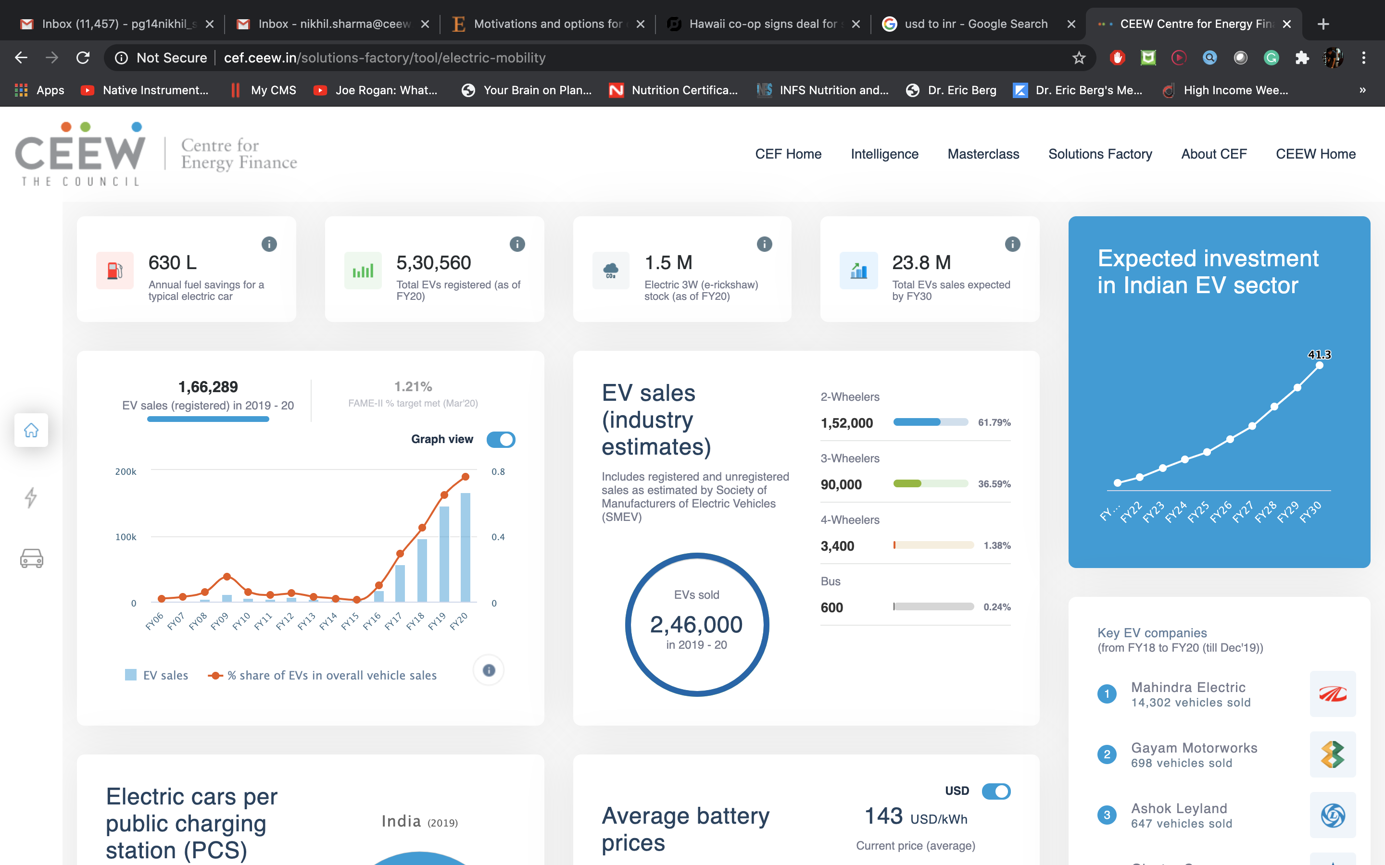
Our recent publications, dashboards and tools
21
Financing India’s Transition to Electric Vehicles
Clean Energy Investment Trends 2020
The Case for Indexed Renewable Energy Tariffs
Scaling Up Solar Manufacturing in India to Enhance India’s Energy Security
CEEW-CEF Dashboard
Open Access Tool
Electric Mobility Dashboard
cef.ceew.in

