Slide 1
CEEW-CEF Market Handbook Q1 2021-22
Image: iStock
12 August 2021
© Council on Energy, Environment and Water 2021

Slide 2
CEEW-CEF Market Handbook
India is undergoing an energy transition from fossil-based to clean energy. Evidence-based decision-making can accelerate the process.
CEEW Centre For Energy Finance’s Market Handbook aims to help key investors, executives and policymakers with evidence-based decision-making by:
Identifying and analysing trends critical to India’s energy transition
Presenting data-backed evidence based on the most relevant indicators
Connecting the dots and presenting a short-term market outlook
The handbook attempts to comment and answer on some critical questions such as:
What is India’s generation capacity and energy mix?
What are the key trends in renewable energy (RE) tariffs?
What is the current situation of the discom payment delay situation?
How have the power market reforms progressed?
What are key trends in the electric vehicles (EV) and energy storage markets?
cef.ceew.in

Slide 3
Contents
Generation Capacity and Energy Mix
4
Coal Phase-Out
6
RE Auctions
7
Discom Payables
8
Power Markets
9
Policy and Regulatory Developments
10
Renewable Energy Finance
11
Energy Storage
14
Electric Mobility
15
Image: iStock
Annexures
17
20
About Us
cef.ceew.in

Slide 4
Generation capacity: RE capacity crosses 25% of the overall generation capacity in India; its addition continues to outpace coal
4
Takeaways & Outlook
Around 1.9 GW of net capacity was added in Q1 FY22, which comprised of 2.6 GW RE capacity addition and retirement of 670 MW coal/lignite capacity. The RE capacity added in Q1 FY22 is roughly three times the capacity added in the same quarter last fiscal year (0.9 GW in Q1 FY21) attributed to the nation-wide lockdown in Q1 FY21.
However, RE capacity addition declined by 19% in Q1 FY22 versus previous quarter (3.2 GW in Q4 FY21) owing to imposition of lockdown in various states that impacted project commissioning. RE capacity addition is expected to regain momentum in Q2 FY22. Within RE, solar (grid-scale and rooftop) continues to dominate, accounting for 2.25 MW (~87%) of the capacity addition in Q1 FY22.
Solar (rooftop) capacity has steadily ramped up since Q1 FY21 with the announcement of favourable state policies (e.g. Gujarat). The earlier cap of 10 kW on solar (rooftop) capacity for a consumer under net metering regime was increased to 500 kW with an amendment to the Electricity (Rights of Consumers) 2020 Rules. This is expected to boost rooftop capacity addition, especially among commercial and industrial consumers.
Source: Central Electricity Authority (CEA). *Includes solar (rooftop) (as of June 2021).
Source: Ministry of New and Renewable Energy. *Till May 2021 as breakup of solar capacity addition (across grid-scale and rooftop) is not available for June 2021.
cef.ceew.in

Slide 5
Energy mix: despite increased power demand, the share of RE remains nearly the same in Q1 FY22 compared to Q1 FY21
5
Takeaways & Outlook
Total power generation in Q1 FY22 was up by 17.2% compared to Q1 FY21, although Q1 FY22 also sustained Covid-19 second wave led lockdown similar to the Covid-19 first wave in Q1 FY21. In June 2021, India hit all-time high electricity demand of 193.9 GW.
April: Up by 40.2%
May: Up by 7.4%
June: Up by 8.2%
Total Q1 FY22: Up by 17.2%
From a share of total generation perspective, RE declined slightly with a notable change in hydro and coal/lignite compared to Q1 FY21, respectively.
RE: Share down from 11.8% to 11.5%
Hydro: Share down from 14.6% to 11.0%
Coal/lignite: Share up from 65.9% to 72.0%
Although, the share of RE in the energy mix declined, its overall generation was up by 15.0% in Q1 FY22 (versus Q1 FY21). Coal/lignite-based generation ramped up by 27.9% while hydro generation dipped by 11.7% in the same period.
RE share snapshot
 | Q1 FY20 |  | Q1 FY21 |  | Q1 FY22
 | RE share % | Day | RE share % | Day | RE share % | Day
Highest | 15.3% | 17 June 2019 | 16.0% | 28 May 2020 | 17.8% | 26 May 2021
Lowest | 7.4% | 2 April 2019 | 8.8% | 30 June 2020 | 7.7% | 13 April 2021
Average (daily) | 9.9% | NA | 11.8% | NA | 11.5% | NA
Source: POSOCO. Note: RE technologies include solar, wind, biomass, waste-to-energy and small hydro and does not include rooftop solar and large hydro (>25 MW) generation.
cef.ceew.in

Slide 6
Coal phase-out: zero coal capacity added for the first time in 14 quarters; 670 MW coal capacity retired in Q1 FY22
6
Takeaways & Outlook
No new coal capacity was added in Q1 FY22, while two major coal plants were retired with an aggregate capacity of 670 MW.
PFC/REC, one of the largest power sector financiers in India, has continued to reduce its exposure to the coal power generation. The share of conventional generation in PFC/REC’s loan book is trending downward and substantially declined to 51% in Q4 FY21 (from 54% in Q3 FY21).
Instead, PFC/REC is increasingly focusing on transmission and distribution (T&D) and RE generation projects, which account for around 39% and 10% of its total loan book as of Q4 FY21(versus 30% and 11% as of Q4 FY20), respectively.
Source: CEA.
Source: PFC investor presentations; figures are derived from the same. Note: Sector-wise break up of PFC loan asset data unavailable for Q1 FY22.
cef.ceew.in

Slide 7
RE auctions: a slow quarter for RE auctions; stay on signing of PPA for an auction from the previous quarter
7
Bid spotlight: MAHAGENCO, Maharashtra, solar, 250 MW
Takeaways & Outlook
Bids in Q1 FY22 were notably oversubscribed and attracted significant participation. Although, the overall RE capacity auctioned (425 MW) declined by 89% (versus 4.4 GW in Q1 FY21).
Multiple auctions were delayed or extended due to unforeseen lockdowns in response to the Covid-19 second wave. A tender from the previous quarter Q4 FY21 (APGECL, Andhra Pradesh, solar, 6,400 MW) is challenged (stay on signing PPA) in the Andhra Pradesh High Court as it violated the provisions under the Electricity Act 2003 in its request for selection (RfS) and PPA.
In Q4 FY21, the Ministry of New and Renewable Energy (MNRE) announced that the basic customs duty (BCD) will be imposed on solar modules (25%) and solar cells (40%) from April 2022.
The announcement has likely affected bid pricing by project developers. But the expiry of the safeguard duty (SGD) in July 2020 has created an eight-month duty-free window with no SGD or BCD levied on modules. Project developers are likely to take advantage of the same and procure modules in bulk during this period.
Key auctions
(Last 6 months)
Capacity allotted (MW)
Least tariff discovered (INR/kWh)
Tariff and winner
MAHAGENCO, Maharashtra, solar, 250 MW (May 2021)
250
2.51
Tariff discovered: 2.51 INR/kWh
Winners: TP Saurya
Key provisions
GUVNL, Gujarat, solar, Phase X-R, 100 MW (May 2021)
100
Minimum capacity utilisation factor (CUF) requirement of 19% on an annual basis.
Excess generation to be purchased by MAHAGENCO at a fixed tariff of 75% of the PPA tariff (excess generation over and above 10% of the declared annual CUF).
Power purchase assurance, the power purchase agreement (PPA) to be signed within 30 days from the date of issuance of the LoA.
In terms of Land identification and acquisition, proposed project will be located at the Dondaicha Solar Park in Dhule.
Q1 FY22
2.64
UPNEDA, Uttar Pradesh, solar, 75 MW (May 2021)
75
2.68
GUVNL, Gujarat, solar, Phase XII, 500 MW (March 2021)
500
2.20
Q4 FY21
SECI, pan India, wind, Tranche X, 1,200 MW (March 2021)
1,200
2.77
Comments
Solar developers are factoring in the imposition of basic customs duty (BCD) on imported solar modules and cells with effect from April 2022.
Amidst Covid-19 second wave lockdown, the solar PV demand was adversely impacted.
In Q1 FY22, module prices continued to fluctuate and are affecting tariff discovery.
Torrent Power Limited, Gujarat, solar, 300 MW (February 2021)
300
2.22
Source: SECI and state renewable agencies. SECI = Solar Energy Corporation of India; GUVNL = Gujarat Urja Vikas Nigam Limited; UPNEDA = Uttar Pradesh New & Renewable Energy Development Agency; MAHAGENCO = Maharashtra State Power Generation Company.
cef.ceew.in

Slide 8
Discom payables: amount overdue by discoms reduced by 8.1% in Q1 FY22; the Union Cabinet approved a reforms-based, result-linked scheme for the power distribution sector
8
Takeaways & Outlook
The amount overdue payable by discoms to power producers marginally declined by 8.1% in Q1 FY22 compared to Q4 FY21 and 34.0% compared to Q1 FY21 owing to disbursement of funds under the PFC/REC liquidity scheme announced in Q1 FY21.
The Covid-19-led economic shock has affected discoms’ ability to pay power producers in time. In Maharashtra, Rajasthan, Madhya Pradesh, Karnataka and Chhattisgarh, the payable days for power purchase increased by more than a month in Q1 FY22 (versus Q1 FY21). However, in Uttar Pradesh, Haryana, Assam and Uttarakhand, the payable days reduced.
In June 2021, the Union Cabinet approved the revamped, reforms-based, result-linked scheme for the power distribution sector with an outlay of INR 3,03,758 crore over five years to provide conditional finance to discoms to improve their operational efficiency and financial sustainability. In addition, the MoP has announced the Electricity (Late Payment Surcharge) Rules, 2021 that impose revised late payment surcharge rates and aim to debar discoms from power exchanges or grant of short-term open access if the payments are overdue for seven months.
Q1 FY22
↓8.1%
↓12%
Q4 FY21
↓32%
Q3 FY21
↑ 1%
Q2 FY21
↑ 5%
Q1 FY21
↑30%
Source: PRAAPTI portal (Based on voluntary disclosure by power producers).
Source: UDAY portal (based on data disclosed by discoms as of 30 June 2021). *Data not available for these states; values derived from 2018–19/ 2019–20 financial reports.
The reforms-based and results-linked, revamped distribution sector scheme aims to reduce AT&C losses to levels of 12–15% by 2024–25, reduce the ACS-ARR gap to zero by 2024–25, and develop institutional capabilities for modern discoms.
cef.ceew.in

Slide 9
Power markets: record peak power demand in India during summers; GTAM volumes spiked in Q1 FY22 coinciding with a high solar insolation season
9
Takeaways & Outlook
Q1 FY22 was historical in terms of peak demand requirement and peak demand met. In June 2021, India hit all-time high electricity demand of 193.9 GW (191.5 GW met) due to an increased air conditioning demand and an economic recovery after the relaxation of Covid-19 second wave led lockdown.
The sell to buy side volume ratio in the GTAM ranged between 0.9 and 1.6 in May – June 2021 (as compared to in 0.5 in April 2021) indicating surplus RE with RE rich discoms selling it over the GTAM. GTAM traded exceptionally high volumes (955 million kWh) in Q1 FY22 (nearly 4.4 times of that traded in previous quarter Q4 FY21). The number of sell-side market participants (discoms as well as RE projects) in GTAM were 34, 43 and 49 for April, May and June 2021, respectively.
Given the continued stay on REC trading, the GTAM has become the chief facilitator of green power procurement for discoms and corporate consumers, offering a competitive and viable route to fulfill their renewable purchase obligations.
Source: CEA.
Source: Indian Energy Exchange (IEX). *Day ahead contingency.
Peak demand consistently surpassed FY21 and FY20 levels, attributable to delayed monsoons in northern India.
Green term ahead market (GTAM) experienced a significant growth in traded volumes, attributable to the peak solar season, resulting in increased participation from RE-surplus discoms.
Source: IEX.
Source: IEX.
Average day ahead spot market prices increased by 31% in Q1 FY22 (compared to Q1 FY21), with an overall volume increase of 7% owing to lowered electricity demand in April-May Q1 FY21 due to the Covid-19 lockdown.
The average price discovered in the real time market (RTM) continued to increase in April. In May, it took a hit due to lower peak demand and climbed again in June as discoms tapped the RTM to cost-effectively meet the volatile (but increasing) electricity demand.
cef.ceew.in

Slide 10
Policy and regulatory developments: MoP amended the net metering provision; FAME II scheme extended till March 2024; PLI scheme announced to promote domestic battery manufacturing
10
Takeaways & Outlook
The MoP rolled out its draft National Electricity Policy (NEP) 2021 and a discussion paper on restructuring the REC mechanism. Q1 FY22 brought good news for the rooftop solar PV market as the MoP amended the net metering provision of the Electricity (Rights of Consumers) 2020 Rules.
In April 2021, the cabinet approved MNRE’s Production Linked Incentive scheme ‘National Programme on High Efficiency Solar PV Modules’ with an outlay of INR 4,500 crore to achieve GW-scale manufacturing capacity. In another announcement, the MoP extended the waiver of ISTS charges for solar and wind projects till June 2025. the waiver is also applicable to pumped hydro storage projects and battery energy storage systems (BESS). This quarter was eventful for the EV sector; Gujarat and West Bengal announced EV policies with ambitious targets. Furthermore, the central government continued to encourage EV adoption and deployment of charging infrastructure.
Ministry of Power (MoP) issued a draft National Electricity Policy (NEP) 2021
PLI scheme - National Programme on Advanced Chemistry Cell (ACC) Battery Storage
Gujarat and West Bengal announced electric vehicle (EV) policy
In April, the MoP released the draft NEP 2021 and invited comments from the stakeholders.
The draft NEP 2021 proposes increasing the share of RE in the energy mix and promotes hybrid RE systems.
It recommends implementing differential tariffs for peak and off-peak hours.
Further, it suggests incorporating vehicle-to-grid provisions for electric vehicles and replacing existing meters with smart meters within 3 years.
Production Linked Incentive (PLI) targets to achieve manufacturing capacity of 50 GWh of ACC and 5 GWh of “niche" ACC with an outlay of INR18,100 crore.
The incentive amount will increase with increased specific energy density and cycles, and local value addition.
It aims to facilitate demand creation for battery energy storage systems (BESS) in India.
It stresses on domestic production and reduction in import dependence.
Government of Gujarat released the EV policy with a target of 2 lakh EVs on road in 4 years. It will provide an incentive of INR 10,000/kWh to 2-W, 3-W and 4-W vehicles. It will also provide a 25% of capital subsidy to commercial public EV charging stations.
Power Department of West Bengal announced the EV policy with a target of 10 lakh EVs on road. The policy proposed the deployment of 1 lakh public and semi-public charging stations in 5 years.
Ministry of Heavy Industries revised FAME* II subsidies and extended implementation period
MoP issued a discussion paper on restructuring renewable energy certificates (REC) mechanism
MoP approved net metering for rooftop solar systems up to 500 kW capacity
Incentives on 2-W EV were raised from INR 10,000/kWh to INR 15,000/kWh. The cap on incentives for 2-W was increased to 40% of the cost of the vehicle.
EESL to aggregate demand for 3 lakh 3-Ws.
The implementation period for the FAME II scheme is extended for a period of two years i.e., up to 31 March 2024.
The discussion paper proposes extending the validity of RECs until it is sold contrary to present validity of 1095 days.
It suggests removing the floor and forbearance prices.
To further encourage RE procurement, RECs can be issued beyond RPO targets.
The MoP amended the Electricity (Rights of Consumers) 2020 Rules released in December 2020 regarding net metering for rooftop solar installations.
The cap on installed capacity was raised to 500 kW from 10 kW.
Source: CEEW-CEF Compilation. *FAME=Faster Adoption and Manufacturing of (Hybrid &) Electric Vehicles in India.
cef.ceew.in

Slide 11
Renewable energy finance: significant dip in auctioned RE capacity; high market concentration in Q1 FY22
11
Notable deals (Q1 FY22)
Takeaways & Outlook
In Q1 FY22, only 425 MW RE capacity was auctioned (versus 4.4 GW in Q1 FY21). Therefore, the market concentration in Q1 FY22 stood at 100%, with two RE developers winning the total capacity. Covid-19 second wave led lockdown slowed down the bid submission and assessment processes and pushed the closing of auctions to Q2 FY22.
SJVN Limited and TP Saurya (a subsidiary of Tata Power) won 250 MW and 175 MW in Q1 FY22, respectively. SJVN, a Government of India utility engaged in hydro projects, entered the RE auctions market in Q2 FY21 by winning 100 MW in GUVNL’s solar tranche-IX, 700 MW tender.
In Q1 FY22, deal activities consisted primarily of equity investment and acquisition of RE assets, highlighting rampant merger and acquisition (M&A) activities in the sector. SB Energy’s portfolio acquisition by Adani Green Energy is the largest in the renewable energy sector in India till now. Another noteworthy deal was Waaree Energy Storage System raising seed funding to strengthen its battery storage manufacturing capacity.
100%
Acquisition
Target: Fortum Oyj Acquirer: Actis LLP Amount: INR 2,495.5 crore (USD 333 million)
June
2021
Q1 FY22
Market concentration in auctioned RE capacity
Acquisition
Target: Acme (900 MW solar project)
Acquirer: Scatec Solar
Amount: INR 2,996.4 crore (USD 400 million)
June
2021
Note: Market concentration is calculated as the ratio of the top five RE capacities auctioned to the total RE capacity auctioned
.
Equity investment
Company: Fourth Partner Energy Investor: Norfund and the Rise Fund Amount: INR 936.4 crore (USD 125 million)
June
2021
Developer-wise RE capacity auctioned during Q1 FY22 (425 MW)
Acquisition
Target: SB Energy
Acquirer: Adani Green Energy
Amount: : INR 26,219.0 crore (USD 3.5 Billion)
May
2021
April
2021
Equity investment – seed funding
Target: Waaree Energy Storage System Investor: HNI Amount: INR 15.0 crore (USD 2 million)
April 2021
Asset acquisition
Target: Azure Power (152 MW solar rooftop assets) Acquirer: Radiance Renewables Amount: INR 536.5 crore (USD 71.6 million)
Source: CEEW Centre for Energy Finance.
Source: CEEW-CEF Compilation.
cef.ceew.in

Slide 12
Renewable energy finance: most RE stocks trended downwards amid the Covid-19 second wave; Adani Green Energy stumbled after a long bullish run
12
Takeaways & Outlook
After witnessing considerable gains in the latter half of FY21, RE stocks stumbled in April and May 2021 due to the second wave of Covid-19 pandemic but they regained investor interest in June 2021.
The share prices of pure-play RE developer Adani Green Energy fluctuated noticeably. It garnered noticeable investor interest after acquiring SB Energy’s 5 GW portfolio in May 2021. The stock fell sharply in June 2021 amid reports of NSDL* freezing the accounts of three foreign funds that own sizeable stakes in the Adani Group of companies. In April 2021, Borosil Renewables announced to double its manufacturing capacity by July 2022 with an investment of INR 500 crore. Borosil, one of India’s few PV glass manufacturers, attracted investor interest following the imposition of a countervailing duty on importing glass from Malaysia for five years. Suzlon Energy and Inox Wind also garnered investors’ interest following the announcement of Q4 FY21 results. Net loss for Suzlon Energy narrowed to INR 54.8 crore in Q4 FY21 from INR 834.0 crore in Q4 FY20. Similarly, Inox wind also hit an upper circuit in June after the announcement of Q4 FY21 results with notable narrowing of its losses.
Q1 FY22
Source: Money Control. *National Securities Depository Limited.
cef.ceew.in

Slide 13
Renewable energy finance: first ever AAA-rated green bond issuance in the domestic market; bond yields remained unaffected by the Covid-19 second wave
13
Takeaways & Outlook
Indian RE developers have traditionally relied on the international green bonds market to access low-cost finance due to low liquidity and credit rating constraints in the Indian bond market. The last six months (January to June 2021) saw USD 3.6 billion worth of international green bond issuances by RE developers.
The international market saw a new entrant, JSW Hydro, in Q1 FY22 with a USD 707 million BB+ (EXP) rated issuance to refinance its hydro assets. On the other hand, Vector Green Energy is set to raise INR 1,237 crore (USD 165 million) through green bonds at a coupon rate of 6.49% to refinance its solar projects. Interestingly, it shall be the first AAA- rated green bond in the domestic market and is expected to encourage other developers to tap the Indian bond market to access low-cost debt finance.
No notable fluctuations were observed in RE bond yields due to the Covid-19 second wave, unlike in Q1 FY21, where a temporary spike in bond yields was noted.
Q1 FY22
Source: Reserve Bank of India, State Bank of India, Trading Economics, Money Control and BondEvalue. * Current yield.
cef.ceew.in

Slide 14
Energy storage: RE plus storage tenders announced in India; BESS leading ‘greening of the islands’ story
14
Battery energy storage system (BESS) to decarbonise the Andaman islands
India’s energy storage tenders
Takeaways & Outlook
Q1 FY22 saw two notable RE plus storage tenders announced by NTPC and REMCL for Uttar Pradesh and Maharashtra, respectively.
Many BESS tenders from the previous year are yet to get concluded owing to multiple deadline extensions.
NLC deployed a 20 MW solar PV with 16 MW / 8 MWh BESS project in Port Blair, Andaman & Nicobar Islands. It will offset ~5 million liters of diesel consumption annually. Additionally, NTPC is developing a 50 MW solar-plus-storage capacity under an MoU signed with the Andaman & Nicobar Administration.
Recently, SunSource Energy won a bid for a 4 MW floating solar power plant with a 2 MW /1 MWh BESS project to be developed at Kalpong Dam, Diglipur, Andaman & Nicobar, as well as a 1.95 MW solar project with a 2.15 MWh BESS project in Lakshadweep.
Project location & tender issue date | Application & technology | Details
Greater Noida, Uttar Pradesh, NTPC, June 2021 | 4 MW solar with 1 MW / 1 MWh BESS | Expected bid conclusion in Q2 FY22
Maharashtra, REMCL, June 2021 | 15 MW solar with 7 MW / 14 MWh BESS, (Railway Land) | Expected bid conclusion in Q2 FY22
Tamil Nadu (TANGEDCO), February 2021 | 1 MW (AC) solar power project with a 3 MWh (BESS) | Expected bid conclusion in Q2 FY22
Leh. UT of Ladakh (SECI), December 2020 | 20 MW solar with 50 MWh BESS | Expected bid conclusion in Q2 FY22 (extended)
Chhattisgarh (SECI), September 2020, | 100 MW solar with 120 MWh BESS (capacity reduced) | Expected bid conclusion in Q2 FY22 (extended)
Pan India (SECI), March 2020 | 2,500 MW solar, wind, storage, others (thermal, hydro, etc.) hybrid in RTC manner (capacity reduced) | Expected bid conclusion in Q2 FY22 (extended)
Leh & Kargil (SECI), January 2020 | 14 MW solar with 42 MWh BESS | Expected results in Q2 FY22 (extended)
Project spotlight:
BESS coupled with solar PV (June 2020)
Neyveli Lignite Corporation (NLC) deployed a 20 MW solar PV with 16 MW / 8 MWh BESS project in Port Blair, Andaman & Nicobar Islands, India.
NLC tendered the project in March 2018 and awarded the execution work to L&T construction. The project was commissioned in July 2020.
The total project cost is estimated at INR 132 crore (USD 18 million)*. The MNRE provided 40% of capital subsidy under the ‘Greening of the Islands’ initiative.
A substantial day-time power requirement of Port Blair is met through solar energy, which has replaced diesel-based power generation.
BESS will ease the integration of RE plants with existing electricity network.
It also provides frequency regulation and smoothing of the solar PV generation curve.
Source: L&T Construction (2020).
*USD 1 = INR 74.256 (as of July 2021).
Source: SECI and state renewable agencies.
cef.ceew.in

Slide 15
Electric mobility: EVs and hybrid vehicles sales hit amid the COVID-19 second wave
15
Takeaways & Outlook
Overall, EV and hybrid vehicle sales saw a sharp dip in mid-April 2021. Overall sales in Q1 FY22 shrunk by 52% compared to the previous quarter (Q4 FY21) due to Covid-19 second wave lockdown. Although, sales improved in June, they are yet to reach pre-lockdown levels.
In Q1 FY22, Gujarat and West Bengal announced EV policies to accelerate uptake of EVs and deployment of charging stations.
The quarter also marked an upward revision of the FAME II subsidy rate to 15,000 INR/kWh for 2Ws and a two year extension of the FAME II scheme.
OEMs with highest EV sales in Q1 FY22 were:
2W: Hero Electric (2,059), Okinawa (2,371) and Ather Energy (1,328)
3W: Y.C. Electric (1,467), Mahindra Electric (859) and Saera Electric (756)
4W: Tata Motors (1,312), Mahindra Electric (446) and MG Motors (353)
Q1 FY22
Source: Vahan Sewa dashboard (it includes only registered vehicles; unregistered vehicles such as low-speed vehicles [< 25 km/hr], e-rickshaws [three-wheelers], and electric two-wheelers are not included), Electric Mobility Dashboard (2021), CEEW Centre for Energy Finance. Based on sales data for Q1 FY22 up to July 2021.
cef.ceew.in

Slide 16
Thank you
You can find us at cef.ceew.in | @CEEW_CEF
Authors
Ruchita Shah (ruchita.shah@ceew.in)
Nikhil Sharma (nikhil.sharma@ceew.in)
Meghna Nair (meghna.nair@ceew.in)
Shreyas Garg (shreyas.garg@ceew.in)
Gagan Sidhu (gagan.sidhu@ceew.in)
cef.ceew.in

Slide 17
Annexure I: Green bond issuances (last 2 years)
17
Date | Company | Size (USD million) | Sector | Coupon rate (%) | Rating | Tenor (Years) | Purpose
May 2021 | JSW Hydro | 707 | Hydro | 4.50% | BB+ (EXP) (Fitch) | 10 | Repayment of existing green project-related rupee-denominated debt
April 2021 | ReNew Power | 585 | Solar and wind | 4.50% | BB- (Fitch) | 7.25 | Refinancing of existing debt
March 2021 | Greenko | 940 | Solar and wind | 3.85% | BB (Fitch) | 5 | Redemption of previous fund raise
March 2021 | Hero Future Energies | 363 | Solar and wind | 4.25% | BB- (Fitch) | 6 | Refinancing of existing debt
February 2021 | ReNew Power | 460 | Solar and wind | 4.00% | BB- (Fitch) | 6 | Refinancing of existing debt
February 2021 | Continuum Green Energy | 561 | Solar and wind | 4.50% | BB+ (Fitch) | 6 | Refinancing of existing debt
October 2020 | CLP Wind Farms | 40 | Wind | Not available | AA (India Ratings) | 2 to 3 | Refinancing of existing debt
October 2020 | ReNew Power | 325 | Solar and wind | 5.375% | BB- (Fitch) | 3.5 | Refinancing high-cost local debt
January 2020 | ReNew Power | 450 | Solar and wind | 5.875% | BB-/Stable (Fitch) | 5 | Refinancing of maturing debt
October 2019 | Adani Green Energy | 362.5 | Solar and wind | 4.625% | BBB- (Fitch) | 20 | Repaying foreign currency loans and rupee borrowings
September 2019 | ReNew Power | 90 | Solar and wind | 6.67% | BB (Fitch) | 4.5 | Refinancing of existing debt
September 2019 | Greenko | 85 | Solar and wind | 5.95% | BB- (Fitch) | 6.75 | Refinancing of existing debt
Source: Climate Bonds Initiative and company press releases.
cef.ceew.in

Slide 18
Annexure I: Green bond issuances (last 2 years)
18
Date | Company | Size (USD million) | Sector | Coupon rate (%) | Rating | Tenor (Years) | Purpose
September 2019 | Azure power | 350 | Solar | 5.65% | BB (Fitch) | 5 | Refinancing of existing debt
September 2019 | ReNew Power | 300 | Solar and wind | 6.45% | Ba2 (Moody's) | 5 | Capacity expansion and repaying high cost debt
August 2019 | Greenko | 85 | Solar and wind | 6.25% | Ba1 (Moody’s) | 3.5 | Refinancing of solar and wind projects
August 2019 | Greenko | 350 | Solar and wind | 6.25% | Ba1 (Moody’s) | 3.5 | Refinancing of solar and wind projects
July 2019 | Greenko | 450 | Solar and wind | 5.95% | BB (Fitch) | 7 | Refinancing of solar and wind projects
July 2019 | Greenko | 500 | Solar and wind | 5.55% | BB (Fitch) | 5.5 | Refinancing of solar and wind projects
June 2019 | Adani Green Energy | 500 | Solar | 6.25% | BB+ (Fitch) | 5 | Refinancing of solar projects
March 2019 | ReNew Power | 60 | Solar and wind | 6.67% | BB (Fitch) | 5 | Capex and refinancing of outstanding ECB
March 2019 | ReNew Power | 375 | Solar and wind | 6.67% | BB (Fitch) | 5 | Capex and refinancing of outstanding ECB
January 2019 | Tata Cleantech | 25.6 | Solar and wind | Not available | Not available | Not available | Capacity expansion
Source: Climate Bonds Initiative and company press releases.
cef.ceew.in

Slide 19
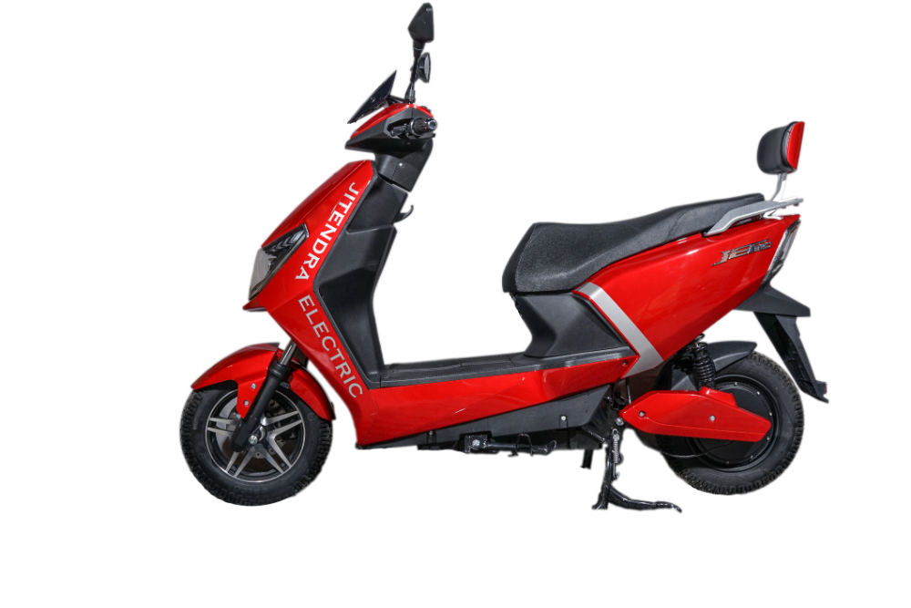
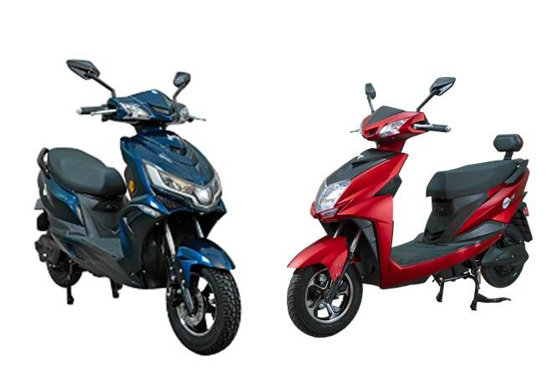
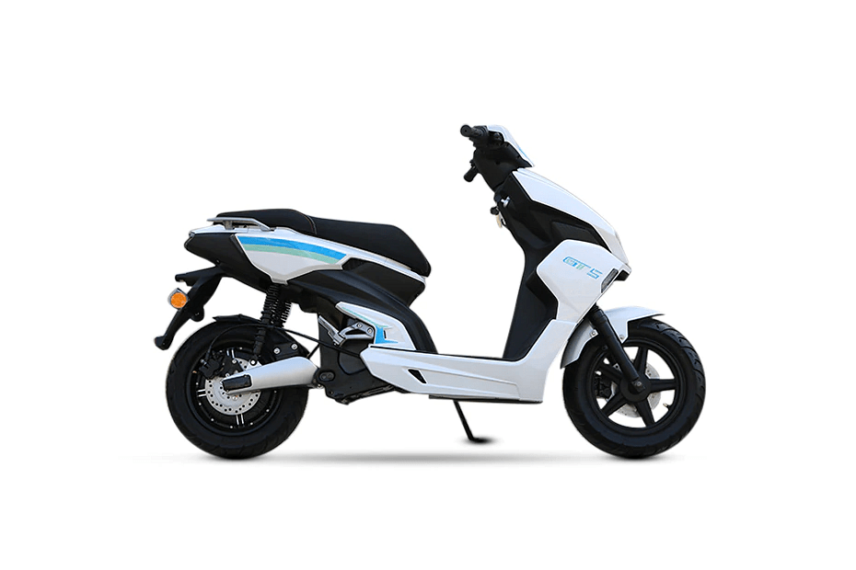
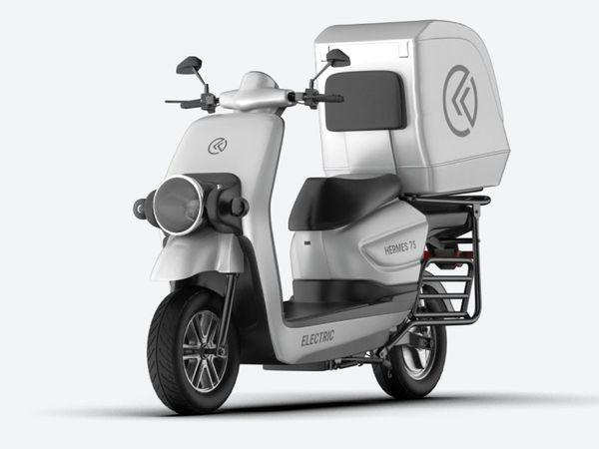
Annexure II: Key electric mobility facts and figures
19
5.92%
366
20
FAME-II target met
Number of EV OEMs in India
States proposed/adopted EV policies
As of June 2021
As of June 2021
As of June 2021
Note: Target of selling 1,562,000 EVs (2W, 3W, 4W and buses) under FAME-II scheme by FY22
EV sales per 1000 non-EV sales
Recent electric vehicle launches
Q1 FY22
61
7,28,131
Jitendra New EV Tech JET 320
Price: INR 72,000
Range: 72 - 80 km
Battery capacity: 20 / 26Ah
Tripura
35
EVs sold
Delhi
As of June 2021
HOP Lyf
21
Price: INR 65,500 onwards
Range: 75-125 km
Battery capacity: 1.44 / 2.52 kWh
Assam
21
White Carbon GT5
Karnataka
Price: INR 1,15,000
Range: 100 km
Battery capacity: 1.8 / 2.4 kWh
10
15.0–28.0Lakh INR
Uttar Pradesh
Kabira Mobility Hermes 75
Price: INR 89,600
Range: 120 km
Battery capacity: 2.4 kWh
Price range for an electric car (SUV)
Source: Vahan Sewa dashboard, CEEW Centre for Energy Finance Electric Mobility dashboard, Department of Heavy Industries, CEA.
cef.ceew.in

Slide 20
About us: CEEW is among Asia’s leading policy research institutions
20
cef.ceew.in

Slide 21
CEEW Centre for Energy Finance
21
Build evidence
Consistent, reliable, and up to date monitoring & analysis of clean energy markets – investment, payment schedules, market trends, etc.
Create coherence
Periodic convening of multi-stakeholder groups to deliberate on market activities in clean energy
Design solutions
Design and feasibility pilots of fit-for-purpose business models & financial solutions for clean energy solutions
cef.ceew.in

Slide 22
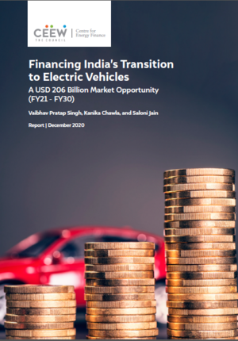
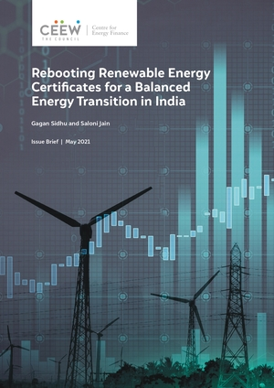
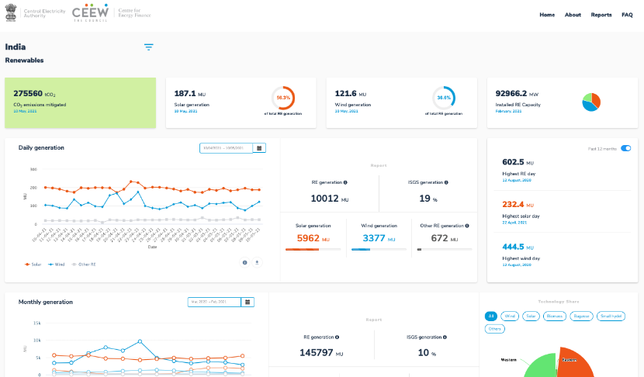
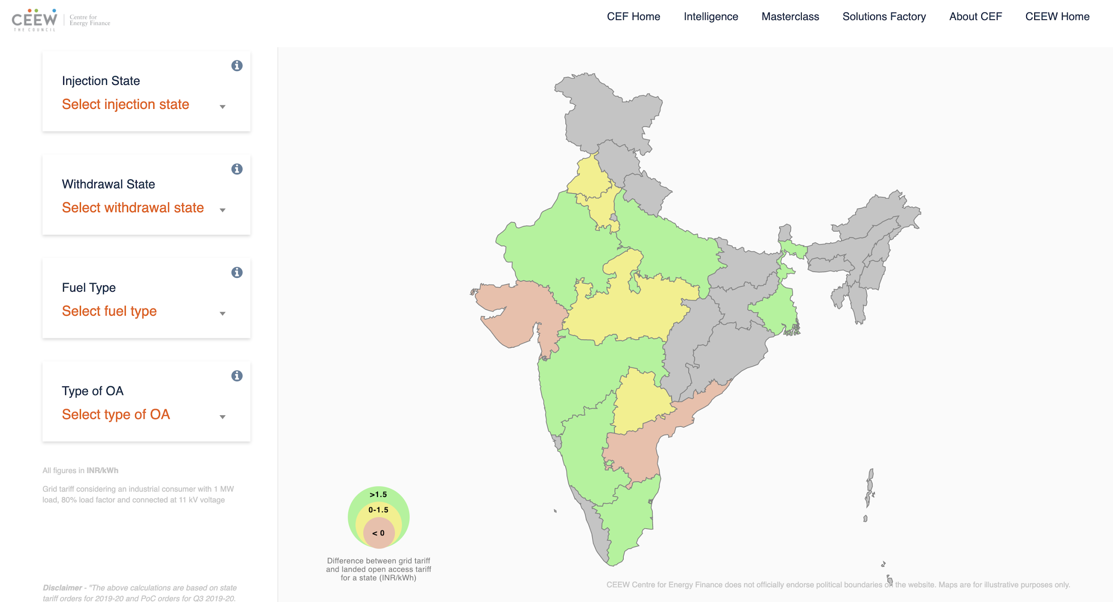
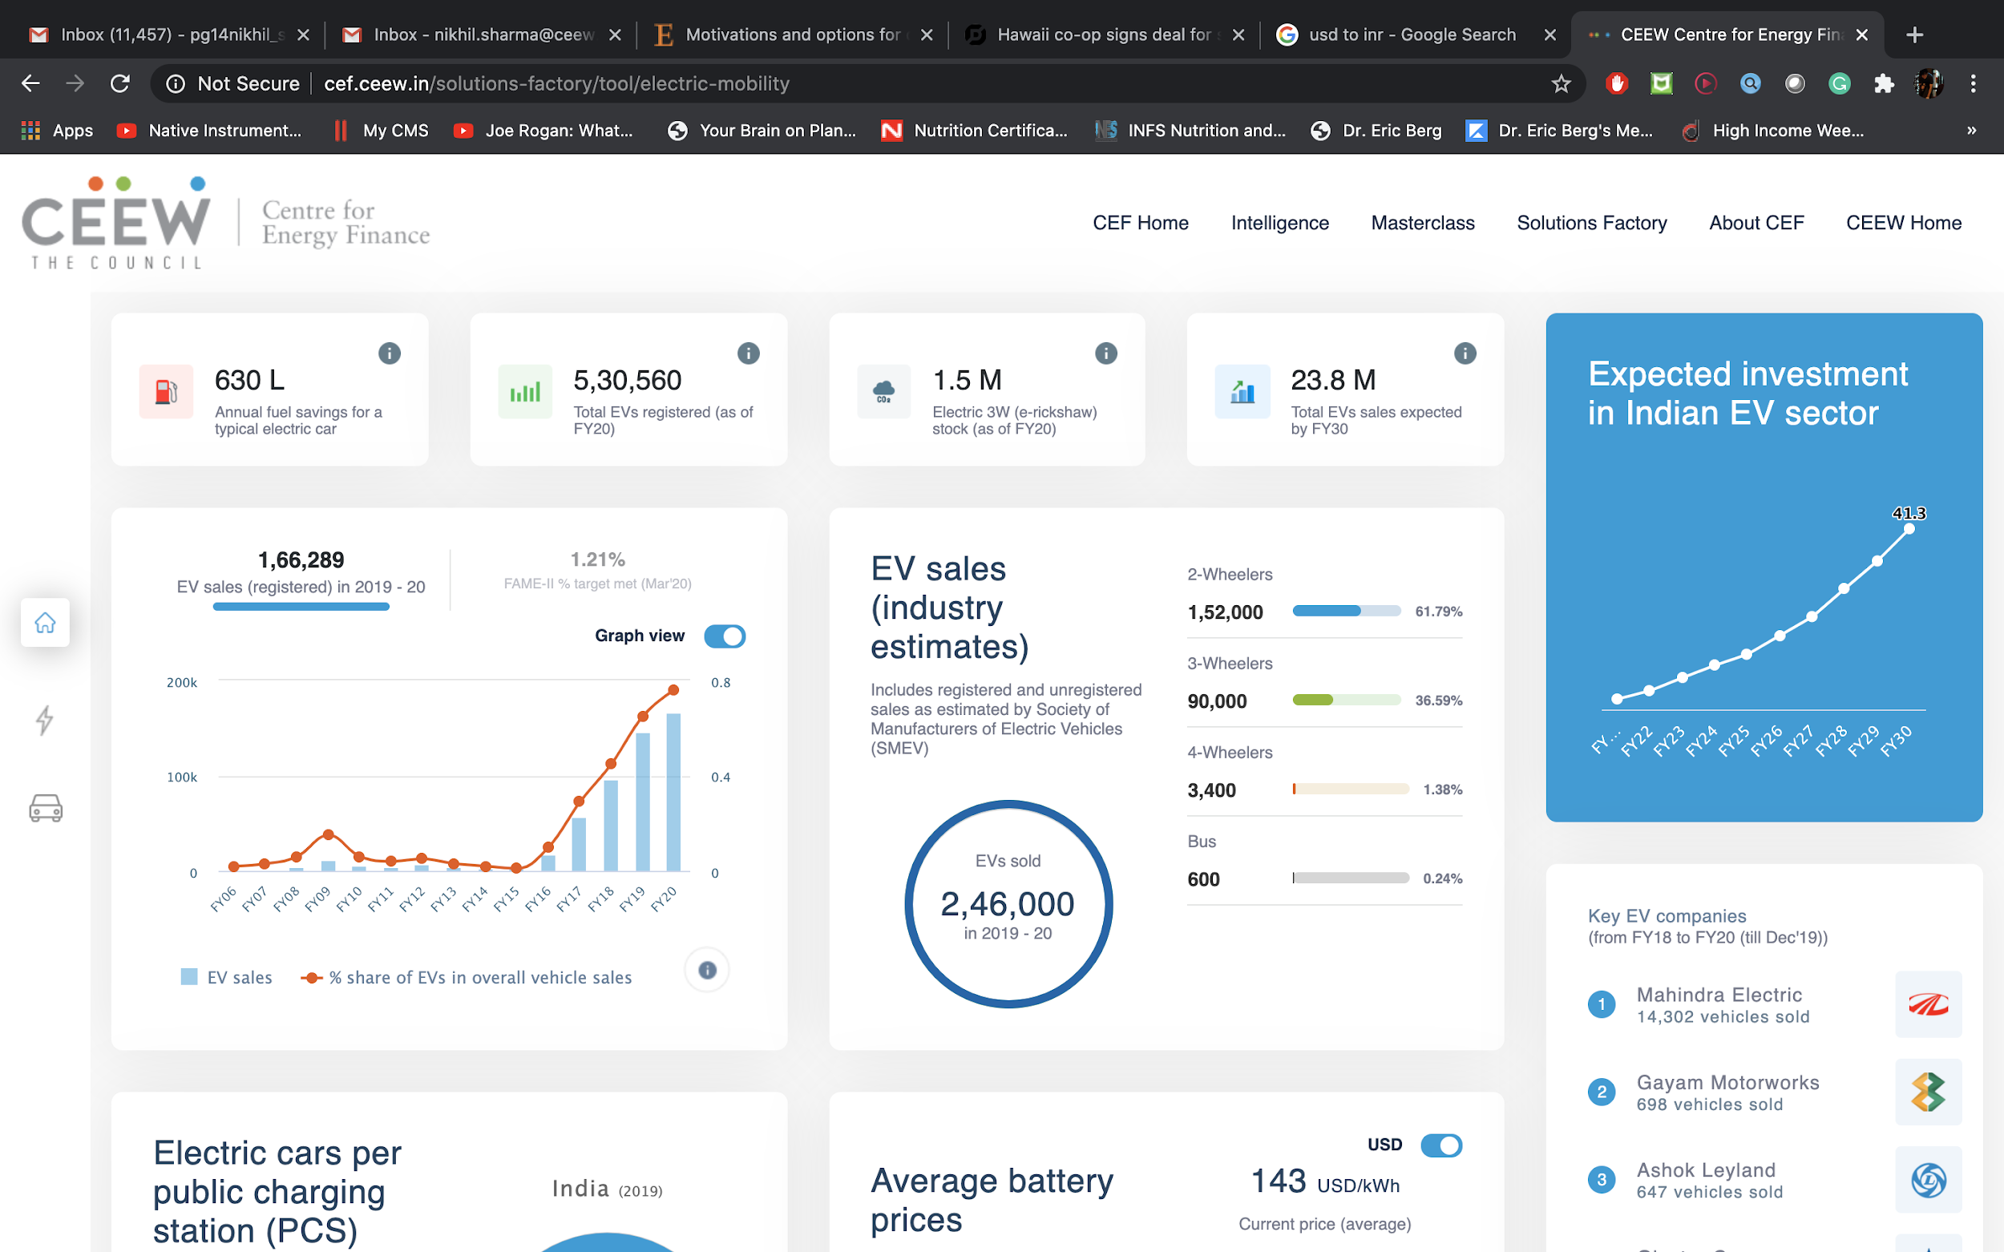
Our recent publications, dashboards and tools
22
Financing India’s Transition to Electric Vehicles
Mapping Costs for Early Coal Decommissioning in India
Laying the Groundwork for Electric Vehicle Roaming in India
Rebooting Renewable Energy Certificates for a Balanced Energy Transition in India
India Renewables Dashboard
Open Access Tool
Electric Mobility Dashboard
cef.ceew.in

