Slide 1
CEEW-CEF Market Handbook Q2 2021-22
Image: iStock
01 November 2021
© Council on Energy, Environment and Water 2021

Slide 2
CEEW-CEF Market Handbook
India is undergoing an energy transition from fossil-based to clean energy. Evidence-based decision-making can accelerate the process.
CEEW Centre For Energy Finance’s Market Handbook aims to help key investors, executives and policymakers with evidence-based decision-making by:
Identifying and analysing trends critical to India’s energy transition
Presenting data-backed evidence based on the most relevant indicators
Connecting the dots and presenting a short-term market outlook
The handbook attempts to comment and answer on some critical questions such as:
What is India’s generation capacity and energy mix?
What are the key trends in renewable energy (RE) tariffs?
What is the current situation of the discom payment delay situation?
How have the power market reforms progressed?
What are key trends in the electric vehicles (EV) and energy storage markets?
cef.ceew.in

Slide 3
Contents
Generation Capacity And Energy Mix
4
Coal Phase-Out
6
RE Auctions
7
Discom Payables
8
Power Markets
9
Policy and Regulatory Developments
10
Renewable Energy Finance
11
Energy Storage
14
Electric Mobility
15
Image: iStock
Annexures
17
20
About Us
cef.ceew.in

Slide 4
Generation capacity: Q2 FY22 sees highest ever RE capacity addition in last 14 quarters
4
Takeaways & Outlook
Around 4.7 GW of net capacity was added in Q2 FY22, most of which came from RE (4.6 GW).
The RE capacity added in Q2 FY22 was almost three times the capacity added in the same quarter in the last fiscal year (1.6 GW in Q2 FY21).
Compared to the previous quarter (Q1 FY22), RE capacity addition gained momentum in Q2 FY22 and was up by 82.9% (from 2.5 GW in Q1 FY22), owing to return to normalcy after the second wave of Covid-19.
In RE, solar (grid-scale and rooftop) continues to dominate, accounting for 3,940 MW (~86%) of the capacity addition in Q2 FY22.
Notable solar rooftop capacity continued to add in Q2 FY22 (538 MW) with the removal of the cap of 10 kW for net-metering consumers (revised to 500 kW) in the previous quarter Q1 FY22.
Source: Central Electricity Authority (CEA). *Includes solar (rooftop) capacity (5,574 MW as of September 2021).
Source: Ministry of New and Renewable Energy (MNRE).
cef.ceew.in

Slide 5
Energy mix: share of RE up from 10.7% in Q2 FY21 to 12.3% in Q2 FY22; notable solar capacity addition during Q2 FY22
5
Takeaways & Outlook
Total power generation for Q2 FY22 (378 billion kWh) was up by 9.1% compared to Q2 FY21 (348 billion kWh), with an improvement in economic activity and lower than normal monsoons* during July (94% of long period average (LPA)) and August 2021 (76% of LPA) leading to a higher power demand.
July: Up by 10.1%
August: Up by 16.2%
September: Up by 1.2%
Total Q2 FY22: Up by 9.1%
In Q2 FY22, RE generation ramped up notably by 24.6% versus the same quarter in the previous fiscal year (Q2 FY21), supported by a lower base due to a sharp reduction in wind speeds in the previous year. Coal/lignite based generation was up by 11.1% and hydro by 2.0% for the same period.
From a share of total generation perspective, hydro declined with an increase in RE and coal/lignite compared to Q2 FY21.
RE: Share up from 10.7% to 12.3%
Hydro: Share down from 17.6% to 16.5%
Coal/lignite: Share up from 65.1% to 66.2%
RE share snapshot
 | Q2 FY20 |  | Q2 FY21 |  | Q2 FY22
 | RE share % | Day | RE share % | Day | RE share % | Day
Highest | 15.8% | 9 July 2019 | 16.8% | 12 August 2020 | 19.2% | 1 August 2021
Lowest | 5.2% | 24 September 2019 | 6.1% | 2 September 2020 | 7.7% | 22 August 2021
Average (Daily) | 11.4% | NA | 10.7% | NA | 12.3% | NA
Source: POSOCO. Note: RE technologies include solar, wind, biomass, waste-to-energy and small hydro and do not include rooftop solar and large hydro (>25 MW) generation. * India Meteorological Department.
cef.ceew.in

Slide 6
Coal phase-out: PFC/REC continues to reduce its exposure to coal power generation
6
Takeaways & Outlook
590 MW of net coal capacity (additions less retirement) was added during Q2 FY22.
PFC/REC, one of the largest power sector financiers in India continues to reduce its exposure to coal power generation. The share of conventional generation in PFC/REC’s loan book is trending downward and substantially declined to 51% in Q4 FY21 from 58% in Q1 FY21 and remained same for Q1 FY22 at 51%.
To compensate, PFC/REC have diverted their focus to transmission and distribution (T&D) and RE generation projects (including large hydro), which account for around 38% (INR 1,41,780 crore) and 10% (INR 38,271 crore) of its total loan book as of Q1 FY22 versus 31% (INR 1,07,881 crore) and 11% (INR 37,005 crore) as of Q1 FY21, respectively.
Source: CEA.
Source: PFC investor presentations; figures are derived from the same. Note: Sector-wise break up of PFC loan asset data unavailable for Q2 FY22.
cef.ceew.in

Slide 7
RE auctions: highest ever RE capacity auctioned in a quarter; lowest tariff discovered for wind-solar hybrid at INR 2.34/kWh
7
Bid spotlight: SECI, wind-solar hybrid, tranche IV, 1,200 MW
Takeaways & Outlook
The overall capacity auctioned in Q2 FY22 attracted significant participation and was oversubscribed. It stood at 10.1 GW, nearly three times the capacity auctioned in the same quarter in the previous year (3.2 GW in Q2 FY21).
Although, the Covid-19 second wave slowed down the auctioned capacity in Q1 FY22 (425 MW), Q2 FY22 witnessed a notable growth. Solar continued to dominate with 7.2 GW auctioned capacity. 1.7 GW of wind-solar hybrid and 1.2 GW of wind capacity was also auctioned in Q2 FY22. Additionally, auction for a 20 MW solar PV with 20 MW/50 MWh BESS in Leh, got concluded.
Historically low tariffs were discovered for wind-solar hybrid projects in Q2 FY22, at INR 2.34 INR/kWh in a pan India 1,200 MW wind-solar hybrid auction. Solar tariffs are returning to Q4 FY21 levels, which may indicate lower risk perception among developers regarding the implementation of BCD on solar modules (25%) and solar cells (40%) with effect from April 2022.
In addition, SECI to sign PSA* with Andhra Pradesh for 9 GW capacity from a previously auctioned manufacturing-linked solar tender at a revised tariff of INR 2.49/ kWh.
Key auctions
(Q2 FY22)
Capacity allotted (MW)
Least tariff discovered (INR/kWh)
Tariff and winner
Tariff discovered: INR 2.34/kWh
Key provisions
Comments
Minimum capacity utilisation factor (CUF) requirement of 30% on an annual basis.
Provision to sell excess generation beyond declared CUF to SECI at 75% of the PPA tariff. Developer may sell the excess generation to any other entity, if SECI refuses to purchase it.
Winners: NTPC, NLC, Ayana Renewables, Azure Power
Oversizing of solar/wind capacities is allowed to utilise the optimisation potential offered by wind-solar hybridisation.
Power purchase assurance, PPA to be signed within 90 days from the date of issue of Letter of Award.
Hybrid power developers to factor imposition of basic customs duty (BCD) on imported solar modules cells with effect from April 2022.
IREDA, pan India, solar, CPSU tranche III, 5,000 MW (September 2021)
5,000
Not applicable (capped at INR 2.20/ kWh under VGF scheme)
SECI, Madhya Pradesh, wind, tranche XI, 1,200 MW (September 2021)
1.200
2.69
SECI, pan India, wind-solar hybrid, tranche IV, 1,200 MW (August 2021)
1,200
2.34
BREDA, Bihar, solar, 250 MW (August 2021)
200
3.11
Q2 FY22
RUMSL, Madhya Pradesh, solar, 500 MW (August 2021)
500
2.14
RUMSL, Madhya Pradesh, solar, 450 MW (July 2021)
450
2.33
RUMSL, Madhya Pradesh, solar, 550 MW (July 2021)
550
2.44
MSEDCL, pan India, wind-solar hybrid, 500 MW (July 2021)
500
2.62
MSEDCL, pan India, solar, 500 MW (July 2021)
500
2.42
Source: SECI and state renewable agencies. SECI = Solar Energy Corporation of India, MSEDCL = Maharashtra State Electricity Distribution Company Limited, RUMSL = Rewa Ultra Mega Solar Limited; BREDA = Bihar Renewable Energy Development Agency; IREDA = Indian Renewable Energy Development Agency Limited. *PSA = power supply agreement.
cef.ceew.in

Slide 8
Discom payables: amount overdue by discoms increased by 29% from June 2021 to September 2021
8
Takeaways & Outlook
The overdue amount payable by discoms to power producers increased by 29% in Q2 FY22 (INR 1,15,384 crore) compared to Q1 FY22 (INR 89,154 crore) and declined by 19% compared to Q2 FY21 (INR 1,41,830 crore).
In August 2021, the Ministry of Power (MoP) announced the amendments to Electricity (Late Payment Surcharge) Rules, 2021, mentioning that payments by a discom will first be adjusted towards late payment surcharge and thereafter, towards monthly charges, starting from the longest overdue.
The amended rules allow a power producer to sell power to any consumer or any other discom or power exchange, for the period of default by a discom. The rules are expected to ensure financial discipline among discoms, particularly the ones delaying payment to power producers (read a detailed analysis here).
For discoms in Maharashtra, Telangana, Madhya Pradesh, and Chhattisgarh, the payable days increased by more than a month in Q2 FY22 (versus Q2 FY21). However, for Uttar Pradesh, Haryana, Gujarat, Rajasthan, Assam and Uttarakhand, the payable days reduced.
Q2 FY22
↑ 29% 8.1%
↓19%
Q1 FY22
Q4 FY21
Q3 FY21
Q2 FY21
Source: PRAAPTI portal (Based on voluntary disclosure from power producers).
Source: UDAY portal (based on data disclosed by discoms as of 30 June 2021). *Data not available for these states; values derived from 2018–19/ 2019–20 financial reports.
Reforms-based and results-linked, revamped distribution sector scheme, approved in June 2021, aims to reduce AT&C losses to pan-India levels of 12-15% by 2024-25, reduce ACS-ARR gap to zero by 2024-25, and develop institutional capabilities for modern discoms.
cef.ceew.in

Slide 9
Power markets: record power demand in Q2 FY22 due to increased economic activity and lesser-than-normal monsoons; coal shortages led to soaring prices in power markets
9
Takeaways & Outlook
Peak power demand continued to soar in Q2 FY22 from the previous quarter and reached a new high of 203 GW in July 2021. In energy terms, demand saw an uptick of 21% in August 2021 (vs August 2019), owing to increased economic activity and lesser-than-normal monsoons.
The increase in power demand combined with coal supply shortages led to lower availability of thermal power plants which supply nearly 70% of India’s total electricity. With heavy rains in the coal mine belt of India, challenges were faced in transporting coal to the power plants. In addition, plants dependent on international coal supplies lowered imports due to high prices. All these factors led the discoms to look for alternate avenues such as day ahead market on the power exchanges, which led to soaring volumes and prices in August 2021.
With the government laying out a revised renewable energy certificate (REC) framework and expected launch of new green trading products in power exchanges, power markets may play an important role in India’s energy transition.
Source: CEA.
Source: Indian Energy Exchange (IEX). *Day ahead contingency.
Peak demand in Q2 FY22 consistently surpassed FY21 and FY20 levels, largely due to increased economic activity and lesser-than-normal monsoons. In energy terms, the demand saw a major uptick in August 2021 by 17.4% (vs August 2020) and 21% (vs August 2019).
Green term–ahead market (GTAM) observed consistent growth in traded volumes, attributed to peak RE season in Q2 FY22, resulting in increased participation from RE surplus discoms.
Source: IEX.
Source: IEX.
With an upswing in power demand in August 2021, discoms resorted to day-ahead market (DAM) which saw an increase in volumes by 48.3% (versus August 2020). Coal supply shortages and lack of thermal plant availability also contributed to the increase in volumes on DAM.
Thermal power shortage due to coal supply issues also translated into increase in volumes in the real-time market (RTM) and discoms tapped RTM to balance real time demand fluctuations.
cef.ceew.in

Slide 10
Policy and regulatory developments: MoP amended the REC mechanism; MNRE’s PLI Scheme for manufacturing of high-efficiency solar PV Modules received a remarkable response
10
Takeaways & Outlook
MoP issued the amendments in the existing REC mechanism to align it with the emerging changes in the power sector and promote new renewable technologies. According to recent amendments, RECs will now be traded without any floor or forbearance prices and will have perpetual validity. A liquid REC market is expected to particularly help corporates in meeting their green commitments.
MNRE’s Production-Linked Incentive (PLI) scheme for manufacturing of high-efficiency solar PV modules received a remarkable response. Bids of 56.8 GW capacity were submitted in IREDA’s tender to set up high-efficiency solar PV modules manufacturing capacities under it.
In the draft Deviation Settlement Mechanism (DSM) and Related Matters Regulations, 2021, CERC proposed a commercial mechanism to restrict the buyers and sellers from deviating from their scheduled drawal and injection of electricity. The deviation charges vary for generators (RE, run-of-river or general) and buyers (>400 MW, <400 MW or an RE-rich state).
Odisha announced electric vehicle (EV) policy
MoP’s draft Electricity (promoting renewable energy through Green Energy Open Access) Rules 2021
MoP issued amendments to Renewable Energy Certificate (REC) mechanism
In August 2021, Commerce & Transport Department, Government of Odisha, approved the EV policy.
The policy is applicable for a period of five years and targets to achieve 20% EV adoption across all vehicle registrations by 2025.
It includes both fiscal (interest free loans, reimbursement of GST, etc.) and financial (subsidies) incentives on purchase of EVs.
It also provide financial incentives to small and micro EV battery manufacturers and on installation of EV charging infrastructure.
MoP circulated the draft Electricity (promoting renewable energy through Green Energy Open Access) Rules, 2021 for comments.
Proposed waiver of additional surcharge for RE open access and capping the increase in cross subsidy surcharge by 50% for 12 years from RE project commissioning.
Proposed monthly banking with a cap on annual energy banked of 10% of electricity consumption from the discom.
In September 2021, MoP announced the amendments to the existing REC mechanism after extensive stakeholder consultation.
Salient features of revamped REC mechanism include perpetual validity of RECs instead of 1,095 days (extended time to time).
The floor and forbearance prices are removed.
The amended mechanism has a provision of technology multiplier to promote the new and high priced RE technologies.
RECs can be issued to obligated entities that purchase RE power beyond their RPO compliance.
Although no RECs can be issued to the beneficiary of subsidies/ concessions or waiver of any other charges.
Additionally, traders and bilateral transactions are allowed in the REC mechanism.
CERC issued the draft Deviation Settlement Mechanism (DSM) and Related Matters Regulations, 2021
MNRE updated List – I under ALMM* order for solar PV modules
In September 2021, MoP announced the draft Deviation Settlement Mechanism (DSM) and Related Matters Regulations, 2021.
It proposes a commercial mechanism to ensure the grid’s security and stability. For an RE generator and a buyer from an RE-rich state, zero deviation charges will be applied for over injection and under drawal, respectively.
In Q2 FY22, MNRE updated the list-1 under ALMM twice. First, it increased the manufactures to 26 with a capacity of 8,367 MW.
Further, in September 2021, increased it to 34 manufacturers (all domestic) with a capacity of 8,874 MW.
Source: CEEW-CEF Compilation. *ALMM = Approved List of Models and Manufacturers; MNRE = Ministry of New and Renewable Energy; PM-KUSUM = Pradhan Mantri Kisan Urja Suraksha evam Utthaan Mahabhiyan; CERC = Central Electricity Regulatory Commission.
cef.ceew.in

Slide 11
Renewable energy finance: Q2 FY22 auctions included diverse bidders; foreign equity flowing in the Indian RE market
11
Notable deals (Q2 FY22)
62%
Takeaways & Outlook
Q2 FY22 was a significant quarter for auctioned RE capacity, with 10.1 GW of RE capacity auctioned (versus 3.2 GW in Q2 FY21). The quarter saw a notable increase in participation from developers (both private as well as public sector) and resulted in a market concentration of 62% (versus 100% for Q1 FY22).
PSUs including NTPC (2,765 MW), SJVN Ltd (1,200 MW), NHPC (1,000 MW) and NLC (1,500) dominated the market accounting for 5 GW of the capacity auctioned under IREDA’s CPSU scheme. Among private players, SolarArise and O2 Power continued to bid aggressively to establish themselves in the Indian renewable energy market but couldn’t win a sizeable capacity.
In Q2 FY22, deal activity primarily consisted of equity investments and acquisitions in the clean energy sector. With the acquisition of L&T Uttaranchal Hydropower Ltd (99 MW), ReNew Power entered the hydropower sector to provide storage solutions for innovative tenders (RTC, assured peak power, etc.). Acquisition of Fotowatio Renewable Ventures by IndiGrid is the first RE acquisition by any InvIT in India.
Acquisition
Target: Surya Vidyut (a subsidiary of CESC Ltd.) Acquirer: Torrent Power Amount: INR 790.7 crore (USD 107.5 million)
Q2 FY22
September
2021
Market concentration in auctioned RE capacity
Asset acquisition
Target: L&T (Hydro asset), NA (Solar asset)
Acquirer: ReNew Power
Amount: INR 2824.5 crore (USD 384 million)
Note: Market concentration is calculated as the ratio of the top five RE capacities auctioned to the total RE capacity auctioned.
.
August
2021
Equity investment
Company: CleanMax Investor: Augment Infrastructure Amount: INR 1634.6 crore (USD 222.23 million)
Developer-wise RE capacity auctioned during Q2 FY22 (10,120 MW)
August
2021
Equity investment
Target: AMP Energy
Investor: Copenhagen Infrastructure New Markets Fund
Amount: : INR 735.5 crore (USD 100 million)
July
2021
July
2021
Equity investment
Target: Avaada Investor: Global Power Synergy Public Company (GPSC) Amount: INR 3334.2 crore (USD 453.29 million)
July
2021
Acquisition
Target: Fotowatio Renewable Ventures Acquirer: IndiGrid Amount: INR 661.9 crore (USD 90 million)
2,190
Source: CEEW-CEF Compilation.
Source: CEEW Centre for Energy Finance.
cef.ceew.in

Slide 12
Renewable energy finance: most share prices remained high as investors showed interest in RE stocks
12
Takeaways & Outlook
In July 2021, share price of pure-play RE developer Adani Green Energy fell amidst reports of NSDL* freezing the accounts of three foreign funds that own sizeable stakes in the Adani Group of companies. With a clarification from NSDL on the account freezing not being related to the Adani Group, the price rallied in August and September 2021.
The share price of solar EPC company Sterling and Wilson Solar rallied up as solar capacity additions picked up notably in Q2 FY22. Borosil Renewables (India’s only solar glass manufacturer), set to double its manufacturing capacity by July 2022, continued to garner investor interest. Suzlon Energy and Inox Wind share prices also sustained high levels with the announcement of Q1 FY22 results during Q2 FY22. Suzlon Energy nearly doubled its revenue in Q1 FY22 (vs Q1 FY21). On the other hand, Inox Wind saw a 74% increase in its revenue for Q1 FY22 (vs Q1 FY21).
In August 2021, ReNew Power became the first Indian renewable energy entity to be listed on Nasdaq**. In addition, Waaree Energies filed draft papers in September 2021 to raise funds via IPO with a fresh issue of INR 1,350 crore.
Q1 FY22
Q2 FY22
Source: Money Control. * National Securities Depository Limited. **Nasdaq is an American stock exchange.
cef.ceew.in

Slide 13
Renewable energy finance: lowest coupon rate green bond issuance at 3.575% per annum
13
Takeaways & Outlook
Indian RE developers have traditionally headed towards the international green bonds market to tap low-cost finance due to low liquidity and credit rating constraints in the Indian bond market.
The international market saw the lowest-ever coupon rate (3.575%) achieved by an Indian RE developer. The green bond was raised by Azure Power, proceeds of which are to refinance an earlier green bond issued in 2017.
The market also saw a new entrant, Acme Solar, in Q2 FY22 with a USD 334 million issuance. In July 2021, Vector Green Energy issued green bonds worth INR 1,237 crore (USD 165 million) at a coupon rate of 6.49%. Interestingly, it is the first AAA- rated green bond in the domestic market. While Greenko and ReNew Power remain the leading issuers among Indian developers, new developers (Continuum Green Energy, Hero Future Energies, JSW Hydro and Acme Solar) made their debut in the international green bond market in 2021 (see annexure I).
No notable fluctuations were observed in the RE bond yields in Q2 FY22.
Q1 FY22
Q2 FY22
Source: Reserve Bank of India, State Bank of India, Trading Economics, Money Control and BondEvalue. * Current yield.
cef.ceew.in

Slide 14
Energy storage: RE plus storage tenders announced in India; Delhi inaugurated first urban microgrid system
14
Urban microgrid system - solar plus battery energy storage system (BESS)
India’s recent energy storage tenders
Takeaways & Outlook
Q2 FY22 saw two notable tenders in the energy storage sector. GSECL announced a solar plus BESS tender in Gujarat for a 35 MW solar and 57 MWh BESS capacity. In the solar rooftop segment, Bihar Renewable Energy Development Agency (BREDA) invited bids for 1 MW hybrid (solar plus BESS) rooftop solar projects.
In Q2 FY22, in SECI’s 20 MW solar with 50 MWh BESS tender (floated in December, 2020) in Leh, UT of Ladakh, Tata Power emerged as the winner. The total cost of the project is estimated at ~INR 386 crore. Although, many BESS tenders from the previous quarters are yet to get concluded due to multiple deadline extensions.
Q2 FY22 saw the commissioning of a first-of-its-kind urban microgrid in Delhi to address the challenges associated with increasing share of RE in the electricity grid. The microgrids can play a critical role in supplying reliable power and enhancing grid flexibility.
Project location & tender issue date | Application & technology | Details
Gujarat (GSECL), September 2021 | 35 MW solar with 57 MWh BESS | Expected bid conclusion in Q3 FY22
Greater Noida, Uttar Pradesh (NTPC), June 2021 | 4 MW solar with 1 MW/1 MWh BESS | Expected bid conclusion in Q3 FY22
Maharashtra (REMCL), June 2021 | 15 MW solar with 7 MW/14 MWh BESS, (Railway Land) | Under evaluation, expected bid conclusion in Q3 FY22
Tamil Nadu (TANGEDCO), February 2021 | 1 MW (AC) solar power project with a 3 MWh (BESS) | Expected bid conclusion in Q3 FY22
Chhattisgarh (SECI), September 2020, | 100 MW solar with 120 MWh BESS | Expected bid conclusion in Q3 FY22 (extended)
Pan India (SECI), March 2020 | 2,500 MW solar, wind, storage, others (thermal, hydro, etc.) hybrid in RTC manner | Bid submitted in September 2021, expected bid conclusion in Q3 FY22 (extended)
Leh & Kargil (SECI), January 2020 | 14 MW solar with 42 MWh BESS | Expected results in Q3 FY22 (extended)
Urban microgrid (Solar PV+BESS) system (September 2021), New Delhi, India
BSES Rajdhani Power Ltd. (BRPL), a discom in New Delhi, India commissioned a first-of-its-kind urban microgrid system connected to low voltage distribution network in Delhi.
The project was implemented under the Indo-German Solar Partnership Project (IGSEP).
It consists of a 100 kWp solar PV with 466 kWh lithium-ion BESS. The system is coupled with an electric vehicle charging station.
The total project cost is nearly INR 5.5 crore.
The microgrid has several unique benefits. It generates ~1.5 lakh units of clean energy annually and can provide a reliable power-back for up to two hours. Through this, it will offset 115 tons of CO2 emissions and avoid usage of about 30 metric tons of coal.
In terms of project design, the solar PV modules are installed on an elevated carport structure.
Source: BSES Rajdhani press release (September 2021).
Source: SECI and state renewable agencies.
cef.ceew.in

Slide 15
Electric mobility: highest ever monthly sales of EVs in September 2021
15
Takeaways & Outlook
Overall electric vehicle (EV) and hybrid vehicle sales recovered from the Q1 FY22 dip and reached a historical high in Q2 FY22 (up by 265%). EV sales in September 2021 were the highest for a month till now, significantly exceeding even the pre-Covid levels. From the share of overall vehicle sales perspective, EVs and hybrid vehicles were 3.43% for the month of September 2021, the highest ever till now.
Increased economic activity and the extension of FAME II scheme for two-years (in the previous quarter) contributed to the sharp rise in sales.
OEMs with highest EV sales* in Q2 FY22 were:
2W: Hero Electric (15,688), Okinawa (8,701) and Ather Energy (5,584)
3W: Y.C. Electric (3,774), Mahindra Electric (1,948) and BAJAJ Auto (1,895)
4W: Tata Motors (2,289), Mahindra Electric (797) and MG Motors (984)
Q1 FY22
Q2 FY22
Source: Vahan Sewa dashboard (includes only registered vehicles, unregistered vehicles include low-speed vehicles (< 25 km/hr), e-rickshaws (three-wheelers) and electric two-wheelers), Electric Mobility Dashboard (2021), CEEW Centre for Energy Finance. *Based on sales data for Q2 FY22.
cef.ceew.in

Slide 16
Thank you
You can find us at cef.ceew.in | @CEEW_CEF
Authors
Ruchita Shah (ruchita.shah@ceew.in)
Nikhil Sharma (nikhil.sharma@ceew.in)
Meghna Nair (meghna.nair@ceew.in)
Shreyas Garg (shreyas.garg@ceew.in)
Reviewers
Gagan Sidhu (gagan.sidhu@ceew.in)
Rishabh Jain (rishabh.jain@ceew.in)
cef.ceew.in

Slide 17
Annexure I: Green bond issuances (last 2 years)
17
Date | Company | Size (USD million) | Sector | Coupon rate (%) | Rating | Tenor (Years) | Purpose
September 2021 | Adani Green Energy | 750 | Solar and wind | 4.375% | Ba3 (Moody) | 3 | Fund equity portion of capital expenditure for under-construction projects
August 2021 | Azure Power | 414 | Solar | 3.575% | Not available | 5 | Refinance existing higher cost green bond debt
July 2021 | Acme Solar | 334 | Solar | 4.70% | Not available | 5 | Refinancing of existing debt
July 2021 | Vector Green Energy | 165 | Solar | 6.49% | AAA (CRISIL, India Ratings) | 3 | Refinance existing high-cost debt of solar projects
May 2021 | JSW Hydro | 707 | Hydro | 4.50% | BB+ (EXP) (Fitch) | 10 | Repayment of existing green project-related rupee-denominated debt
April 2021 | ReNew Power | 585 | Solar and wind | 4.50% | BB- (Fitch) | 7.25 | Refinancing of existing debt
March 2021 | Greenko | 940 | Solar and wind | 3.85% | BB (Fitch) | 5 | Redemption of previous fund raise
March 2021 | Hero Future Energies | 363 | Solar and wind | 4.25% | BB- (Fitch) | 6 | Refinancing of existing debt
February 2021 | ReNew Power | 460 | Solar and wind | 4.00% | BB- (Fitch) | 6 | Refinancing of existing debt
February 2021 | Continuum Green Energy | 561 | Solar and wind | 4.50% | BB+ (Fitch) | 6 | Refinancing of existing debt
October 2020 | CLP Wind Farms | 40 | Wind | Not available | AA (India Ratings) | 2 to 3 | Refinancing of existing debt
October 2020 | ReNew Power | 325 | Solar and wind | 5.375% | BB- (Fitch) | 3.5 | Refinancing high-cost local debt
Source: Climate Bonds Initiative and company press releases.
cef.ceew.in

Slide 18
Annexure I: Green bond issuances (last 2 years)
18
Date | Company | Size (USD million) | Sector | Coupon rate (%) | Rating | Tenor (Years) | Purpose
January 2020 | ReNew Power | 450 | Solar and wind | 5.875% | BB-/Stable (Fitch) | 5 | Refinancing of maturing debt
October 2019 | Adani Green Energy | 362.5 | Solar and wind | 4.625% | BBB- (Fitch) | 20 | Repaying foreign currency loans and rupee borrowings
September 2019 | ReNew Power | 90 | Solar and wind | 6.67% | BB (Fitch) | 4.5 | Refinancing of existing debt
September 2019 | Greenko | 85 | Solar and wind | 5.95% | BB- (Fitch) | 6.75 | Refinancing of existing debt
September 2019 | Azure power | 350 | Solar | 5.65% | BB (Fitch) | 5 | Refinancing of existing debt
September 2019 | ReNew Power | 300 | Solar and wind | 6.45% | Ba2 (Moody's) | 5 | Capacity expansion and repaying high cost debt
August 2019 | Greenko | 85 | Solar and wind | 6.25% | Ba1 (Moody’s) | 3.5 | Refinancing of solar and wind projects
August 2019 | Greenko | 350 | Solar and wind | 6.25% | Ba1 (Moody’s) | 3.5 | Refinancing of solar and wind projects
July 2019 | Greenko | 450 | Solar and wind | 5.95% | BB (Fitch) | 7 | Refinancing of solar and wind projects
July 2019 | Greenko | 500 | Solar and wind | 5.55% | BB (Fitch) | 5.5 | Refinancing of solar and wind projects
Source: Climate Bonds Initiative and company press releases.
cef.ceew.in

Slide 19
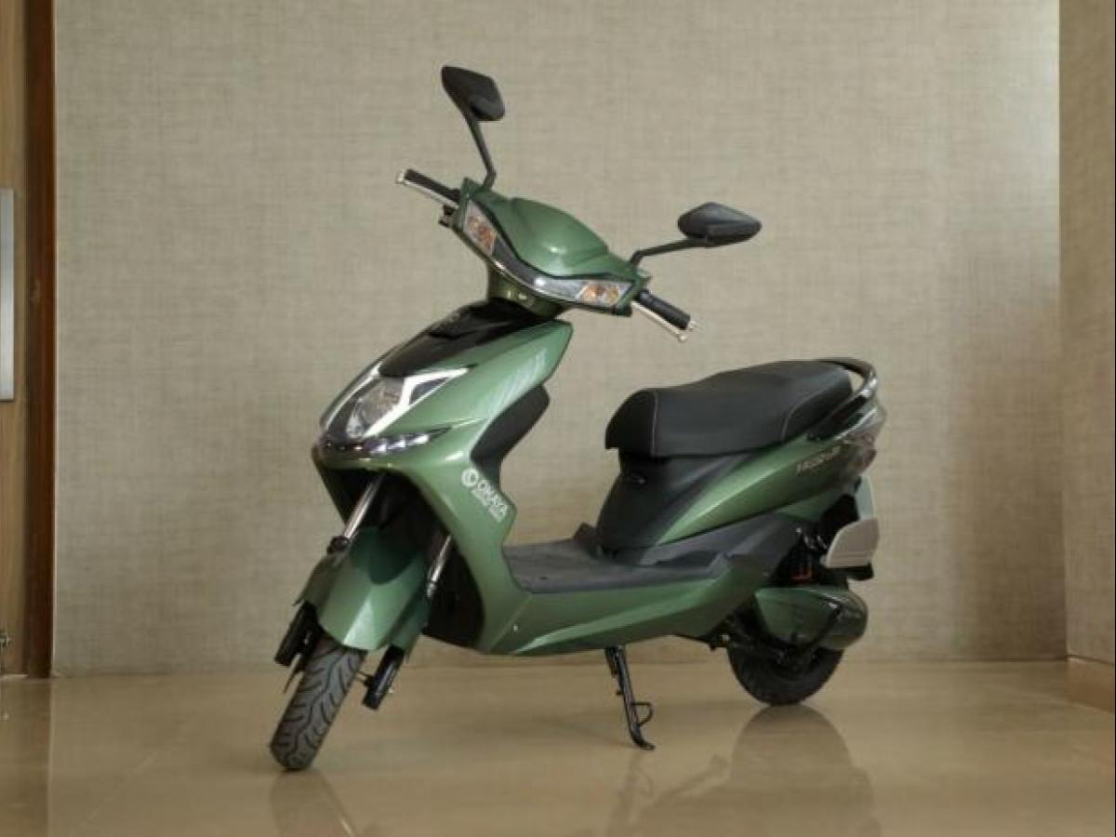
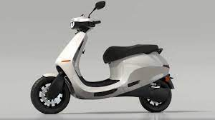
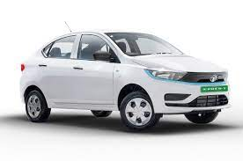
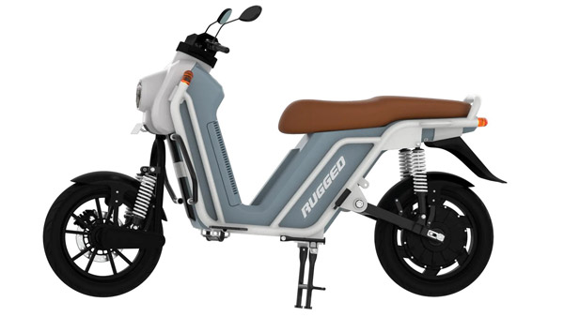
Annexure II: Key electric mobility facts and figures
19
6.45%
441
143
FAME-II target met
Number of EV OEMs in India
Total FAME II approved models
As of October 2021
As of October 2021
As of October 2021
Note: Target of selling 1,562,000 EVs (2W, 3W, 4W and buses) under FAME-II scheme by FY22
EV sales per 1000 non-EV sales
7,59,182
Recent electric vehicle launches
As of October 2021
63
Okaya Freedum LI-2 and LA-2
Price: INR 69,999 onwards
Range: 50 - 80 km
Battery capacity: 48/30Ah
Delhi
EVs sold
53
As of October 2021
Tripura
Ola S1 and Ola S1 Pro
32
Price: INR 99,999 onwards
Range: 121 - 181 km
Battery capacity: 2.98 – 3.97 kWh
Karnataka
32
46.8%
3.9%
Tata Tigor EV Facelift
Assam
Price: INR 11,99,000 onwards
Range: 306 km
Battery capacity: 26 kWh
29
Uttarakhand
Share of 2W and 4W in total EVs sold in FY22
Tata EBikeGo Rugged
As of October 2021
Price: INR 79,999 onwards
Range: 160 km
Battery capacity: 3 kWh
For more updates visit CEEW-CEF Electric Mobility Dashboard
Source: Vahan Sewa dashboard, CEEW Centre for Energy Finance Electric Mobility dashboard, Department of Heavy Industries, CEA.
cef.ceew.in

Slide 20
About us: CEEW is among Asia’s leading policy research institutions
20
cef.ceew.in

Slide 21
CEEW Centre for Energy Finance
21
Build evidence
Consistent, reliable, and up to date monitoring & analysis of clean energy markets – investment, payment schedules, market trends, etc.
Create coherence
Periodic convening of multi-stakeholder groups to deliberate on market activities in clean energy
Design solutions
Design and feasibility pilots of fit-for-purpose business models & financial solutions for clean energy solutions
cef.ceew.in

Slide 22
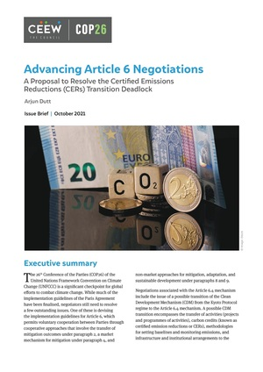
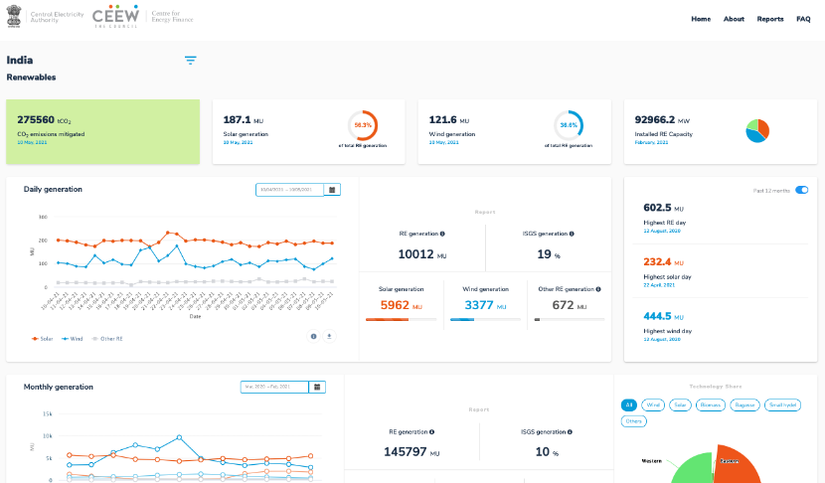
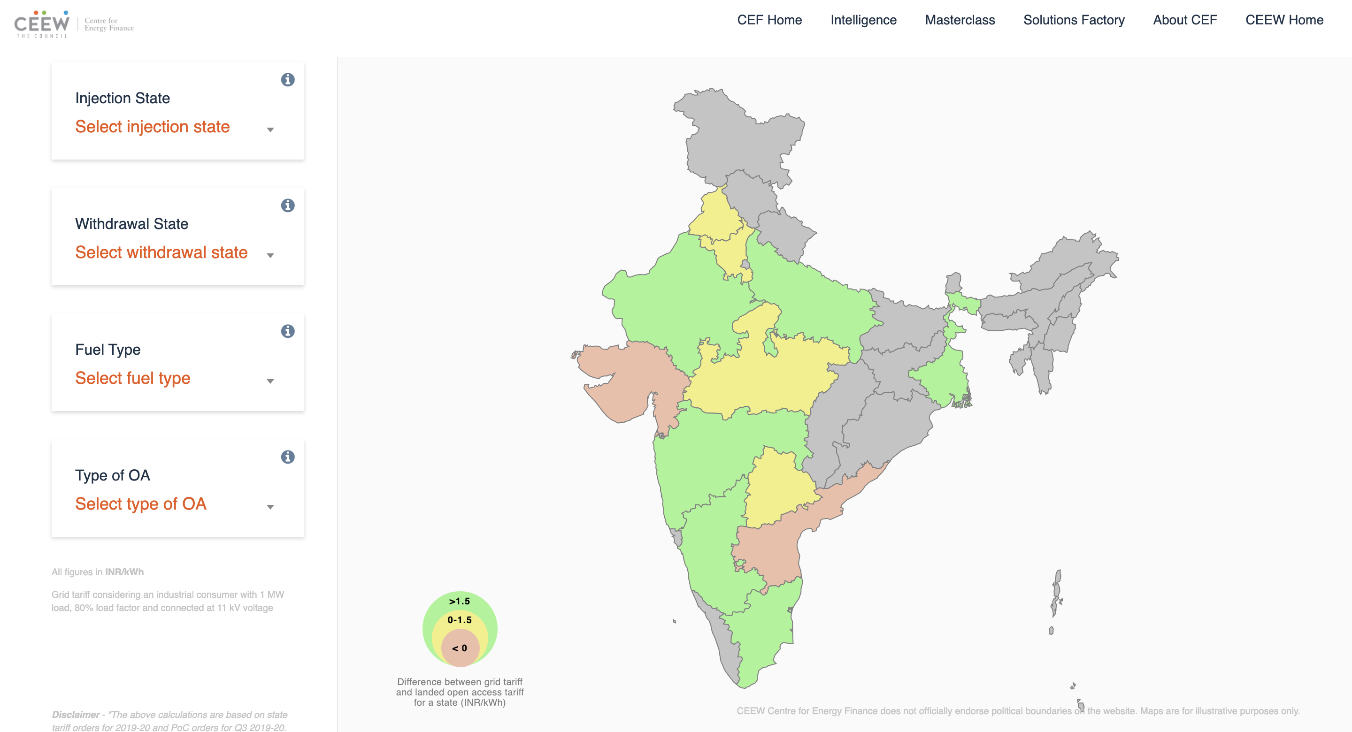
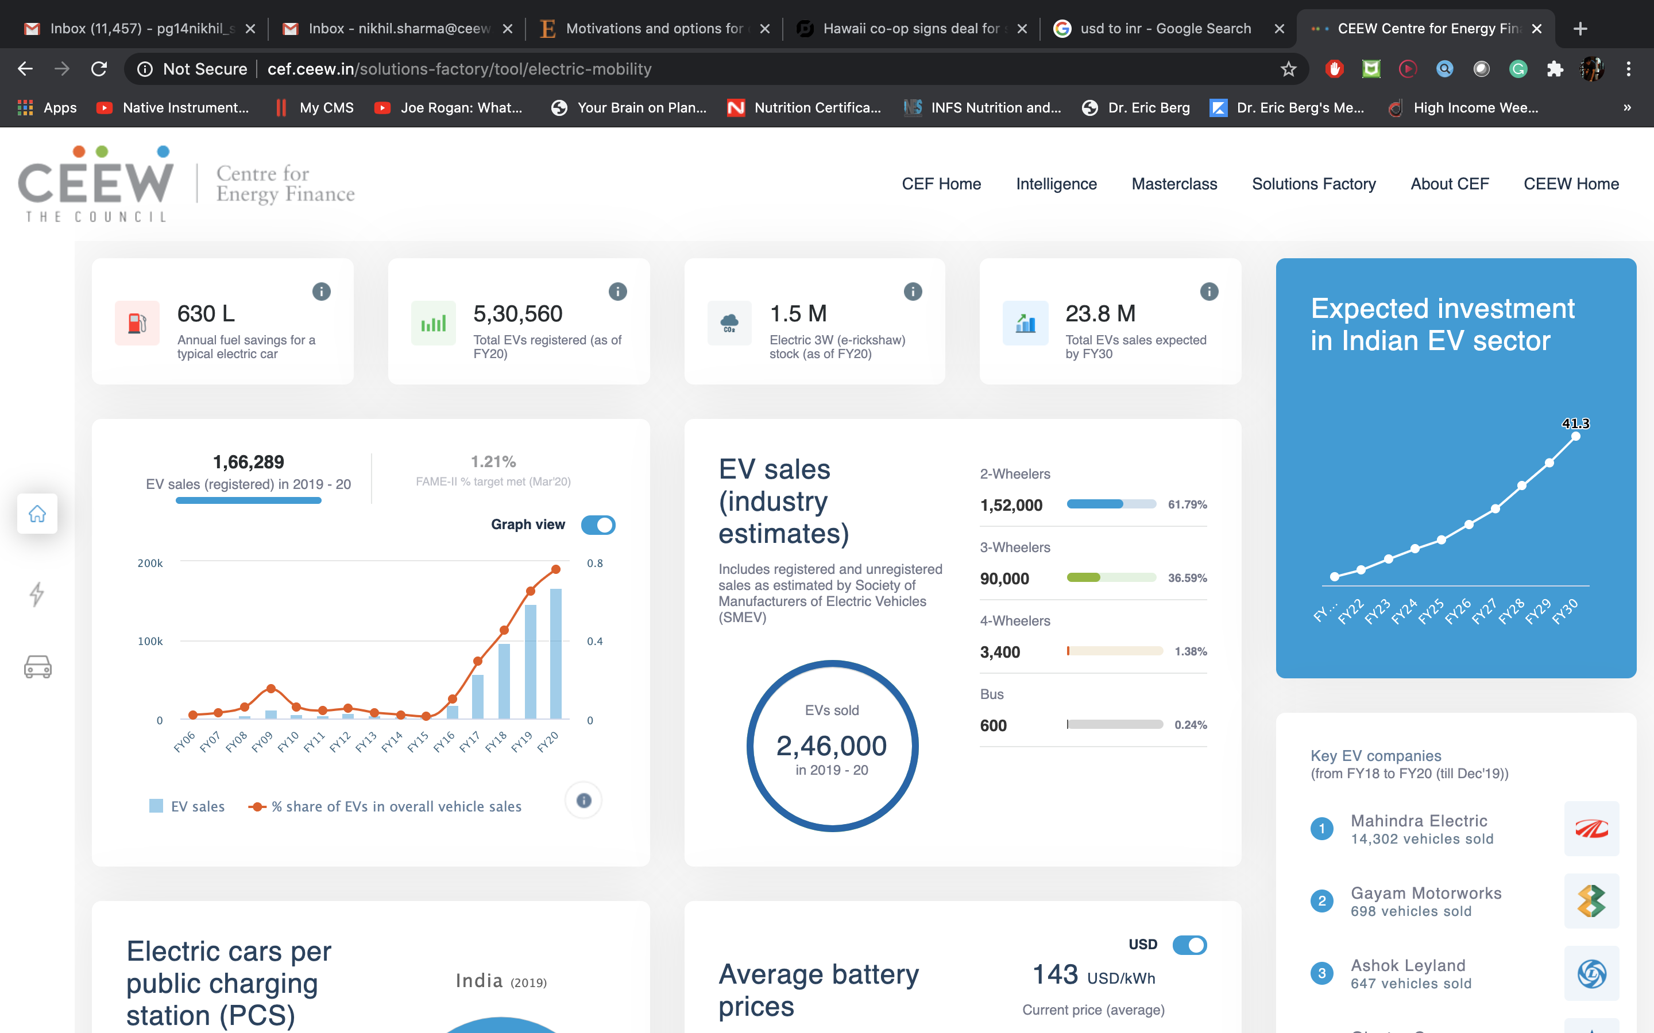
Our recent publications, dashboards and tools
22
Advancing Article 6 Negotiations
Financing India’s Energy Transition Through International Bond Markets
Mapping Costs for Early Coal Decommissioning in India
Laying the Groundwork for Electric Vehicle Roaming in India
India Renewables Dashboard
Open Access Tool
Electric Mobility Dashboard
cef.ceew.in

