Slide 1
CEEW-CEF Market Handbook Q3 2021-22
Image: iStock
10 February 2022
© Council on Energy, Environment and Water 2022

Slide 2
CEEW-CEF Market Handbook
India is undergoing an energy transition from fossil-based to clean energy. Evidence-based decision-making can accelerate the process.
CEEW Centre For Energy Finance’s Market Handbook aims to help key investors, executives and policymakers with evidence-based decision-making by:
Identifying and analysing trends critical to India’s energy transition
Presenting data-backed evidence based on the most relevant indicators
Connecting the dots and presenting a short-term market outlook
The handbook attempts to comment and answer on some critical questions such as:
What is India’s generation capacity and energy mix?
What are the key trends in renewable energy (RE) tariffs?
What is the current situation of the discom payment delay situation?
How have the power market reforms progressed?
What are key trends in the electric vehicles (EV) and energy storage markets?
cef.ceew.in

Slide 3
Contents
Generation Capacity And Energy Mix
4
Coal Phase-Out
6
RE Auctions
7
Discom Payables
8
Power Markets
9
Policy and Regulatory Developments
10
Renewable Energy Finance
11
Energy Storage
14
Electric Mobility
15
Image: iStock
Annexures
17
20
About Us
cef.ceew.in

Slide 4
Generation capacity: 3.4 GW of RE capacity was added in Q3 FY22; the share of RE in the overall capacity was 26.7%
4
Takeaways & Outlook
4.5 GW net capacity was added in Q3 FY22, most of which came from renewable energy (RE).
The RE capacity added in Q3 FY22 (3.4 GW), although 27% lower than in the previous quarter (4.6 GW in Q2 FY22), was 79% higher than that of the same quarter of the last fiscal year (1.9 GW in Q3 FY21).
Solar energy (grid-scale and rooftop) continues to dominate within RE, accounting for 3.1 GW (~92%) of the RE capacity addition in Q3 FY22 with the wind energy at 212 MW.
Significant solar rooftop capacity added in Q3 FY22 (700 MW) compared to Q3 FY21 (289 MW) after the removal of the cap of 10 kW on net-metering in Q1 FY22 (revised to 500 kW).
In November 2021, India committed to achieving a target of net-zero emissions by 2070 at COP26 in Glasgow. To achieve this goal, India aims to raise its non-fossil fuel-based capacity to 500 GW by 2030. In Q2 FY22, RE reached the 100 GW mark. In Q3 FY22, the cumulative non-fossil fuel-based installed capacity stood at 151.4 GW.
Source: Central Electricity Authority (CEA). *Includes solar (rooftop) capacity (6,185.9 MW as of December 2021).
Source: Ministry of New and Renewable Energy (MNRE).
cef.ceew.in

Slide 5
Energy mix: share of RE remained unchanged in Q3 FY22 versus Q3 FY21; the Government of India committed to source 50% of energy through RE by 2030
5
Takeaways & Outlook
The total power generation decreased by 12% in Q3 FY22 (333 billion kWh) compared to Q2 FY22 (affected by lower-than-normal monsoons* and improved economic activities), and increased by 2.7% in comparison to Q3 FY21 (324 billion kWh).
October: Up by 2.8%
November: Up by 2.4%
December: Up by 3.0%
Total Q3 FY22: Up by 2.7%
In Q3 FY22, RE generation increased by 3.5% versus the same quarter in the previous fiscal year (Q3 FY21). Coal/lignite based generation was up by 3.3% and hydro by 13.3% for the same period.
From a share in total generation perspective, hydro, RE and coal/lignite have increased marginally compared to Q3 FY21.
RE: Share up from 9.0% to 9.1%
Hydro: Share up from 9.9% to 11.0%
Coal/lignite: Share up from 74.1% to 74.5%
Interestingly, one of India's five commitments at COP26 was sourcing 50% of its energy through RE by 2030.
RE share snapshot
 | Q3 FY20 |  | Q3 FY21 |  | Q3 FY22
 | RE share % | Day | RE share % | Day | RE share % | Day
Highest | 11.7% | 17 December 2019 | 12.4% | 27 November 2020 | 12.6% | 18 October 2021
Lowest | 5.3% | 11 October 2019 | 6.5% | 29 October 2020 | 7.0% | 23 December 2021
Average (Daily) | 8.0% | NA | 9.0% | NA | 9.1% | NA
Source: POSOCO. Note: RE technologies include solar, wind, biomass, waste-to-energy and small hydro and do not include rooftop solar and large hydro (>25 MW) generation. * India Meteorological Department.
cef.ceew.in

Slide 6
Coal phase-out: PFC/REC continues to reduce its exposure to conventional power generation with an increased focus on financing T&D projects
6
Takeaways & Outlook
2,095 MW* of coal capacity was added in Q3 FY22 with no capacity retired during this period. The new coal capacity was commissioned in the states of Rajasthan (state sector), Tamil Nadu (private sector) and Bihar (central sector).
PFC/REC, one of India's largest power sector financiers, continues to reduce its exposure to coal power generation. The share of conventional generation in PFC/REC’s loan book is trending downward and declined to 49% in Q2 FY22 from 51% in Q1 FY22 and 58% in Q2 FY21.
To compensate, PFC/REC have diverted their focus to transmission and distribution (T&D) and RE generation projects (including large hydro). This account for around 40% (INR 1,49,904 crore) and 10% (INR 37,240 crore) of its total loan book as of Q2 FY22 versus 34% (INR 1,21,922 crore) and 11% (INR 37,515 crore) as of Q2 FY21, respectively. PFC/REC’s overall gross loan assets haven’t observed any noticeable change during that period.
Source: CEA.
Source: PFC investor presentations; figures are derived from the same. Note: Sector-wise break up of PFC loan asset data unavailable for Q3 FY22. *coal capacity of 900 MW was converted to captive mode.
cef.ceew.in

Slide 7
RE auctions: SECI’s RE + thermal round-the-clock (RTC) power bid concluded with lowest tariff quoted at INR 3.01/ kWh
7
Bid spotlight: SECI, pan India,
RE + Thermal, RTC-II, 2,500 MW
Takeaways & Outlook
Auctioned capacity stood at 4,785 MW, over 1.5 times the capacity auctioned in Q3 FY21 (2,970 MW). The overall capacity auctioned in Q3 FY22 attracted significant participants, including a few thermal project developers. SECI’s 1,785 MW solar tender in Rajasthan (Tranche-IV) was oversubscribed by 9.3 GW.
The capacity auctioned in Q3 FY22 declined notably compared to Q2 FY22 (10.1 GW), the highest-ever auctioned capacity in a quarter. Solar (1,885 MW) continued to dominate the auctioned capacity along with 2,500 MW RTC RE + thermal category.
Despite the concerns around the implementation of basic customs duty (BCD), supply chain constraints, increased module prices, and ALMM* obligations, solar tariffs continued to trend downwards, with the lowest tariff discovered at INR 2.17/kWh.
Solar module (mainly global) prices continued to remain high in Q3 FY22 due to an increase in the cost of raw materials. Module prices surged to INR 21 /Wp (~USD 0.28 /Wp) in Q3 FY22 Vs INR 15 /Wp (~USD 0.20 /Wp) in Q3 FY21.
Key auctions
(last six months)
Capacity allotted (MW)
Least tariff discovered (INR/kWh)
Tariff and winner
Tariff discovered: INR 3.01/kWh
Key provisions
Round-the-clock energy supply with a combination of thermal and any RE resource(s) (as defined by MNRE).
Comments
Winners: Greenko, Hindustan Thermal Projects, ReNew Samir Urja, JSW New Energy, Power Mech Projects
Bundling a conventional power plant with a renewable resource address the issues associated with RE such as intermittency in RE power projects, limited power supply hours, and under utilisation of transmission infrastructure.
The projects can be located anywhere in India with multiple injection points within the same region. Excess generation can be supplied to the SECI/discom(s), any third party or sold in the power exchanges.
Minimum 51% of annual energy supplied to be from renewable energy sources.
SECI, Chhattisgarh, solar+BESS, 40 MW/120MWh (December 2021)
100 (Solar)
NA
SECI, Rajasthan, solar,
1785 MW (December 2021)
1,785
`
2.17
Q3 FY22
PSPCL, Punjab, solar, 250 MW (November 2021)
100
2.69
MSEDCL, pan India, wind, 300 MW (October 2021)
300
3.43
SECI, pan India, RE + Thermal, RTC-II, 2,500 MW
(October 2021)
2,500
3.01
SECI, Madhya Pradesh, wind, tranche XI, 1,200 MW (September 2021)
SECI, Madhya Pradesh, wind, tranche XI, 1,200 MW (September 2021)
1,200
2.69
SECI, pan India, wind-solar hybrid, tranche IV, 1,200 MW (August 2021)
1,200
2.34
Q2 FY22
RUMSL, Madhya Pradesh, solar, 500 MW (August 2021)
500
2.14
MSEDCL, pan India, wind-solar hybrid, 500 MW
(July 2021)
500
2.62
Source: SECI and state renewable agencies. SECI = Solar Energy Corporation of India, MSEDCL = Maharashtra State Electricity Distribution Company Limited, RUMSL = Rewa Ultra Mega Solar Limited; PSPCL = Punjab State Power Corporation Limited; BESS = battery energy storage system; ALMM* = Approved List of Models and Manufacturers.
cef.ceew.in

Slide 8
Discom payables: discoms overdues increased by 7% in Q3 FY22
8
Takeaways & Outlook
The overdue amount payable by discoms to power producers increased by 7% in Q3 FY22 (INR 1,23,657 crore) compared to Q2 FY22 (INR 1,15,384 crore) but declined by 14% compared to Q3 FY21 (INR 1,43,116 crore).
In December, MoP issued the draft Electricity (Late Payment Surcharge and related matters) rules, 2021 and proposed to repeal the Electricity (Late Payment Surcharge) Rules, 2021 issued previously (refer slide 10 for details).
In December 2021, the MoP notified the progress of Revamped Distribution Sector Scheme (RDSS) - reforms-based and result-linked (issued in June 2021). Meghalaya and Assam emerged as frontrunners in planning their operational and financial reforms. To date, 39 out of 55 beneficiary discoms have submitted their draft proposals.
For discoms in Tamil Nadu, Karnataka, Rajasthan, Madhya Pradesh, Telangana, Andhra Pradesh and Chhattisgarh, the payable days decreased by more than a month in Q3 FY22 (versus Q3 FY21). However, for Maharashtra, the payable days increased.
Q3 FY22
↑ 7% 8.1%
↓14%
Q2 FY22
Q1 FY21
Q4 FY21
Q3 FY21
Source: PRAAPTI portal (Based on voluntary disclosure from power producers).
Source: UDAY portal (based on data disclosed by discoms as of 30 June 2021). *Data not available/updated for these states; values derived from 2018–19/ 2019–20 financial reports.
Reforms-based and results-linked, revamped distribution sector scheme, approved in June 2021, aims to reduce AT&C losses to pan-India levels of 12-15% by 2024-25, reduce ACS-ARR gap to zero by 2024-25, and develop institutional capabilities for modern discoms.
cef.ceew.in

Slide 9
Power markets: green day ahead market introduced in power exchanges; REC trading resumed after 16 months
9
Takeaways & Outlook
Although lesser than the previous quarter, peak power demand continued to soar to 183.4 GW in Q3 FY22 due to improved economic activity,
In energy terms, demand saw a slight uptick (3.3% in October, 2.5% in November and 2.9% in December) in Q3 FY22 (vs Q3 FY21).
On 24 November 2021, IEX resumed renewable energy certificates (REC) trading. Overall, 5,08,098 solar and 33,20,132 non-solar RECs were traded in Q3 FY22 at an average price of INR 2,106 /MWh and INR 1,000 /MWh for solar and non-solar, respectively.
Further, the Central Electricity Regulatory Commission (CERC) approved IEX and PXIL’s petitions to introduce a new green trading segment under the integrated day ahead market segment – green day ahead contract (GDAC) or green day-ahead market (GDAM) on their trading platforms. After commencement, GDAM attracted 93 and 105 participants and achieved 150 million and 157 million units at a weighted average price of INR 3.72 /kWh and INR 4.09 /kWh during November and December, respectively.
Source: CEA.
Source: Indian Energy Exchange (IEX). *Day ahead contingency.
Peak demand in Q3 FY22 consistently surpassed Q3 FY21 and Q3 FY20 levels, with improvement in commercial and industrial activity. In energy terms, the demand saw a slight uptick of 3% in Q3 FY22 (vs Q3 FY21).
Green term–ahead market (GTAM) observed consistent growth in traded volumes. It attracted 46, 29 and 39 participants in October, November and December respectively, across a balanced mix of RE rich and RE deficits states.
Source: IEX.
Source: IEX.
In October, the anticipated thermal power shortage led to an upswing in price and demand in the day-ahead market (DAM); after various supply-side interventions by the government such as improved domestic coal availability and enhanced transport, the prices stabilised in mid-Q3 FY22.
In October, due to the anticipated thermal power shortage, the real-time market (RTM) witnessed an increase in traded volumes. Since its inception, discoms are tapping RTM for power demand-supply balancing in real-time.
cef.ceew.in

Slide 10
Policy and regulatory developments: 6 GW capacity selected under MNRE’s PLI Scheme for manufacturing solar PV modules; curtailment of RE to receive monetary compensation
10
Takeaways & Outlook
In October, the MoP issued the Electricity (Timely Recovery of Costs due to Change in Law) Rules, 2021. It provided a formula to calculate the adjustment in the monthly tariff due to the impact of Change in Law. In December, the MoP issued draft Electricity (Late Payment Surcharge and related matters) rules, 2021 and proposed to repeal the previously issued Electricity (Late Payment Surcharge) Rules, 2021. Overall, Q3 FY22 was encouraging for RE generators.
In Q3, IREDA announced the winners and waitlist of the Production-Linked Incentive (PLI) scheme for manufacturing solar PV modules. To date, three winners are selected under PLI scheme; Shirdi Sai Electricals (2 GW, INR 1,875 crore), Reliance New Energy Solar (2 GW, INR 1,917 crore) and Adani Infrastructure Private Limited (2 GW, INR 663 crore (in the process)).
In March 2021, the MNRE issued the first list of models and module manufacturers under the ALMM. Initially, 23 module manufacturers were enlisted. After its launch, the list has been updated four times to now include 41 domestic module manufacturers and includes none of the foreign module manufacturers.
MoP announced Electricity (Promotion of Generation of Electricity from Must-Run Power Plant) Rules, 2021
Revised scheme for flexibility in generation and scheduling of thermal/hydro power plants
MoP issued draft Electricity (Late Payment Surcharge and related matters) rules, 2021
In October 2021, the MoP notified the Electricity (Promotion of Generation of Electricity from Must-Run Power Plant) Rules, 2021.
It reiterated that must-run power plants shall not be subjected to curtailment except for technical constraints or grid security reasons.
Added a clause of compensation payable by the procurer in the event of curtailment and allowed the generator to sell the unscheduled electricity in the power exchange.
Introduced a provision of intermediary procurers to buy power for discoms through transparent bidding.
In November 2021, MoP and MNRE released a revised scheme to allow bundling of thermal/ hydropower projects with RE projects.
It will allow the discoms to procure RE power under the existing PPA to meet their renewable purchase obligation (RPO).
Tariff for a co-located RE project will be decided by an appropriate commission or through competitive bidding.
No additional transmission charges will be levied for bundling of a co-located/ nearby RE power plant.
In December 2021, the MoP issued the draft Electricity (Late Payment Surcharge and related matters) rules, 2021.
It includes late payment surcharge rates; adjustment towards late payment surcharge; and liquidation arrears.
In addition, it recommends on how to operationalise the payment security mechanism and its consequences; regulation of access to defaulting entities; supply obligation on generators; power not requisitioned; and order of payment and adjustment towards late payment surcharge.
Goa announced electric vehicle (EV) policy
MNRE issued the RLMM of wind turbines
MNRE updated List – I under ALMM* order for solar PV modules
In December, Goa adopted the EV policy Goa Electric Mobility Promotion Policy-2021 with a target to boost EV adoption to 30% by 2025. It aims to create 10,000 direct and indirect jobs by 2025.
It will provide purchase incentives, scrapping incentives, and interest subvention on loans.
In Q3 FY22, the MNRE updated the list-1 under ALMM. First, in November, it increased the number of manufacturers to 39 with a capacity of 10,819 MW. Further in December, increased it to 41 manufacturers with a capacity of 10,906 MW.
In December, the MNRE released the RLMM of wind turbines (revised time-to-time) to include 15 manufacturers and 35 wind turbine models. It includes both domestic and international manufacturers.
Source: CEEW-CEF Compilation. *ALMM = Approved List of Models and Manufacturers; MNRE = Ministry of New and Renewable Energy; IREDA = Indian Renewable Energy Development Agency Limited.
cef.ceew.in

Slide 11
Renewable energy finance: Q3 FY22 auctions included multiple bidders; deal activity in solar manufacturing
11
Notable deals (Q3 FY22)
76%
Takeaways & Outlook
Q3 FY22 was an appreciable quarter for auctioned RE capacity, with 4,785 MW auctioned (versus 2,970 MW in Q3 FY21). The quarter saw a notable increase in participation from both private and public sector developers and resulted in a market concentration of 76% (versus 62% for Q2 FY22).
The quarter witnessed new market entrants; Hindustan Thermal Projects (250 MW) and Power Mech Projects (550 MW) won in the SECI’s RTC II bid. PSUs, including NTPC (500 MW) and SJVN Ltd (100 MW), continued to emerge as winners this quarter as well.
In Q3 FY22, deal activity primarily consisted of acquisitions in the solar module/cell manufacturing sector and solar asset acquisitions. By acquiring REC Solar Holdings, Reliance New Energy Solar will gain a foothold in the global solar PV manufacturing market. Further, in a strategic disinvestment move, the Government of India intends to sell CEL, a domestic solar cell and module manufacturing CPSU.
Asset acquisition
Target: Ayana Renewables (250 MW solar project) Acquirer: Acme Solar Amount: -
Q3 FY22
December
2021
Market concentration in auctioned RE capacity
Debt investment
Target: Rural Electrification Corporation Ltd.
Investor: KfW Development Bank
Amount: INR 1257.1 crore (USD 169.5 million)
Note: Market concentration is calculated as the ratio of the top five RE capacities auctioned to the total RE capacity auctioned.
.
December
2021
Acquisition (yet to finalise)
Company: Central Electronics Limited (CEL) Acquirer: Nandal Finance and Leasing Private Ltd. Amount: INR 210 crore (USD 28.02 million)
Developer-wise RE capacity auctioned during Q3 FY22 (4,785 MW*)
November
2021
Debt investment
Target: Cleantech Solar
Investor: NIIF Infrastructure
Amount: INR 198.2 crore (USD 26.72 million)
October
2021
October
2021
Debt investment
Target: Vector Green Investor: Indian Renewable Energy Development Agency Ltd. Amount: INR 1100 crore (USD 184 million)
October
2021
Acquisition
Target: REC Solar Holdings Acquirer: Reliance New Energy Solar Amount: INR 5717.9 crore (USD 771 million)
5,370
Source: CEEW-CEF Compilation.
Source: CEEW Centre for Energy Finance. *includes 2,500 MW RE+thermal RTC-II
cef.ceew.in

Slide 12
Renewable energy finance: in contrast to a lacklustre Indian share market during Q3 FY22, most RE stocks continued to rally up
12
Takeaways & Outlook
Despite a 1.5% decline in the market (Sensex), most RE stocks in India continued to garner investor interest during Q3 FY22.
Borosil Renewables was up by 102% during Q3 FY22 and continues to hold a monopoly position in India’s solar glass manufacturing industry.
Suzlon Energy and Inox Wind share prices also sustained high levels with the announcement of Q2 FY22 results during Q3 FY22. Suzlon Energy nearly doubled its revenue in Q2 FY22 (vs Q2 FY21). On the other hand, Inox Wind saw a 34% increase in its revenue for Q2 FY22 (vs Q2 FY21).
With a net loss reported for the previous quarter (Q2 FY22), Azure Power, an Indian solar project developer listed on New York Stock Exchange, saw a decline in share prices during Q3 FY22. Meanwhile, Adani Green, a solar/wind developer listed in India, continued to gain investor interest with a consistent increase in its quarterly revenues.
In October 2021, Reliance New Energy Solar announced a 40% acquisition in Sterling and Wilson Solar, a solar EPC company in India.
Q1 FY22
Q2 FY22
Q3 FY22
Source: Money Control.
cef.ceew.in

Slide 13
Renewable energy finance: bond yields largely remained flat with the exception of NTPC in Q3 FY22
13
Takeaways & Outlook
In the last three quarters, the international market witnessed a tremendous rise in green and sustainability-link bond (SBL)** issuance. It includes the USD 3.1 billion green bonds issued by RE developers such as Greenko, ReNew Power, Acme Solar, and Adani Green Energy. Additionally, JSW Steel and Adani Electricity Mumbai Limited raised USD 1.3 billion through SLB.
Although no new green bonds were issued in Q3 FY22, raising funds through green bonds appears promising for the RE sector in India.
In the previous quarter, the international market saw the lowest-ever coupon rate (3.575%) achieved by an Indian RE developer, Azure Power. Additionally, Vector Green Energy issued green bonds worth INR 1,237 crore (USD 165 million) at a coupon rate of 6.49% which is the first AAA-rated green bond in the domestic market.
Apart from the NTPC bond, no notable fluctuations were observed in RE bond yields in Q3 FY22.
Q1 FY22
Q2 FY22
Q3 FY22
Source: Reserve Bank of India, State Bank of India, Trading Economics, Money Control and BondEvalue. * Current yield. **SLBs are issued with specific sustainability performance targets that include predefined key performance indicators (KPIs) and allow a diverse set of issuers to obtain financing via this route.
cef.ceew.in

Slide 14
Energy storage: RE plus storage tenders announced in India; one of the world’s largest solar-charged BESS commissioned in the U.S.
14
Battery energy storage system (BESS) with solar for peak power supply
India’s recent energy storage tenders
Takeaways & Outlook
Q3 FY22 saw two notable storage tenders in India. REMCL* announced a pan-India 150 MW RE with thermal, hydro, gas, or energy storage tender for RTC supply, and SECI released a draft RfS for 500 MW/1000 MWh standalone BESS.
In Q3 FY22, SECI concluded a 100 MW solar with 120 MWh BESS tender (floated in September 2020) and Tata Power solar emerged as the winner. In addition, winners of SECI’s long-pending pan India 2,500 MW RTC II (RE with thermal, hydro, gas or energy storage) bid were declared in Q3 FY22, with Hindustan Thermal Projects emerging as the lowest bidder at INR 3.01/kWh.
In December 2021, Florida Power and Light Company (FPL) unveiled one of the world’s largest solar-powered BESS in Florida, U.S., with a BESS capacity of 409 MW/ 900 MWh and a solar capacity of 74.5MW. The energy storage can provide a backup of more than two hours for approximately 3,29,000 homes.
Project location & tender issue date | Application & technology | Details
Pan India (REMCL*) November 2021 | 150 MW RE, thermal, hydro and gas with energy storage in RTC manner | RfS released in Q3 FY22, bid conclusion expected in Q4 FY22
Rajasthan (SECI) October 2021 | 500 MW/1000 MWh standalone BESS (ESS-I) | Draft RfS released in Q3 FY22, bid conclusion expected in Q4 FY22
Gujarat (GSECL), September 2021 | 35 MW solar with 57 MWh BESS (EPC) | Bid conclusion expected in Q4 FY22
Greater Noida, Uttar Pradesh (NTPC), June 2021 | 4 MW solar with 1 MW/1 MWh BESS | Bid conclusion expected in Q4 FY22
Maharashtra (REMCL), June 2021 | 15 MW solar with 7 MW/14 MWh BESS, (railway land) | Under evaluation, bid conclusion expected in Q4 FY22
Tamil Nadu (TANGEDCO), February 2021 | 1 MW (AC) solar power project with a 3 MWh (BESS) | Bid conclusion expected in Q4 FY22
Leh & Kargil (SECI), January 2020 | 14 MW solar with 42 MWh BESS | Results expected in Q4 FY22 (extended)
Grid-connected solar plus BESS project awarded (December 2021),
Chhattisgarh India.
In December 2021, the SECI awarded a contract to Tata Power Solar Systems Limited for setting up a 100 MW solar with 40 MW/120 MWh BESS project in Rajnandgaon, Chhattisgarh, India.
It will be one of the largest grid-connected BESS projects in the country. It aims to demonstrate the use of large battery storage systems like BESS to supply solar power during evening peak hours.
The project is backed by the World Bank and SECI's internal resources and domestic loans.
The cost of the awarded project is estimated at INR 944.7 crore, which includes design, supply & installation (DSI) costs with taxes & duties, and O&M cost for 10 years.
Source: Press Information Bureau, India (December 2021).
Source: SECI and state renewable agencies. RfS = request for selection. *REMCL = Railway Energy Management Company Limited.
cef.ceew.in

Slide 15
Electric mobility: highest ever monthly EV sales in December 2021
15
Takeaways & Outlook
EV sales continued to grow in Q3 FY22 with an increase of 283% vs Q3 FY21. Also, Q3 FY22 observed a gain of 47% vs Q2 FY22, EV sales crossed the 50,000 mark in December 2021, the highest for a month till now.
In terms of the share of overall vehicle sales, EV sales were 2.76% of the total vehicle sales in Q2 FY22, the highest so far in any quarter. Further, in the total 3W and bus sales, the share of EV 3Ws was 48% and that of EV buses was 11.4%, respectively.
A surge in fuel prices along with the remodelling and extension of the FAME II scheme for two years (in June 2021) has contributed to the consistent growth in EV sales.
OEMs with the highest EV sales* in Q3 FY22 were:
2W: Hero Electric (19,448), Okinawa (15,554) and Ather Energy (6,661)
3W: Y.C. Electric (5,876), Mahindra Electric (2,413) and Saera Electric Auto Pvt. Ltd. (2,845)
4W: Tata Motors (4,838), Mahindra Electric (1,720) and MG Motors (514)
Source: Vahan Sewa dashboard (includes only registered vehicles, unregistered vehicles include low-speed vehicles (< 25 km/hr), e-rickshaws (three-wheelers) and electric two-wheelers), Electric Mobility Dashboard (2021), CEEW Centre for Energy Finance. *Based on sales data for Q3 FY22.
cef.ceew.in

Slide 16
Thank you
You can find us at cef.ceew.in | @CEEW_CEF
Authors
Ruchita Shah (ruchita.shah@ceew.in)
Nikhil Sharma (nikhil.sharma@ceew.in)
Meghna Nair (meghna.nair@ceew.in)
Shreyas Garg (shreyas.garg@ceew.in)
Reviewers
Gagan Sidhu (gagan.sidhu@ceew.in)
Rishabh Jain (rishabh.jain@ceew.in)
cef.ceew.in

Slide 17
Annexure I: Green bond issuances (last 2 years)
17
Date | Company | Size (USD million) | Sector | Coupon rate (%) | Rating | Tenor (Years) | Purpose
September 2021 | Adani Green Energy | 750 | Solar and wind | 4.375% | Ba3 (Moody) | 3 | Fund equity portion of capital expenditure for under-construction projects
August 2021 | Azure Power | 414 | Solar | 3.575% | Not available | 5 | Refinance existing higher cost green bond debt
July 2021 | Acme Solar | 334 | Solar | 4.70% | Not available | 5 | Refinancing of existing debt
July 2021 | Vector Green Energy | 165 | Solar | 6.49% | AAA (CRISIL, India Ratings) | 3 | Refinance existing high-cost debt of solar projects
May 2021 | JSW Hydro | 707 | Hydro | 4.50% | BB+ (EXP) (Fitch) | 10 | Repayment of existing green project-related rupee-denominated debt
April 2021 | ReNew Power | 585 | Solar and wind | 4.50% | BB- (Fitch) | 7.25 | Refinancing of existing debt
March 2021 | Greenko | 940 | Solar and wind | 3.85% | BB (Fitch) | 5 | Redemption of previous fund raise
March 2021 | Hero Future Energies | 363 | Solar and wind | 4.25% | BB- (Fitch) | 6 | Refinancing of existing debt
February 2021 | ReNew Power | 460 | Solar and wind | 4.00% | BB- (Fitch) | 6 | Refinancing of existing debt
February 2021 | Continuum Green Energy | 561 | Solar and wind | 4.50% | BB+ (Fitch) | 6 | Refinancing of existing debt
October 2020 | CLP Wind Farms | 40 | Wind | Not available | AA (India Ratings) | 2 to 3 | Refinancing of existing debt
October 2020 | ReNew Power | 325 | Solar and wind | 5.375% | BB- (Fitch) | 3.5 | Refinancing high-cost local debt
Source: Climate Bonds Initiative and company press releases.
cef.ceew.in

Slide 18
Annexure I: Green bond issuances (last 2 years)
18
Date | Company | Size (USD million) | Sector | Coupon rate (%) | Rating | Tenor (Years) | Purpose
January 2020 | ReNew Power | 450 | Solar and wind | 5.875% | BB-/Stable (Fitch) | 5 | Refinancing of maturing debt
October 2019 | Adani Green Energy | 362.5 | Solar and wind | 4.625% | BBB- (Fitch) | 20 | Repaying foreign currency loans and rupee borrowings
September 2019 | ReNew Power | 90 | Solar and wind | 6.67% | BB (Fitch) | 4.5 | Refinancing of existing debt
September 2019 | Greenko | 85 | Solar and wind | 5.95% | BB- (Fitch) | 6.75 | Refinancing of existing debt
September 2019 | Azure power | 350 | Solar | 5.65% | BB (Fitch) | 5 | Refinancing of existing debt
September 2019 | ReNew Power | 300 | Solar and wind | 6.45% | Ba2 (Moody's) | 5 | Capacity expansion and repaying high cost debt
August 2019 | Greenko | 85 | Solar and wind | 6.25% | Ba1 (Moody’s) | 3.5 | Refinancing of solar and wind projects
August 2019 | Greenko | 350 | Solar and wind | 6.25% | Ba1 (Moody’s) | 3.5 | Refinancing of solar and wind projects
July 2019 | Greenko | 450 | Solar and wind | 5.95% | BB (Fitch) | 7 | Refinancing of solar and wind projects
July 2019 | Greenko | 500 | Solar and wind | 5.55% | BB (Fitch) | 5.5 | Refinancing of solar and wind projects
Source: Climate Bonds Initiative and company press releases.
cef.ceew.in

Slide 19
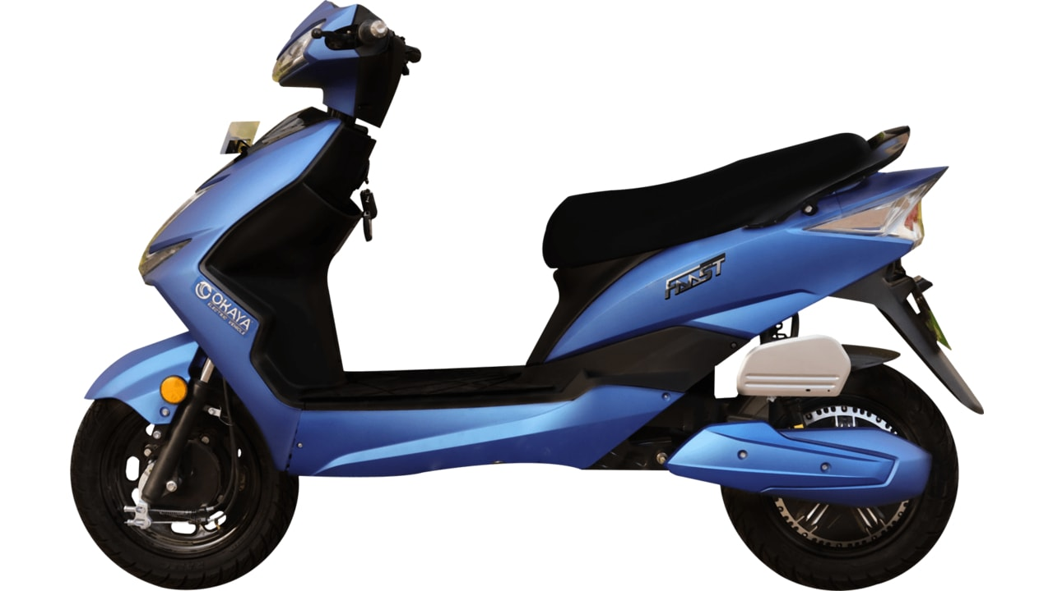
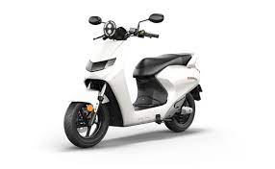
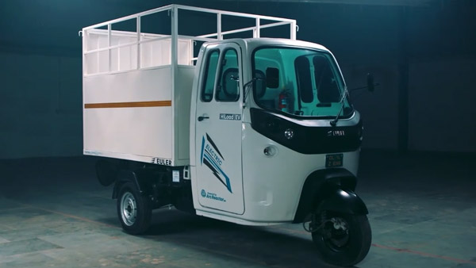
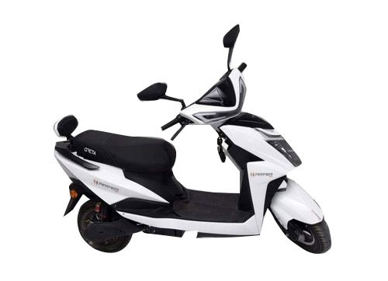
Annexure II: Key electric mobility facts and figures
19
13.46%
447
160
FAME-II target met
Number of EV OEMs in India
Total FAME II approved models
As of January 2022
As of January 2022
As of January 2022
Note: Target of selling 1,562,000 EVs (2W, 3W, 4W and buses) under FAME-II scheme by FY22
EV sales per 1000 non-EV sales
9,03,365
Recent electric vehicle launches
As of January 2022
66
Okaya Faast
Price: INR 89,999 onwards
Range: 60 - 70 km
Battery capacity: 72V/45Ah
Delhi
EVs sold
53
As of January 2022
Tripura
Bounce Infinity E1
40
Price: INR 45,099 onwards
Range: 85 km
Battery capacity: 48V/39Ah
Assam
35
11.4%
48%
EULER HiLoad
Karnataka
Price: INR 3,49,999 onwards
Range: 151 km
Battery capacity: 12.4 kWh
31
Uttarakhand
Share of EV Bus and 3W in total bus and 3W sales
Greta Electric Scooters
Q3 FY22
Price: INR 60,000 – 92,000
Range: 70 - 120 km
Battery capacity: 48V/60Ah
For more updates visit CEEW-CEF Electric Mobility Dashboard
Source: Vahan Sewa dashboard, CEEW Centre for Energy Finance Electric Mobility dashboard, Department of Heavy Industries, CEA.
cef.ceew.in

Slide 20
About us: CEEW is among Asia’s leading policy research institutions
20
cef.ceew.in

Slide 21
CEEW Centre for Energy Finance
21
Build evidence
Consistent, reliable, and up to date monitoring & analysis of clean energy markets – investment, payment schedules, market trends, etc.
Create coherence
Periodic convening of multi-stakeholder groups to deliberate on market activities in clean energy
Design solutions
Design and feasibility pilots of fit-for-purpose business models & financial solutions for clean energy solutions
cef.ceew.in

Slide 22
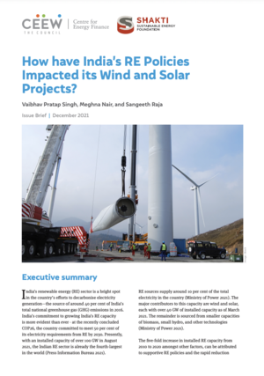
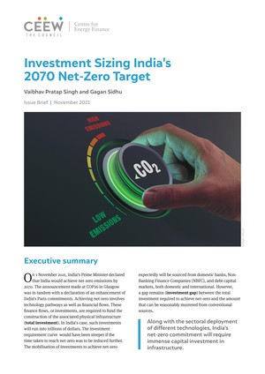
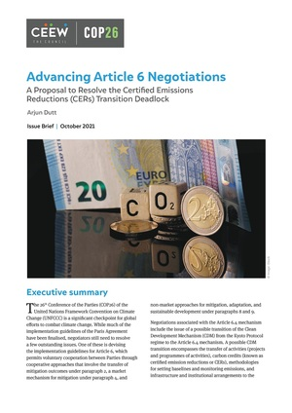
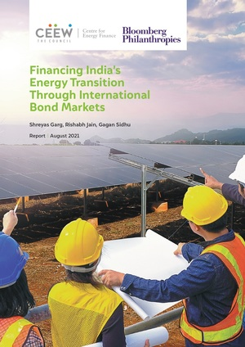
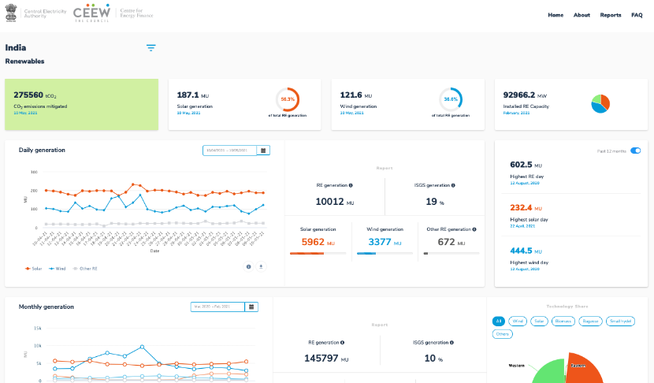
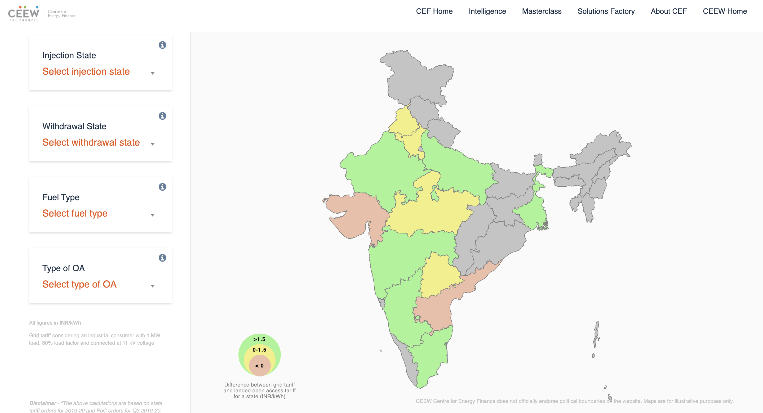
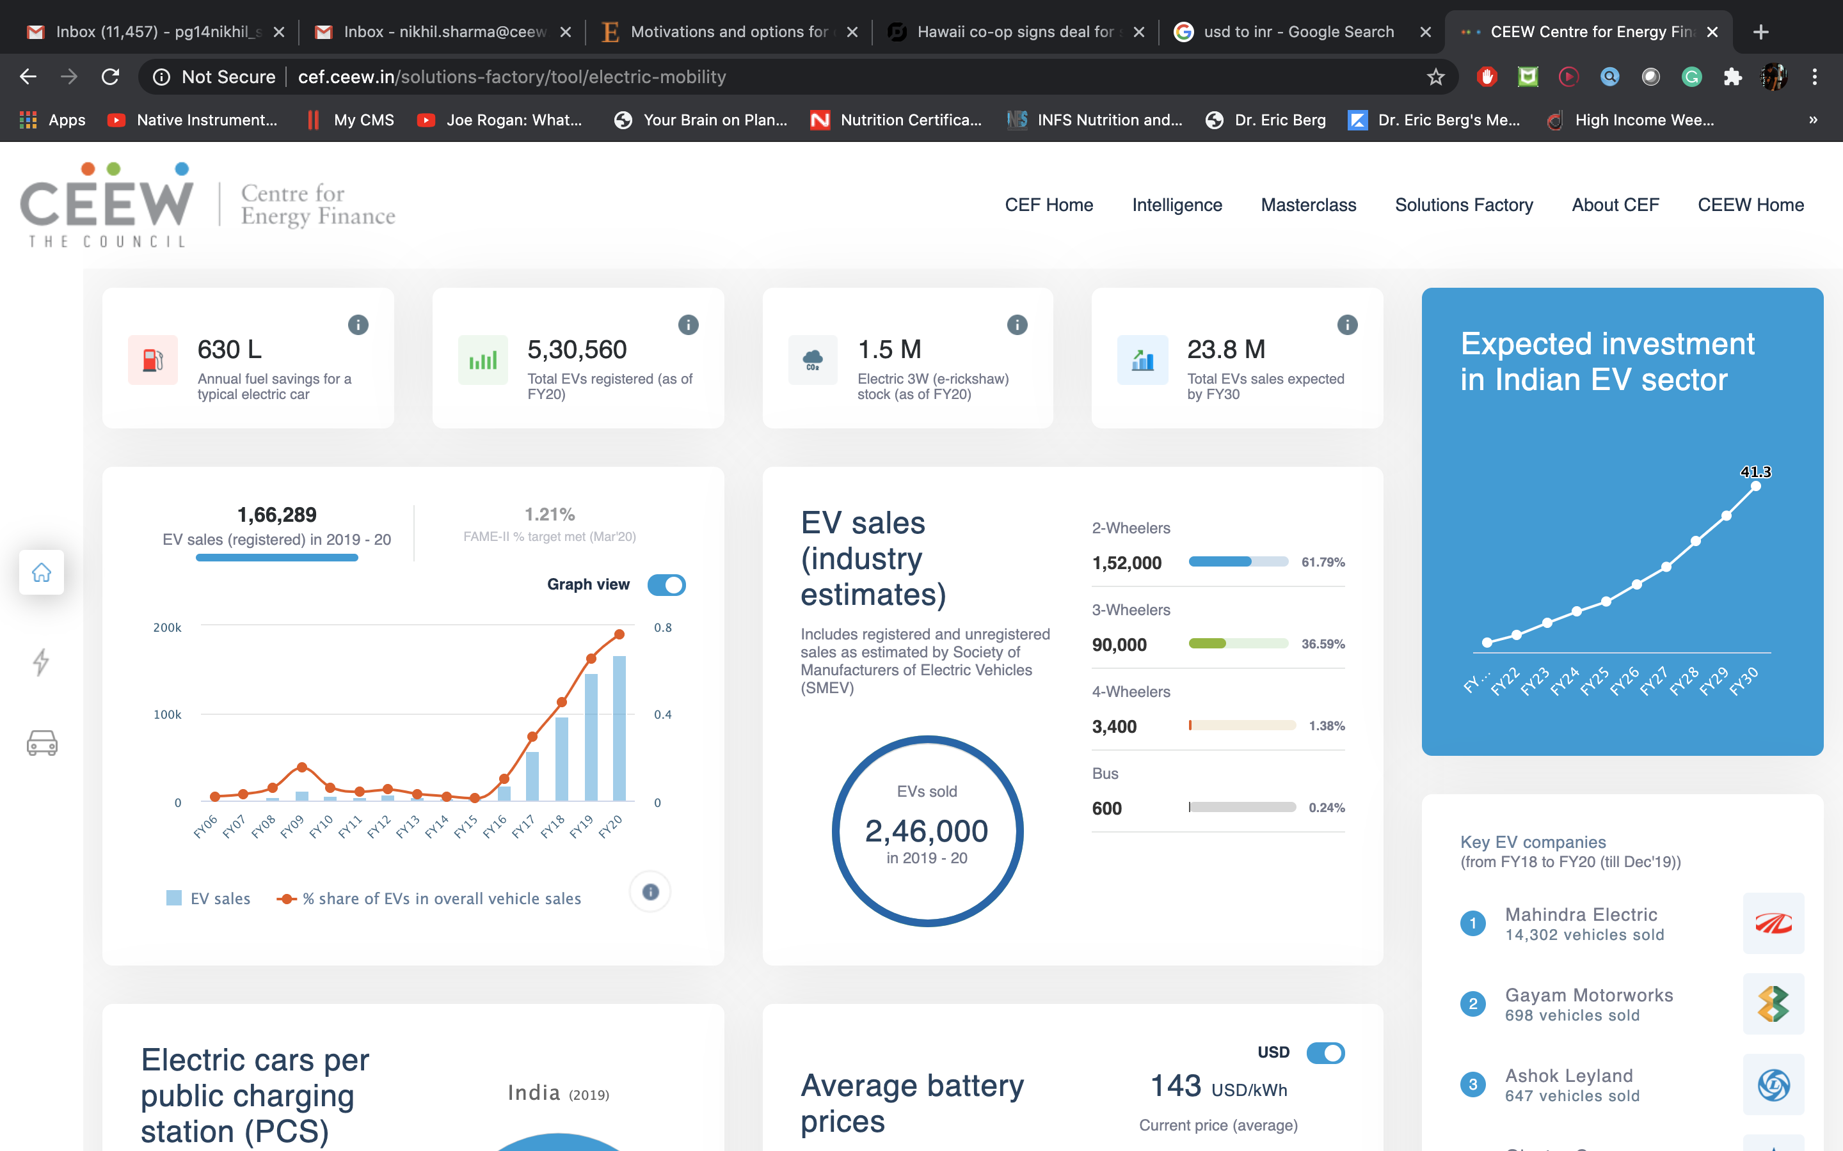
Our recent publications, dashboards and tools
22
How have India’s RE Policies Impacted its Solar and Wind Projects
Investment Sizing India’s 2070 Net-Zero Target
Advancing Article 6 Negotiations
Financing India’s Energy Transition Through International Bond Markets
India Renewables Dashboard
Open Access Tool
Electric Mobility Dashboard
cef.ceew.in

